Slide 1



+
1st CLME+ Steering Committee Meeting & Inception Workshop
26 – 28 January 2016, Cartagena, Colombia
Agenda Item # 10
CLME+ Over-arching
Communication Strategy
with central and decentralized components
“Communication to, by and through partners”

Slide 2

The CLME+ SAP = “Umbrella Programme”
SAP “UMBRELLA”
CLME+
project
CLME+ PROJECT: PROGRAMME COORDINATION & OVERSIGHT (M&E)
Implementation of new
projects under the SAP
supported by the GEF
Exisitng Projects
New Projects

Slide 3
CLME+
The PROJECT (5 yrs)
The STRATEGIC ACTION PROGRAMME (SAP, 10 yrs)
The PARTNERSHIP (10 yrs, and beyond?)

Slide 4
Interactive governance
the whole of interactions
among civil, public and private actors
taken to
solve societal problems
and to
create societal opportunities;
including the formulation & application of principles
guiding those interactions
and care for institutions that enable and control them

Slide 5
CLME+ Target Audiences
CLME+ Countries
NFPs
Deputy/Alternate NFPs
National Intersectoral Committes (NICs)
Sub-Project Focal Points
Fisheries & Environment Ministers
Project Partners
IGOs, CBOs, NGOs
Private Sector
Donors
Academia
Media
General Public
Global LME Practitioners’ Community
IMPOSSIBLE FOR THE CLME+ PCU TO PRODUCE MATERIALS TAILORED TO EACH AND ANY OF THE POSSIBLE TARGET AUDIENCES
General and specific target audience(s) for CLME+ PCU and for partners (?)

Slide 6





















UNDP/GEF
Caribbean & North Brazil Shelf
Large Marine Ecosystems Project (CLME⁺)
co-financing/co-executing partners
prospective partners (declarations of intent)

Slide 7
CLME+
The PARTNERSHIP (10 yrs, and beyond?)
CLME+ ProDoc Section 2.3.5 (Component 5)
The establishment of a “Global Partnership for the implementation of the CLME+ SAP” (the “CLME+ Partnership”) will bring the different stakeholders, donors and development partners together – such will be key to achieving coordinated, collaborative action under the framework of the SAP
The SAP is not the PCU’s, or the CLME+ Project’s SAP, it is the REGION’s SAP, it is our common framework for collaborative action!

Slide 8
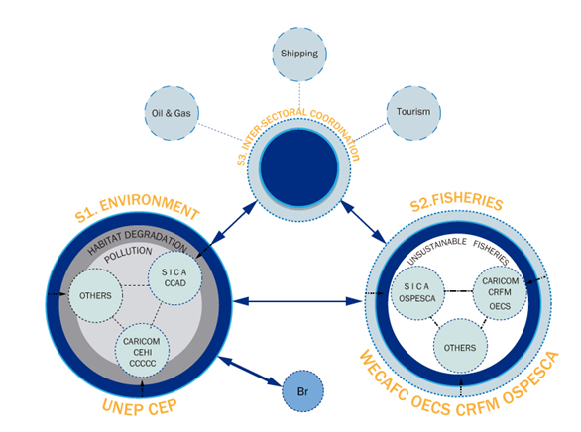
REGIONAL GOVERNANCE FRAMEWORK:
MANY PIECES OF THE PUZZLE
ALREADY IN PLACE

Slide 9
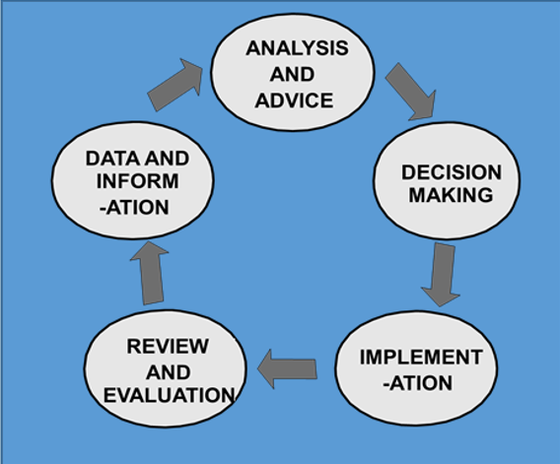
The CLME+ Regional Governance Framework
A multi-level policy-cycle based governance framework
Policy cycles must be:
Complete
Linked vertically
Linked laterally
Notes:
9

Slide 10
DECENTRALIZED COMPONENTS
Wo has a formal mandate(s)
Who has played a broadly recognized role
Within what thematic area?
within which geographic scope?
APPLY
SUBSIDIARITY
PRINCIPLE!

Slide 11
The CLME+
Regional Governance Framework
a multi-level policy-cycle based governance framework
Policy cycles must be:
Complete
Linked vertically
Linked laterally
→ multi-level communication
Notes:
11

Slide 12
CLME+
COMMUNICATION STRATEGY
CLME+ ProDoc Section 2.3.2 (Component 2)
OUTPUT 2.4 (O2.4) – Overarching Strategy, with central and decentralized components and responsibilities
Enhanced communication and info exchange among key actors involved in the different Programmes, Projects and Initiatives that (can) contribute to the CLME+ SAP will be of crucial importance.
In full alignment with their formal mandates and/or recognized roles in the CLME+, responsibilities (…) will be shared by a number of international and regional CLME+ partners

Slide 13
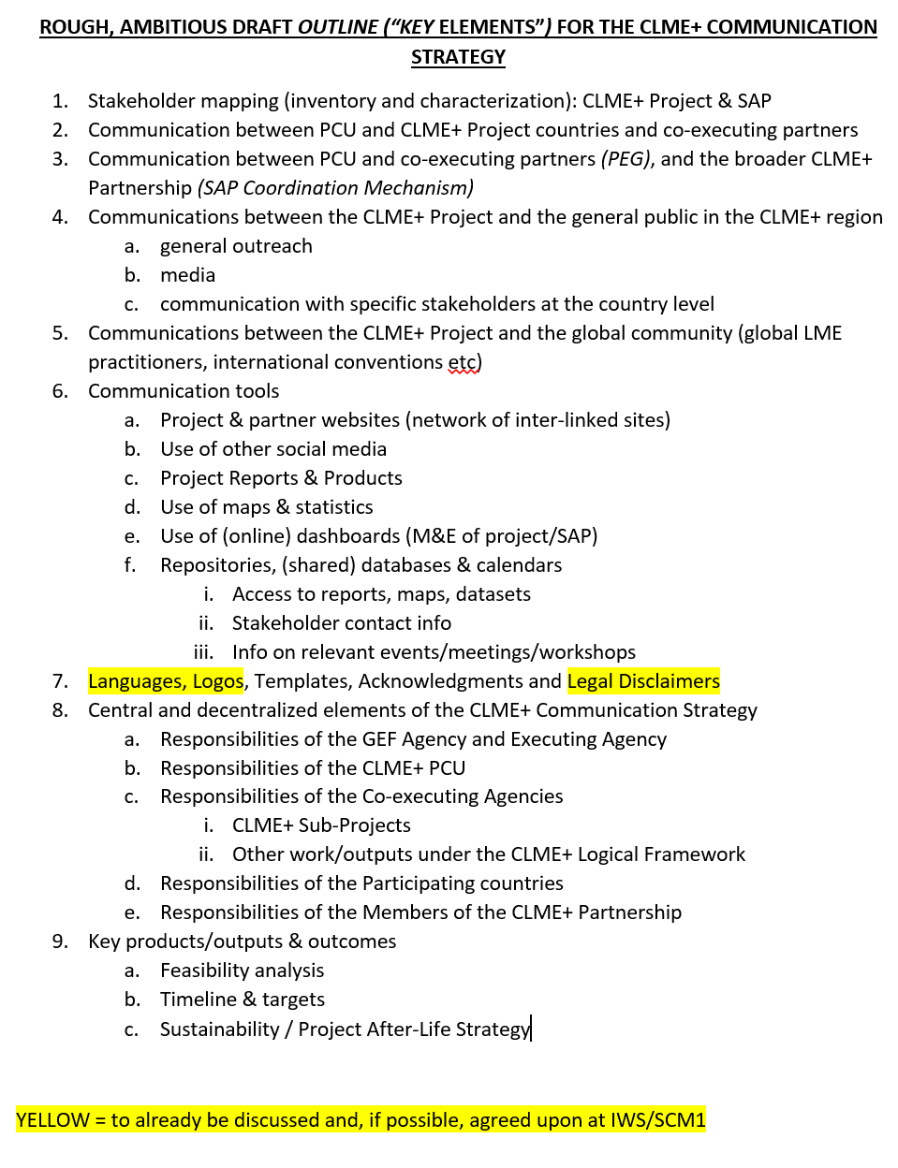
COMMUNICATION STRATEGY
DRAFT OUTLINE (“KEY ELEMENTS”)
More detailed outline in Meeting Documents: “Agenda Item 10 - Draft Outline Communications Strategy (proposal)”

Slide 14
COMMUNICATION STRATEGY
DRAFT OUTLINE (“KEY ELEMENTS”)
Stakeholder mapping (inventory & characterization): Project & SAP
Communication between PCU and CLME+ Project countries and co-executing partners
Communication between PCU and co-executing partners (PEG), and the broader CLME+ Partnership (SAP Coordination Mechanism)
Communications between the CLME+ Project and the general public in the CLME+ region/in CLME+ countries
Communications between the CLME+ Project and the global public
Red = to already be discussed and, if possible, agreed upon at IWS/SCM1

Slide 15
COMMUNICATION STRATEGY
DRAFT OUTLINE (“KEY ELEMENTS”)
Communication tools
Languages, Logos, Templates, Acknowledgements and Legal Disclaimers
Central and decentralized elements of the CLME+ Communication Strategy: responsibilities
Key products/outputs & outcomes
Red = to already be discussed and, if possible, agreed upon at IWS/SCM1

Slide 16
2. Communication between PCU and CLME+ Project countries and co-executing partners
ProDoc Section 5.1.7 National-level arrangements (CLME+ Project implementation)
“Complementing the appointment of a NFP with Sectoral Project Contacts among the different relevant ministries or institutions will be put to the consideration of the SC members at the Inception Steering Committee Meeting”
“Such action can be part of the operationalization of national inter-sectoral consultation & coordination mechanism(s).”
ProDoc Section 5.2.2 National-level arrangements (CLME+ SAP implementation)
“At the national level, arrangements (…) can contemplate the appointment of national focal/contact points for the different SAP Strategies.
“Such appointments can take reference of the existing CLME+ NFP and national focal/contact points under international conventions and/or (sub-)regional governance bodies”
→ suggestion from CLME+ co-executing partner to formalize nomination of Sub-Project National Focal Points
→ agreement on CLME+ PCU ↔ Partner ↔ CLME+ NFP ↔ CLME+ Alternative NFP ↔ CLME+ Sub-Project NFP “Communications Protocol”
DECISION REQUIRED

Slide 17
2. Communication between PCU and CLME+ Project countries and co-executing partners
“Communications Protocol”
PRINCIPLE # 1 PROPOSED FOR ADOPTION
(written communications):
CLME+ PCU
and CLME+ Co-Executing Partners
can communicate, and exchange CLME+ related materials
directly with
Alternate/Deputy National Focal Points
Sub-Project Focal Points
SAP Strategy Focal Point
BUT
It is [recommended] [recommended, at the discretion of the PCU/Partner] [mandatory] that the principal
CLME+ National Focal Point is [always] put in cc
DECISION REQUIRED

Slide 18
2. Communication between PCU and CLME+ Project countries and co-executing partners
“Communications Protocol”
PRINCIPLE # 2 PROPOSED FOR ADOPTION
(written communications):
[Standard] [best practice]* is to put
Alternate/Deputy National Focal Points
Sub-Project Focal Points
SAP Strategy Focal Point
directly in cc
in communications/exchanges
between the CLME+ PCU and the
principal CLME+ National Focal Point
(*sound judgment is to be applied)
(exceptions may be justified)
DECISION REQUIRED

Slide 19
2. Communication between PCU and CLME+ Project countries and co-executing partners
“Communications Protocol”
PRINCIPLE # 3 PROPOSED FOR ADOPTION
(written communications):
It is the responsibility of the
principal CLME+ National Focal Point
Alternate/Deputy National Focal Points
Sub-Project Focal Points
SAP Strategy Focal Point
to bring relevant, CLME+ related information
to the knowledge of the applicable
National Intersectoral Coordination Committee or Mechanism (NIC)
It is the responsibility of the
principal CLME+ National Focal Point
to report back on any relevant NIC outcomes/decisions/conclusions, or to share any relevant information from the NIC processes,
with the CLME+ PCU and relevant Project Co-executing Partners
DECISION REQUIRED

Slide 20
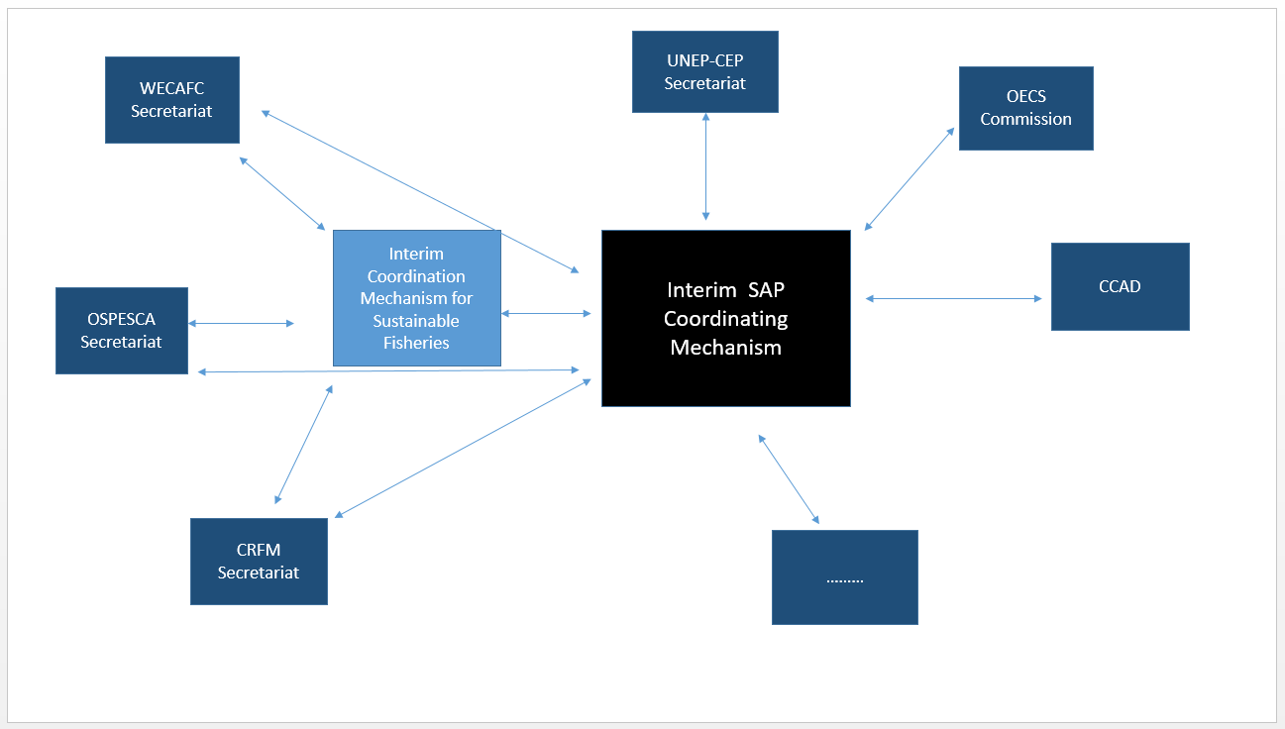
3. Communication between PCU and co-executing partners (PEG), and the broader CLME+ Partnership (through the SAP Coordination Mechanism)
Interim Fisheries and Interim SAP Coordination Mechanisms

Slide 21
4. Communications between the CLME+ Project and the general public in CLME+ countries
“Communications Protocol”
PRINCIPLE # 4 PROPOSED FOR ADOPTION
(written communications):
Best practice*
is to put at least the
principal CLME+ National Focal Point
in cc
when corresponding with, responding to requests from,
or disseminating materials among
stakeholders/general public in CLME+ countries
(*sound judgment is to be applied)
(exceptions may be justified)
DECISION REQUIRED

Slide 22
LANGUAGES
MEETINGS
CONSTRAINTS: FINANCIAL & HUMAN RESOURCES
Steering Committee Meeting (full) | English & Spanish (French: if deemed necessary?)
PEG Meeting | English (+ Spanish, as deemed necessary)
Representative’s Committee Meeting | English & Spanish
Inter-sessional SC Meeting (teleconference) | English & Spanish
Interim Fisheries Coordination Mechanism Meeting | English (+ Spanish, as deemed necessary)
Interim SAP Coordination Mechanism | English (+ Spanish, as deemed necessary)
Technical Workshops | as deemed necessary
FOR ADOPTION BY SCM

Slide 23
LANGUAGES
PROJECT OUTPUTS, MATERIALS
CONSTRAINTS: FINANCIAL & HUMAN RESOURCES
Project Outputs, Reports | Decide on a case-by-case basis. Principle: if to be approved/endorsed by full Steering Committee, then at least in English & Spanish
CLME+ Website | English & Spanish, as min.
CLME+ dissemination materials | Decide on a case-by-case basis based on target public
FOR ADOPTION BY SCM

Slide 24
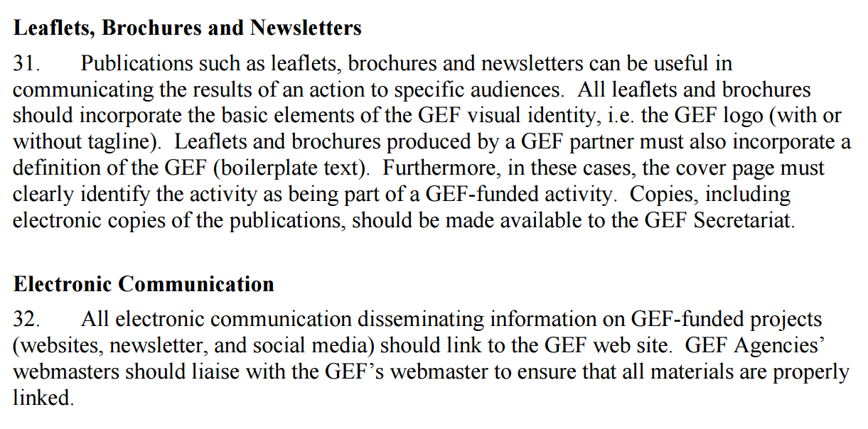
PROJECT REFERENCES & ACKNOWLEDEGEMENTS
GEF Communication and Visibility Policy
EXTRACT
SEE FOR FULL DETAILS: https://www.thegef.org/gef/sites/thegef.org/files/documents/C.40.08_Branding_the_GEF%20final_0.pdf

Slide 25


B. Publications
UNDP Communication & Branding Guidance
B2. UNDP (outside of UNDP-GEF) or External Party Publications that include UNDP-supported GEF/LDCF/SCCF-financed projects
When one or more of the projects in a UNDP or external party publication is a UNDP-supported GEF/LDCF/SCCF-financed project, please use the following guidelines.
Acknowledgement box: The support provided by UNDP and the GEF/LDCF/SCCF financing of the project(s) should be recognised in an acknowledgement box in the communications material (typically included on the inside cover). If this is not feasible, then the UNDP support and GEF financing must be acknowledged in the section related to the UNDP-supported GEF-financed project.
UNDP publication acknowledgement box (to be included in a UNDP-led publication)
b. External party publication acknowledgement box (to be included in publications led by external parties)
We would like to recognize the many partners who have contributed to the projects outlined in this publication, and thank the Global Environment Facility (www.thegef.org) along with [insert names of other financial donors and include logos, as appropriate] for their financial contribution to these projects.
We would like to recognize the many partners who have contributed to the projects outlined in this publication, the United Nations Development Programme (www.undp.org) and the Global Environment Facility (www.thegef.org) along with [insert names of other financial donors and include logos, as appropriate] for their support and financial contribution to these projects.

Slide 26
B. Publications
UNDP Communication & Branding Guidance
B3. Other Products
All communications products featuring UNDP-supported and GEF-financed projects — including videos, brochures, reports, COP flyers, etc. (portfolio- or project-level) — must follow UNDP and GEF guidelines. Other donors and partners should also be acknowledged according to their guidelines.
See Enhancing the Visibility of the GEF and UNDP Communications Toolkit
Logos: The UNDP and GEF logos (and other partner/donor logos, as appropriate) should appear on all project communication materials. Please be sure to obtain permission for logo use when required.
Editing: All types of products should go through substantive editing, copy editing, and proofreading
Examples of products:
VIDEOS: For videos about UNDP-supported GEF-financed projects, the UNDP and GEF logos must appear at the beginning and/or the end of the video. Where space permits, both the UNDP boilerplate text and the GEF boilerplate text should also appear in the video. View a sample video here (UNDP and GEF logos appear at the end).
NEWSLETTERS: example (UNDP logo at top, partner logos listed at bottom)
PRESENTATIONS: Standard UNDP ppt templates are available in English, French, and Spanish on the UNDP Logo & Tagline portal

Slide 27
ACKNOWLEDEGEMENTS
The following text is proposed as standard text for mandatory inclusion in any materials or products that have been created with (financial) support from the CLME+ PROJECT
The UNDP/GEF CLME+ Project is a 5-year project (2015-2020) implemented by the United Nations Development Programme (UNDP) and co-financed by the Global Environment Facility (GEF). [OPTION 1: ADD IN HERE A SHORT TEXT RELATIVE TO YOUR ORGANIZATION’S ROLE IN THE PROJECT].
The CLME+ Project is executed by the United Nations Office for Project Services (UNOPS), in close collaboration with a large number of global, regional and national-level partners. The regional Project Coordination Unit (the “CLME+ PCU”) is located within the IOCARIBE Offices of the IOC of UNESCO, in Cartagena, Colombia. [OPTION 2: ADD IN HERE SHORT TEXT RELATIVE TO YOUR ORGANIZATION’S ROLE IN THE PROJECT]
[link to your organizations’ website]
www.thegef.org Under its International Waters Focal Area, the Global Environment Facility (GEF) helps countries to collectively and sustainably manage their transboundary surface water basins, groundwater basins, and coastal and marine ecosystems.
www.undp.org As a GEF Agency, the United Nations Development Programme (UNDP) implements a global portfolio of GEF co-funded Large Marine Ecosystem projects, among which the CLME+ Project.
www.unops.org UNOPS mission is to serve people in need by expanding the ability of the United Nations, governments and other partners to manage projects, infrastructure and procurement in a sustainable and efficient manner.
Contacts: [PROVIDE YOUR CONTACT INFO HERE] / CLME+ PCU: info@clmeproject.org, +(57) 5 664 88 82
PROPOSED STANDARD TEXT FOR ADOPTION BY THE PSC

Slide 28
ACKNOWLEDEGEMENTS
FOR ADOPTION BY SCM
Brief Project Description
for inclusion in dissemination materials, reports,…
(recommended standard text - optional)
The UNDP/GEF Project “CLME⁺: Catalysing Implementation of the Strategic Action Programme for the Sustainable Management of shared Living Marine Resources in the Caribbean and North Brazil Shelf Large Marine Ecosystems” (GEF ID 5542; 2015-2020) is a 5-year project that aims to facilitate the implementation of a 10-year, politically endorsed Strategic Action Programme on the marine environment (the “CLME⁺ SAP”). The project seeks to achieve this by enabling a progressive transition to ecosystem based management/an ecosystem approach to fisheries (EBM/EAF) in the region, in such a way that a sustainable and climate-resilient provision of goods and services from living marine resources can be secured. Given its geographic scope and comprehensive nature, the Project is uniquely positioned to address the root causes of environmental degradation, in particular the gaps and weaknesses in transboundary and cross-sectoral governance arrangements. The project will assist stakeholders in achieving improved coordination, collaboration and integration among the wide array of ongoing and newly planned projects and initiatives that are of relevance to the wider objectives of the CLME⁺ SAP. [EXPAND HERE ON YOUR ORGANIZATION’S ROLE IN THE CLME+ PROJECT/SAP].
GEF contribution: US$ 12,500,000. Partner Co-financing*: US$ 134,153,695 (*status: February 2015)

Slide 29
STANDARDIZED
PROJECT REFERENCES
Use of CLME+ Projects’ long and short title:
LONG TITLE:
FIRST TIME THE PROJECT IS BEING REFERRED TO IN A FULL-TEXT DOCUMENT/LEAFLET/WEBSITE:
‘The UNDP/GEF Project: “Catalysing Implementation of the Strategic Action Programme (SAP) for the Sustainable Management of shared Living Marine Resources in the Caribbean and North Brazil Shelf Large Marine Ecosystems” (“CLME+ Project”, 2015-2020)’
SHORT TITLE(S):
FIRST REFERENCE: ‘ The UNDP/GEF CLME+ Project (2015-2020)’
Subsequent References: ‘The CLME+ Project’
FOR ADOPTION BY SCM

Slide 30
LOGOS & TEMPLATES
CLME+ LOGO(s)
Old CLME Logo will be “updated/refreshed”, to reflect the transition to CLME+. Only minor changes, to keep the old concept recognizable and to make that the linkage with prior efforts (CLME Project) remains evident
→ Fact that CLME+ covers 2 LME’s needs to be
better reflected in “updated” logo
→ Project Logo always to be used in conjunction with UNDP & GEF Logos. Co-executing Partner Logo(s) can be added
The PEG recommended that the CLME+ PCU should retain, or simply modify, the existing project logo as it is already well established and recognized. It was agreed that the UNDP and GEF logos would be integrated into the CLME+ Project logo.
“interim logo”
FOR ADOPTION BY SCM

Slide 31
LOGOS & TEMPLATES
CLME+ TEMPLATE
CLME+ PCU Communications Specialist will develop, in conjunction and consultation with Project Co-executing Partners, a template(s) for Project Reports, incl. for the CLME+ Sub-projects executed by Partner Organizations

Slide 32
LEGAL DISCLAIMERS

Slide 33
Country & maritime boundaries and disclaimers
Recommendation from prior project (CLME):
“do not use EEZ boundaries on maps”
But:
no objection to use of country boundaries, even without the use of disclaimers
Proposal for CLME+:
use of EEZ and country boundaries acceptable (and derived statistics), but only when in combination of mandatory Legal Disclaimer, approved by the CLME+ PSC

Slide 34
POSSIBLE LEGAL DISCLAIMER
(PROPOSAL FOR CONSIDERATION BY THE CLME+ PSC)
“The depiction and use of boundaries, geographic names, designations, and related data used [on maps and] in [other] documents [that are on this site or otherwise] made available by the UNDP/GEF CLME+ Project do not imply any determination on the legal status of any territory, nor does it constitute endorsement or acceptance as to the legal status or frontier of any territory by [the CLME+ Project Coordination Unit], the GEF, the GEF Agency, the Executing Agency, the CLME+ Co-executing Partners, and the CLME+ participating countries. In addition, no guarantee is provided as to the accuracy of the available maps.”
PROPOSED STANDARD TEXT FOR ADOPTION BY THE PSC

Slide 35
KEY ACTIVITIES FOR
2016 - 2017
COMMUNICATIONS STRATEGY DEVELOPMENT
HIRING OF CLME+ COMMUNICATIONS SPECIALIST
COMMUNICATIONS STRATEGY DOCUMENT
1 OR 2 WORKSHOPS
Strategy development
Coordination on decentralized components
DRAFT DOCUMENT - CIRCULATION FOR “ENDORSEMENT”
IMPLEMENTATION
CLME LOGO → “REFRESHMENT”
CLME+ PROJECT WEBSITE
“PROTOCOLS”
Component 5 – Twinning/Exchange – regional and global LME COP
o GEF International Waters Conference o LME Consultative Group

Slide 36
PROPOSED DECISIONS
related to Agenda Item # 10
The CLME+ Project Steering Committee (PSC) Members:
commit to support the development & implementation of the relevant elements of the CLME+ Over-Arching Communication Strategy (the “CLME+ CS”) (subject to approval of the Strategy Document, and while giving due consideration of existing logistical and financial constraints)
endorse the draft Outline for the CLME+ CS, as [presented at] [amended during] the 1st SCM, and recommend that the elements contained in this draft be considered during the development of the full CLME+ Communication Strategy Document (CLME+ Output O2.4)
support the request that CLME+ Sub-Project National Focal Points be formally nominated, and recommend coordinated action in this context among the CLME+ PCU and the corresponding CLME+ Co-Executing Partner and Principal and Alternate National Focal Points (as applicable)

Slide 37
PROPOSED DECISIONS
related to Agenda Item # 10
The CLME+ Project Steering Committee (PSC) Members:
adopt the 4 “Communications Protocol” principles, as [presented at] [amended during] the 1st SCM
endorse the CLME+ proposal, as [presented at] [amended during] the 1st SCM, with reference to the use of languages and provision of translations during meetings and in the production of project outputs & materials; note is taken in this context by the PSC members that financial and logistical constraints may apply
adopt the principle that the GEF Communication and Visibility Policy is to be adhered to by all CLME+ Project partners, and that [–unless practically impossible or unreasonable-] the CLME+ Logo is to be used in conjunction with the official logo of the Donor and the GEF Agency (resp. GEF and UNDP)

Slide 38
PROPOSED DECISIONS
related to Agenda Item # 10
The CLME+ Project Steering Committee (PSC) Members:
adopts the principle of mandatory inclusion of the standard “Acknowledgements” text on the CLME+ Project, as [presented at] [amended during] the 1st SCM, in any materials or products that are created with (financial) support from the CLME+ Project
adopts the recommended standard text, as [presented at] [amended during] the 1st SCM under the title “Brief Project Description”, as a recommended standardized brief project description for (optional) inclusion in CLME+ Project dissemination materials and reports
adopts the recommendation for systematic use by all CLME+ Project Partners of the standardized project references, as [presented at] [amended during] the 1st SCM, in their formal communications and publications

Slide 39
PROPOSED DECISIONS
related to Agenda Item # 10
The CLME+ Project Steering Committee (PSC) Members:
The CLME+ Steering Committee Members endorses the use of mapping terms, country and/or maritime boundaries, and associated codifications and/or derived statistics in any written or electronic materials produced, disseminated or made publicly available by the CLME+ Project, under the strict condition that the following Legal Disclaimer is systematically added: […PLEASE FURTHER COMPLETE THIS….]

