Slide 1


The CLME+ Partnership
CLME+ Project Inception Workshop and First Steering Committee Meeting, Cartagena, Colombia
26 – 28 January, 2016

Slide 2
The CLME+ PARTNERSHIP (10 yrs, and beyond?)
CLME+ ProDoc Section 2.3.5 (Component 5)
The establishment of a “Global Partnership for the implementation of the CLME+ SAP” (the “CLME+ Partnership”) will bring the different stakeholders, donors and development partners together – such will be key to achieving coordinated, collaborative action under the framework of the SAP
The SAP is not the PCU’s, or the CLME+ Project’s SAP, it is the REGION’s SAP, it is our common framework for collaborative action!

Slide 3
Relation to the CLME+ Project Document
Output 5.1. (O5.1.) Cooperation among development partners, Programmes, Projects, Initiatives (“PPIs”) and countries/territories with a stake in the CLME+ SAP (“CLME+ SAP Partnership”) (Targets O5.1.T.PI1-6)
Milestones & Targets:
T.PI1. Active involvement of min. 70% of CLME+ countries in Project and SAP implementation, by 2017; further up-scaled to 90% by 2019
T.PI2. Active involvement of min. 33% of CLME⁺ overseas territories in Project & SAP implementation by 2019
T.PI3. Active participation of at least 12 organizations with mandates highly relevant to the SAP, by 2017. Formal commitments from/active participation by major civil society and private sector partners: combined, at least 8, resp. 13 partners by 2017 and 2019

Slide 4
Why do we need a CLME+ Partnership
Insufficient communication, co-ordination and information exchange among primary CLME+ SAP stakeholders
Insufficient communication among existing and planned projects, activities and initiatives
Bring together different stakeholders, donors and development partners to achieve coordinated action under CLME+ SAP framework
Facilitate better communication, co-ordination and collaboration towards the objectives of the SAP

Slide 5
Objectives of the CLME+ Partnership
Improved integration, coordination and cooperation
Streamlining of efforts and programmes
Support the Implementation of the CLME+ SAP
Sharing of data and information through platforms
Leverage additional resources to support implementation of the CLME+ SAP
Enhance and support the monitoring and evaluation of the progress of SAP Implementation

Slide 6
CLME+ Partnership
Expanding the CLME+ Partnership
will fall under the mandate of
the (interim) CLME+ SAP Coordination Mechanism

Slide 7
CLME+ Partnership
CLME+ SAP
(interim) CLME+ SAP Coordination Mechanism
CLME+ Partnership

Slide 8



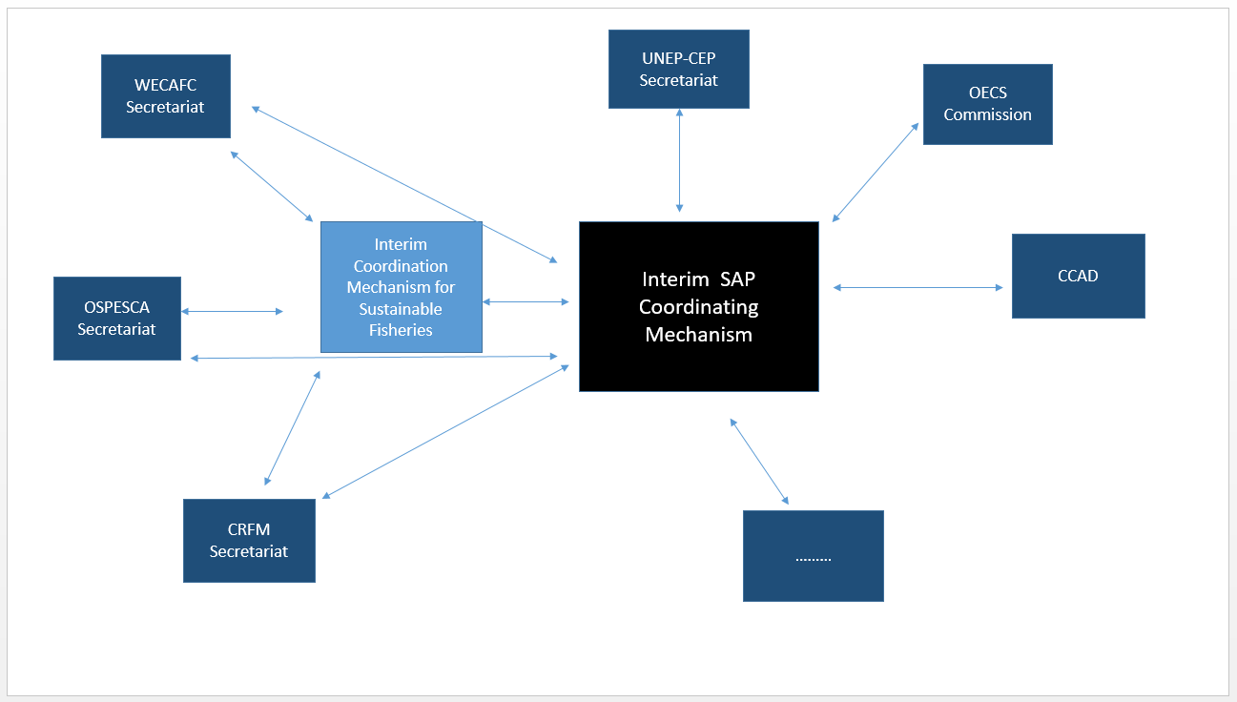

COLLABORATIVE ARRANGEMENTS
Interim Fisheries and Interim SAP Coordination Mechanisms

Slide 9
CLME+ Partnership – the PARTNERS
CLME+ countries (Gov’t Institutions)
Regional Governance Bodies
Donors
Development partners
Private Sector
IGOs
NGOs (Regional and Global)
CSOs
Research Institutions and Academia

Slide 10
Proposed Structure of CLME+ Partnership
CLME+ Partnership Levels
Level 1 – countries and partner organizations that have contributed co-financing to support CLME+ SAP implementation
Level 2 – organizations that have submitted Letters of Intent
Level 3 – Organisations that have expressed an interest in the partnership arrangement
Level 1
Level 2
Level 3

Slide 11
Proposed Activities of the CLME+ Partnership
Develop Terms of Reference for the CLME+ Partnership (generic)
Expand the membership of CLME+ Partnership
Support the development of a joint CLME+ SAP Monitoring and Evaluation (M&E) framework and associated, dashboard-type (network of) “CLME+ status” web portal(s) and reporting tools
Leverage additional contributions towards CLME+ SAP implementation (increase in total investments portfolio value)
Updating and maintenance of the PPI database

Slide 12
Expand CLME+ Partnership
Letter of Intent
Scoping process for areas of collaboration
Aide Memoire/TORs
Co-financing commitment letters
Commitment to contribute to the M&E of the SAP (areas relevant to the Partner’s field of work, and using a jointly adopted M&E framework/indicator set)
We invite interested parties to contact the CLME+ Project Coordination Unit

Slide 13

















MEMBERS OF
THE CLME⁺ PARTNERSHIP
co-financing/co-executing partners
prospective partners (declarations of intent)
(the information in this slide was valid at the moment of production and may no longer be fully up-to-date)

Slide 14
Thank you
http://clmeproject.wordpress.com
CLME+ Project Coordination Unit
Cartagena, Colombia
(57) (5) 664 88 82
info@clmeproject.org

