Slide 1

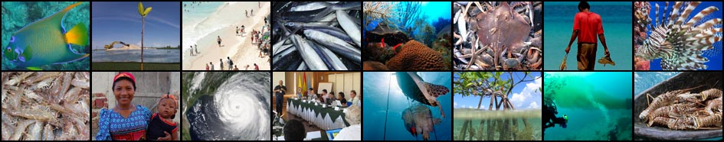
Background & Contextual Settings:
Large Marine Ecosystems and the Caribbean and North Brazil Shelf
LMEs
CLME+ Project Inception Workshop and First Steering Committee Meeting, Cartagena, Colombia
26 – 28 January, 2016

Slide 2
Large Marine Ecosystems (LMEs)
Regions of the world's oceans, encompassing coastal areas from river basins and estuaries to the seaward boundaries of continental shelves and the outer margins of the major ocean current systems, and/or occupying semi-enclosed seas
Characterized by distinct bathymetry, hydrography, productivity, and trophically dependent populations of marine species
Seen as a good geo-spatial unit to promote implementation of ecosystem-based management
Sixty-six LMEs have been delineated globally

Slide 3
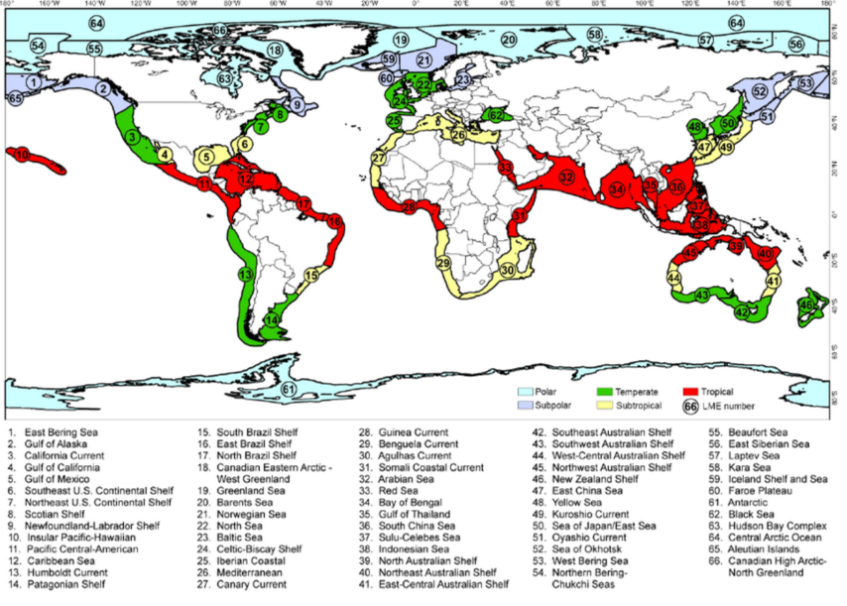
Distribution of Global LMEs
Data source: www.researchgate.net/

Slide 4
LMEs and the Global Environment Facility (GEF)
GEF International Waters focal area, which comprises LMEs, established to support countries to jointly manage their transboundary surface water basins, groundwater basins, and coastal and marine systems
Goal - Promote collective management for transboundary water systems and subsequent implementation of the full range of policy, legal, and institutional reforms and investments contributing to sustainable use and maintenance of ecosystem services

Slide 5
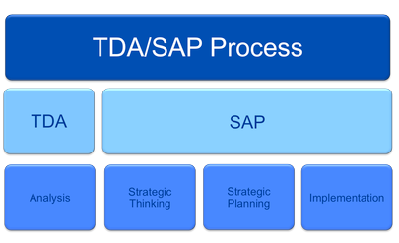
Transboundary Diagnostic Analysis (TDA) and Strategic Action Programme (SAP)
SAP - negotiated policy document
Endorsed at the highest level of all relevant sectors of government
Establishes clear priorities for action (e.g., policy, legal, institutional reforms, or investments) to resolve the priority transboundary problems
TDA - identify, quantify, and set priorities for environmental problems that are transboundary in nature
Mechanism used to have countries agree on facts

Slide 6
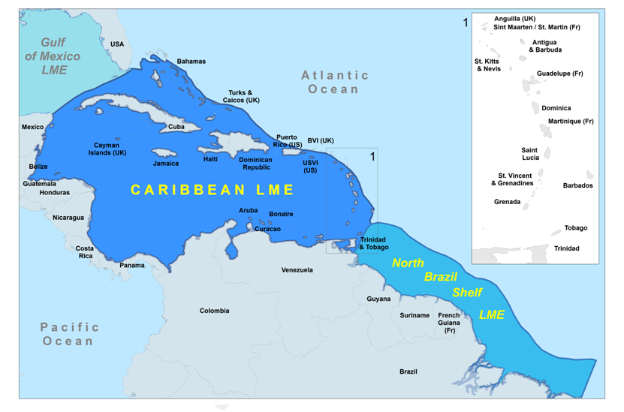
CLME⁺ region = 2 LMEs: the CARIBBEAN LME and the NORTH BRAZIL SHELF LME
25 GEF-eligible countries + 18 overseas territories + USA
The Caribbean and North Brazil Shelf Large Marine Ecosystems
(4.4 million km²)

Slide 7
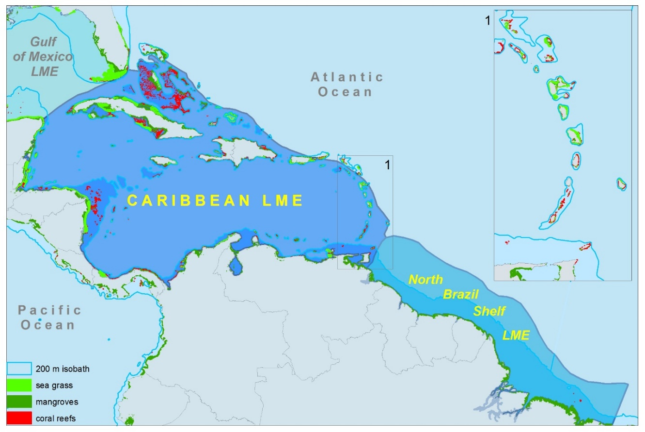
Key Ecosystem Types in CLME+
1. Coral Reef & Associated Habitats
2. Pelagic
3. Continental Shelf

Slide 8
Caribbean & North Brazil Shelf LMEs
Referred to as one of the most geopolitically diverse and complex LMEs
  26 independent States and 18 overseas/associated territories
  Size of countries
  Development status
  Number of regional political & economic integration mechanisms
Caribbean Sea contains approx. 10% of the world coral reefs
CLME+ - 20% of world remaining mangrove forest
Potential to be major producer of hyrdocarbons
900,000 people directly engaged in the fisheries sector
Fisheries sector contributes approx. USD 1.2billion to the Caribbean in export earnings
Caribbean 60% of the world’s cruise tourism industry

Slide 9
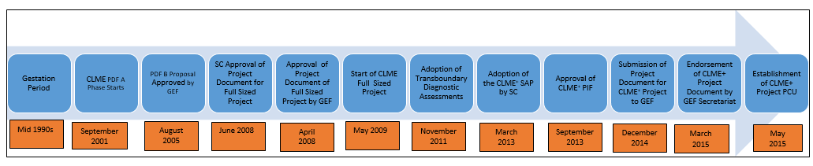
CLME+ Milestones and Timeline

Slide 10


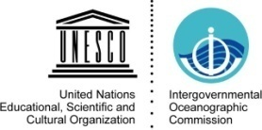

CLME:
Sustainable Management of the
Shared Living Marine Resources of the
Caribbean Large Marine Ecosystem (CLME) and Adjacent Regions
4-year project (co-)financed by
GLOBAL ENVIRONMENT FACILITY (GEF)
GEF Contribution: aprox. US$ 7 million
Focal Area : International Waters
Start Date: May 2009 End Date: May 2014

Slide 11
The CLME+ “Umbrella” SAP
PILOT PROJECTS
CASE STUDIES
“UMBRELLA” SAP
TRANSBOUNDARY DIAGNOSTIC ANALYSES (TDA´S)
GOVERNANCE ANALYSIS
IMS-REMP
PROTOTYPE
PROJECT / PROGRAMME COORDINATION & OVERSIGHT
Implementation of new
projects under the SAP
supported by the GEF
Existing Projects
New Projects

Slide 12
Threats to the CLME+
CLME+ Transboundary issues
UNSUSTAINABLE FISHERIES
CLIMATE
CHANGE
SOCIETAL
CHANGE
POLLUTION
HABITAT DEGRADATION

Slide 13
ROOT CAUSES of the 3 (+1) CLME issues
    Weaknesses in GOVERNANCE
    limited HUMAN & FINANCIAL resources;
    inadequate (ACCESS to) DATA and INFORMATION/KNOWLEDGE
    inadequate public AWARENESS and INVOLVEMENT
    inadequate consideration of the VALUE of ECOSYSTEM goods & services
    POPULATION GROWTH and CULTURAL pressures;
    trade and EXTERNAL DEPENDENCY
Notes:
As part of the Casual Chain Analysis, seven main root causes were identified including inadequate access to data and information/knowledge and inadequate consideration of the value of ecosystem goods and services. Yet it was noted that all could be linked back and associated to the main, over-arching root cause, being: weak governance.

Slide 14
CLME+ Milestones and Timeline

Slide 15
Thank you
http://clmeproject.wordpress.com
CLME+ Project Coordination Unit
Cartagena, Colombia
(57) (5) 664 88 82
info@clmeproject.org

