Slide 1

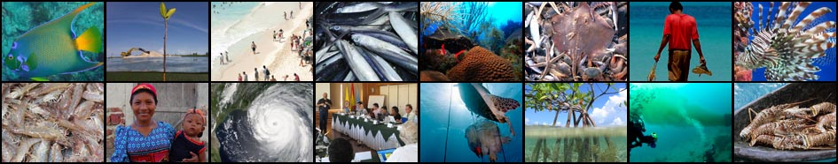
The Caribbean and North Brazil Shelf Large Marine Ecosystems (CLME+) Strategic Action Programme (SAP)
CLME+ Project Inception Workshop and First Steering Committee Meeting, Cartagena, Colombia
26 – 28 January, 2016

Slide 2
CLME+ SAP
Road-map towards sustainable living marine resources management through strengthened and consolidated regional cooperation
Combines actions for structural change with capacity building at the regional and national levels
Addresses the root causes of the environmental degradation that affects the coral reef, continental shelf and pelagic ecosystems of the CLME+ region
Seeks to strengthen existing organizations responsible for the management of shared living marine resources

Slide 3

CLME+ SAP Development Process
BROAD CONSULTATION
TORs for SAP Development Process developed and shared with CLME SCM Members
CLME+ SAP developed through a consultative process
Meetings of SAP Core Development Team (CDT)
Review of drafts by SAP Formulation & Endorsement Support Team (FEST)
Review and discussion of CLME+ SAP draft with National Focal Points
All efforts undertaken to ensure opportunities for wide consultation with stakeholders and partners during SAP development
Opportunities were created to provide input into a number of components of the SAP

Slide 4

The CLME+ “umbrela” SAP
PILOT PROJECTS
CASE STUDIES
“UMBRELLA” SAP
TRANSBOUNDARY DIAGNOSTIC ANALYSES (TDAs)
GOVERNANCE ANALYSIS
IMS-REMP
PROTOTYPE
PROJECT / PROGRAMME COORDINATION & OVERSIGHT
Implementation of new
projects under the SAP
supported by the GEF
Exisitng Projects
New Projects

Slide 5
STRATEGIC ACTION
PROGRAMME
DEVELOPMENT
(SAP):
FLOW CHART
AND
KEY CONCEPTS
CLME⁺ SAP:
a 6 (+4) Strategies Programme and its correspondent
Actions
The SAP will be implemented through a series of projects:

Slide 6
DEVELOPMENT OF THE CLME ACTIONS PROGRAMME: STEPS 1-3

Slide 7
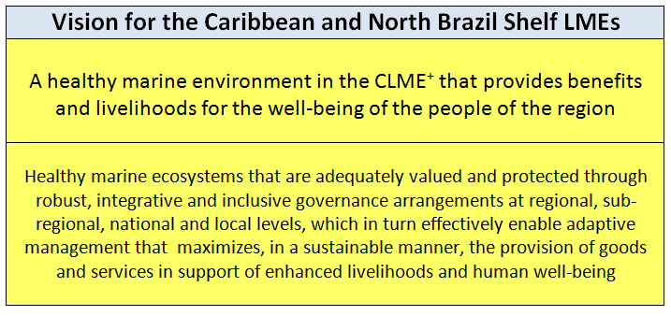

Slide 8
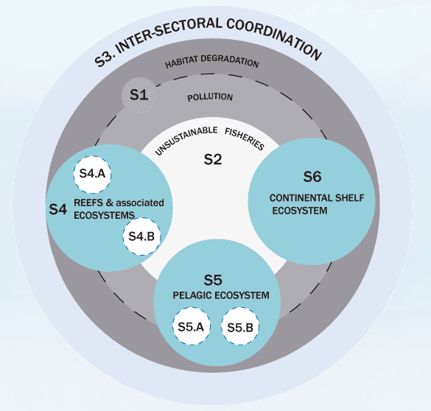
CLME+ SAP:
6 main STRATEGIES
and 4 sub-strategies
S1 – Protection of the
Marine Environment
S2 – Sustainable Fisheries
S3 – Inter-sectoral Coordination
S4 – EBM, Reef Ecosystems
S4a Spiny Lobster Fisheries
S4b Queen Conch Fisheries
S5 – EAF, Pelagic Ecosystem
S5a Flyingfish Fisheries
S4b Large Pelagics Fisheries
S6 – EAF, Continental Shelf

Slide 9
CLME+
Strategic Action Programme:
3 Regional Strategies
“S3” – Strategy 3
Establish and operationalise a regional policy coordination mechanism for OCEAN GOVERNANCE
(with initial focus on shared living marine resources)
“S1” - Strategy1
Enhance the regional governance arrangements for the PROTECTION OF THE MARINE ENVIRONMENT
“S2” – Strategy 2
Enhance the regional governance arrangements for SUSTAINABLE FISHERIES

Slide 10
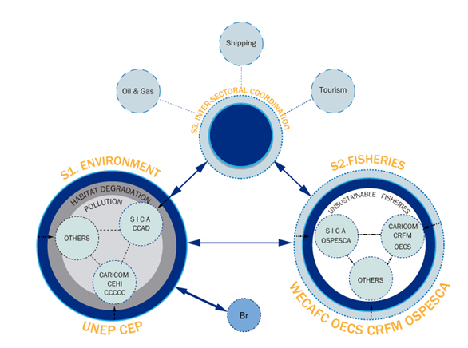
CLME+
Strategic Action Programme:
3 Regional Strategies
APPLY
SUBSIDIARITY
PRINCIPLE!
Notes:
Under this new project, gaps and missing linkages in the governance arrangements for, e.g. spiny lobster can then be addressed (including the science-policy interface – and we do see a potentially important role there for the GCFI community), and a better linkage with the work on habitats

Slide 11
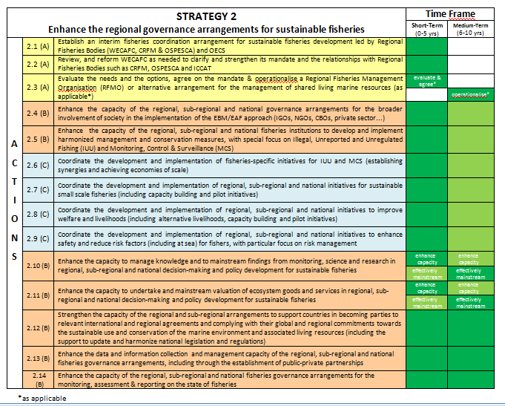





“SAP ACTIONS “CODING”
There are no ACTIVITIES
throughout these years
Low intensity ACTIVITIES
throughout these years
High intensity ACTIVITIES
throughout these years
TYPE “A” ACTIONS: IMPROVE LEGAL AND INSTITUTIONAL FRAMEWORK
TYPE “B” ACTIONS: BUILDING CAPACITY
TYPE “C” ACTIONS: PRACTICAL INITIATIVES, ACTIONS IN THE FIELD

Slide 12
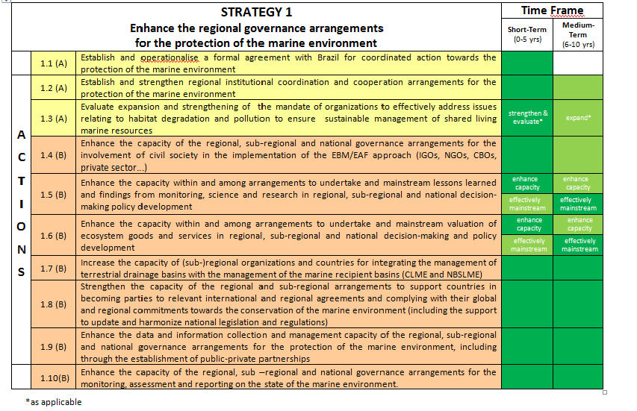

Slide 14
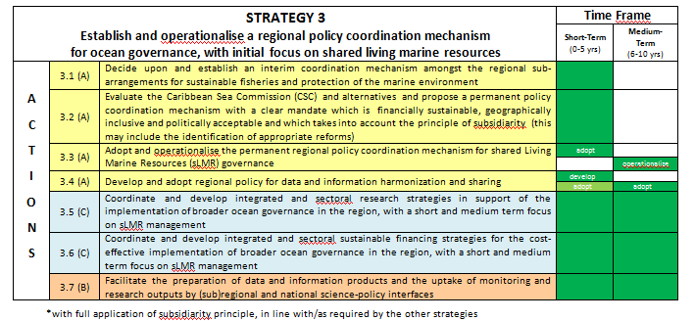

Slide 15
CLME+ SAP:
3 Fishery Ecosystems Strategies
+4 sub-strategies of key fisheries
“S4” – Strategy 4
Enhance the governance arrangements for ecosystem-based management for REEFS AND ASSOCIATED ECOSYSTEMS
“S5”-Strategy 5
Enhance the governance arrangements for implementing an ecosystem approach for PELAGIC FISHERIES
“S6” - Strategy 6
Establish governance arrangements for implementing ecosystem-based management of the GUIANAS-BRAZIL CONTINENTAL SHELF
S4a Lobster
S4b Conch
S5a Flyingfish
S5b Large Pelagics

Slide 16
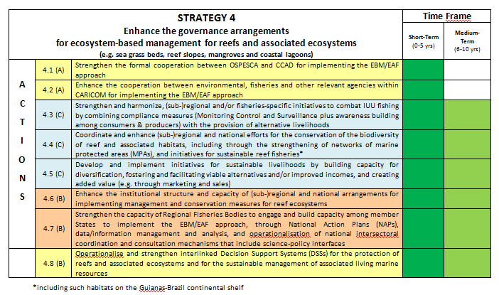

Slide 17
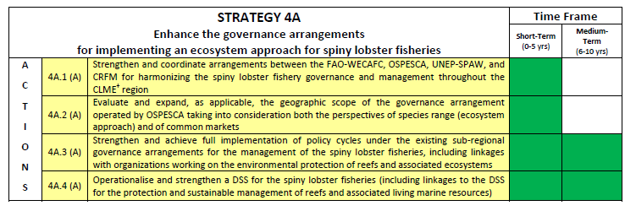

Slide 18
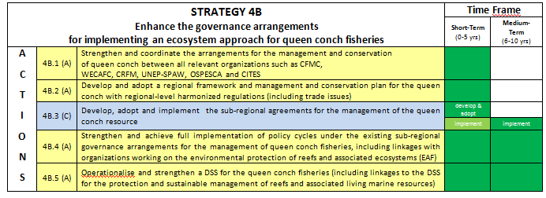

Slide 19
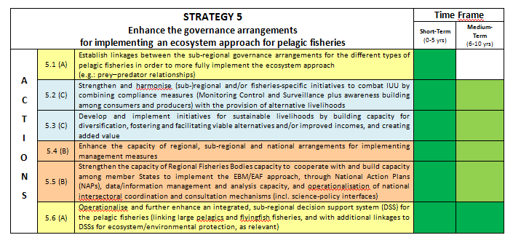

Slide 20
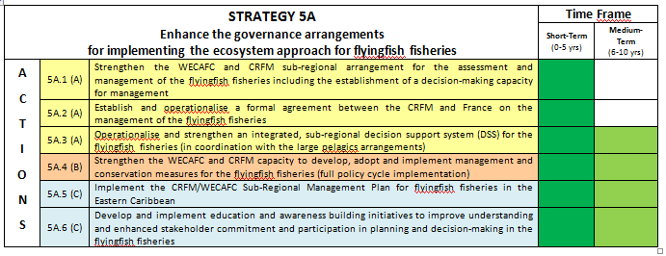

Slide 21
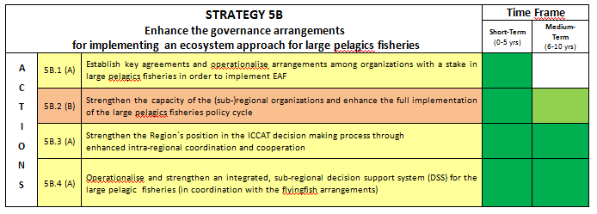

Slide 22
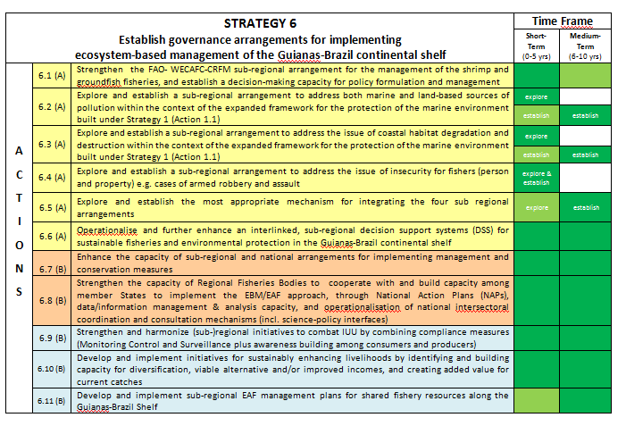

Slide 23
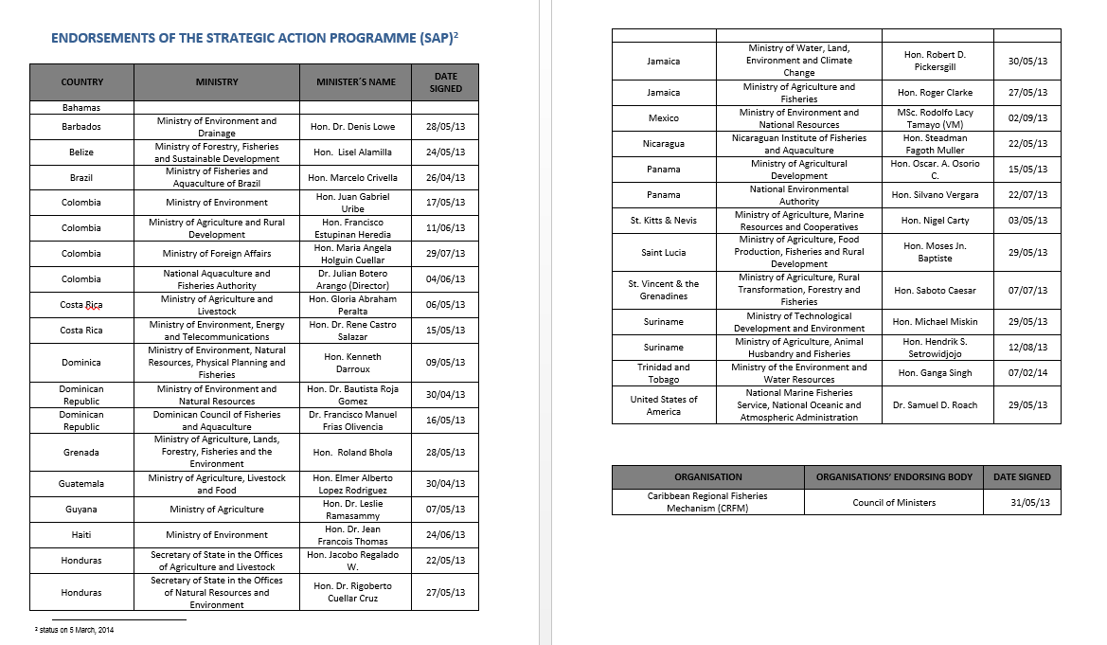
As of March 2014, 31 ministers in 22 countries had endorsed the CLME+ SAP

Slide 24
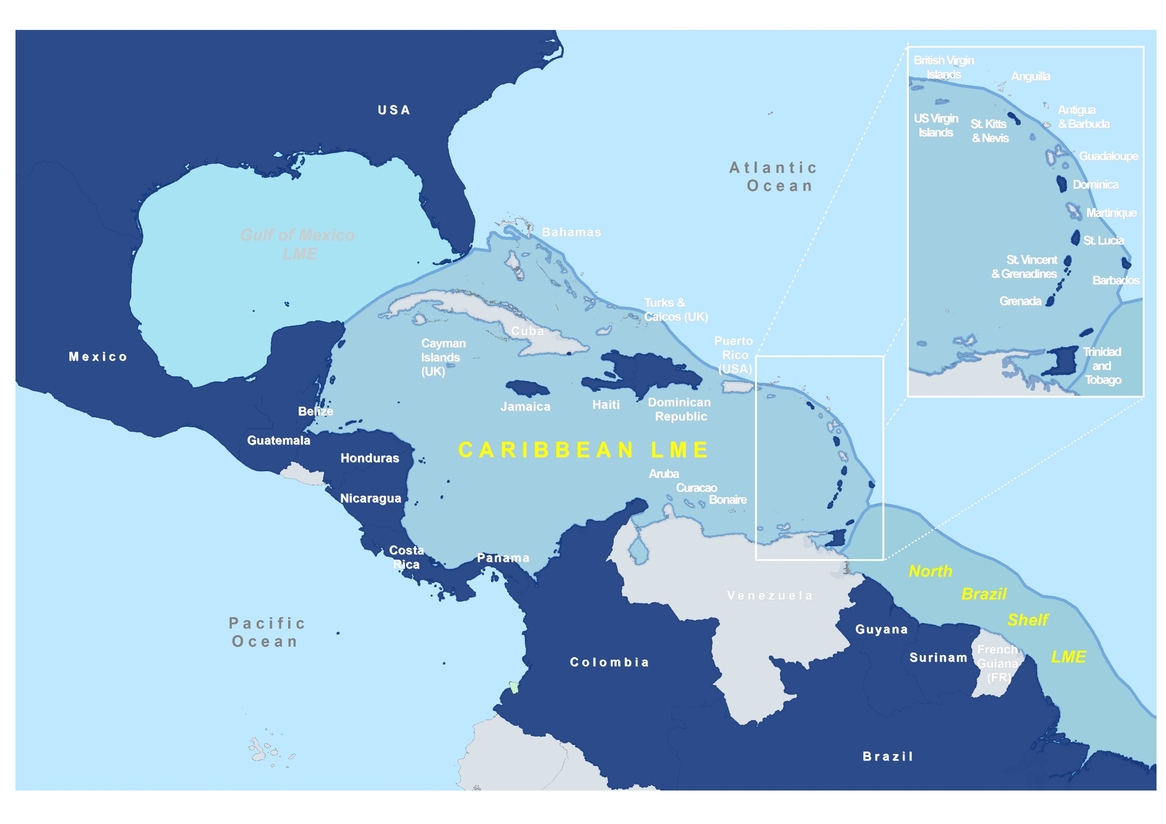
SAP SIGNED BY AT LEAST 1 MINISTER

Slide 25
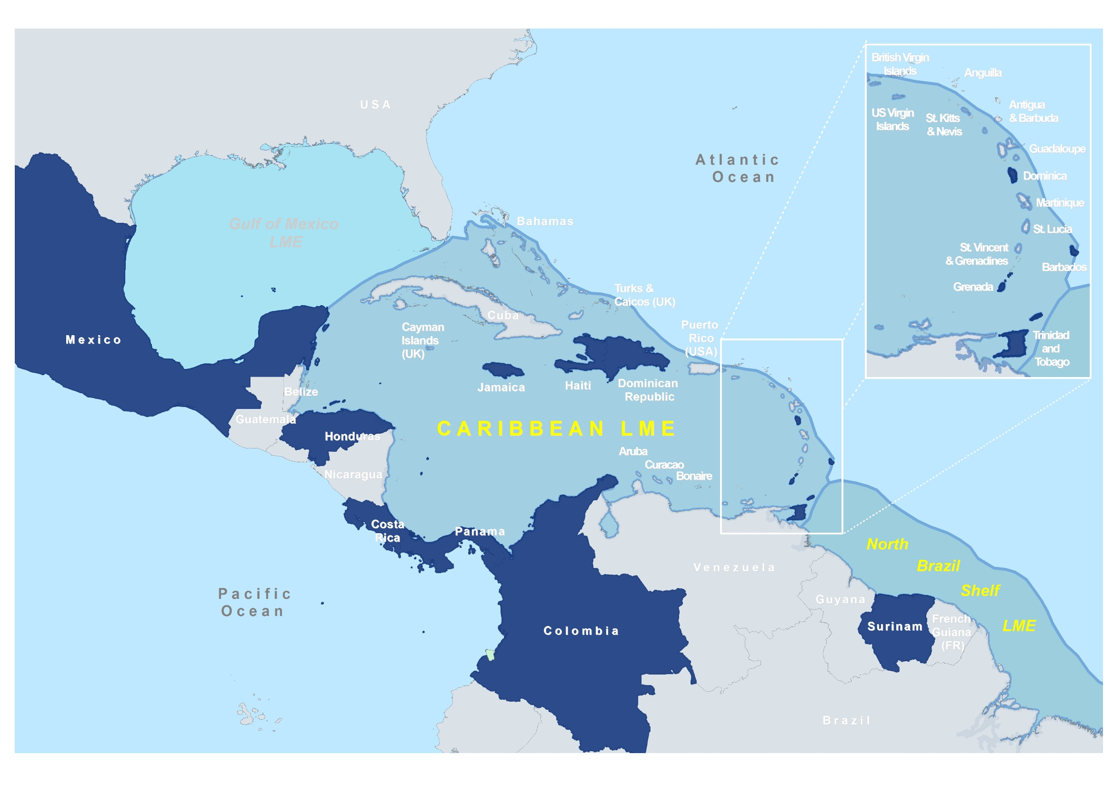
SAP SIGNED BY MINISTER of ENVIRONMENT

Slide 26
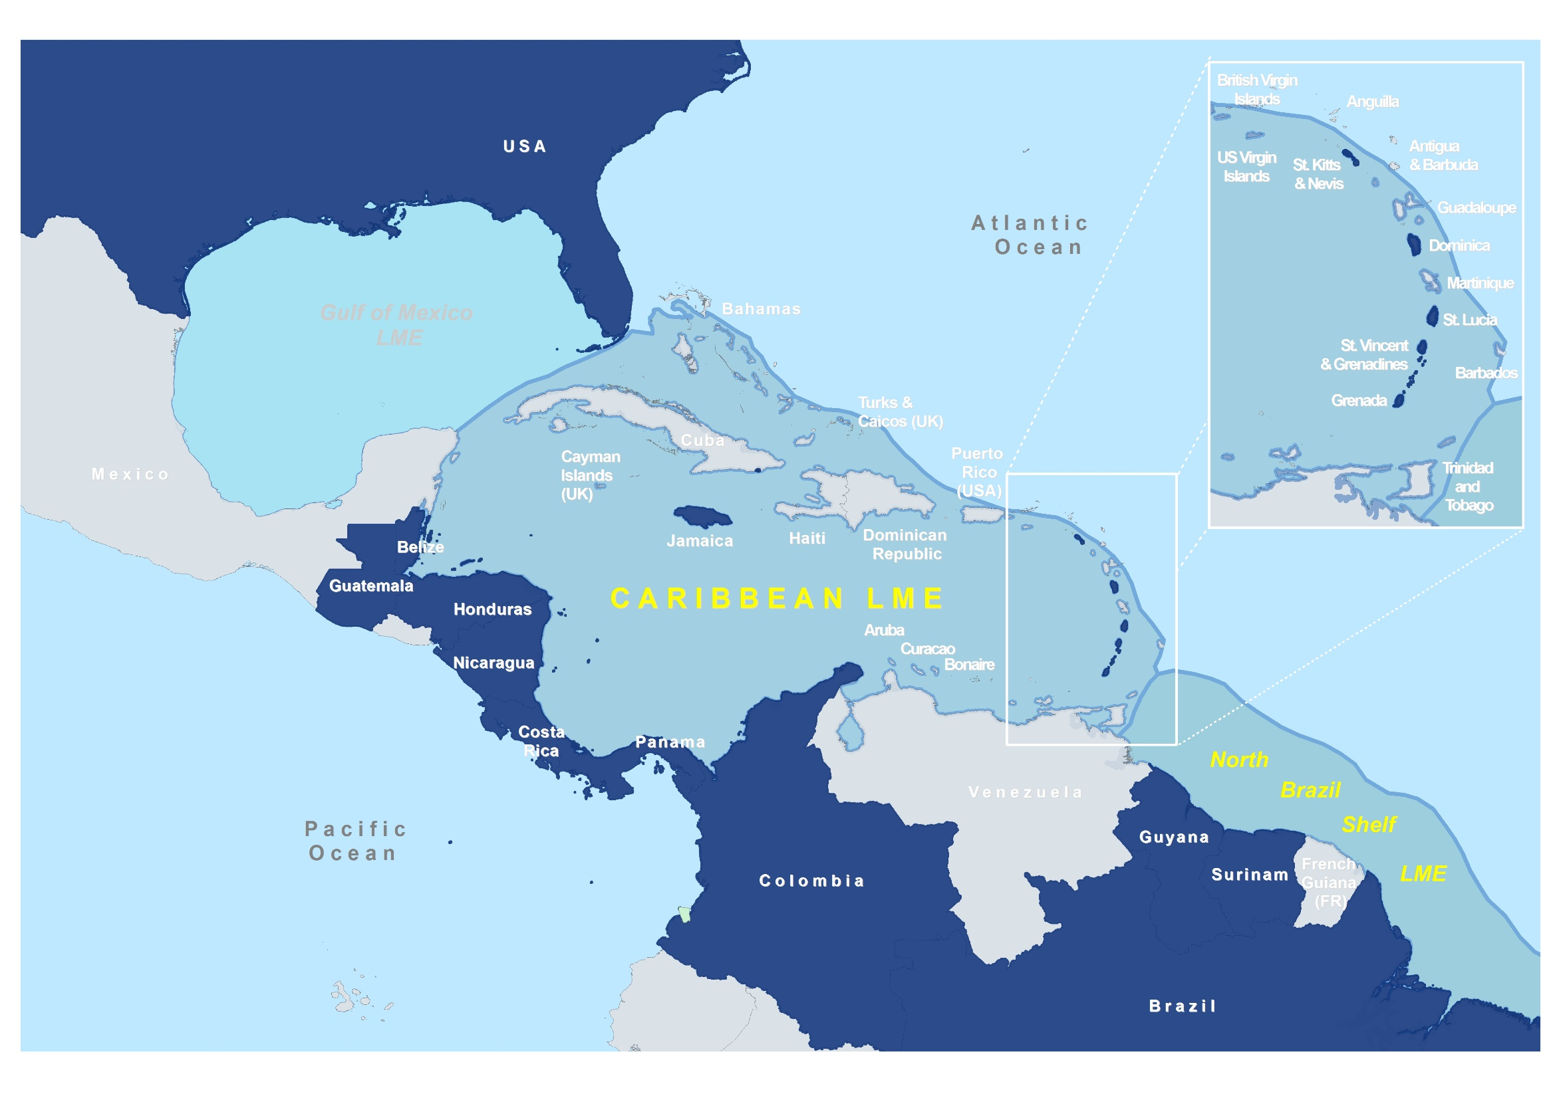
SAP SIGNED BY MINISTER of FISHERIES

Slide 27
CLME+ SAP Endorsements
Additional endorsement of CLME+ SAP is required for it to become truly a regionally supported Programme
CLME + Region
26 Independent States
18 overseas/associated territories
CLME+ SAP endorsements
22 Independent States
21 GEF Eligible countries
1 non GEF Eligible country
ACTION REQUIRED
MEETING DECISION SOUGHT

Slide 28
Thank you
http://clmeproject.wordpress.com
CLME+ Project Coordination Unit
Cartagena, Colombia
(57) (5) 664 88 82
info@clmeproject.org

