Slide 1

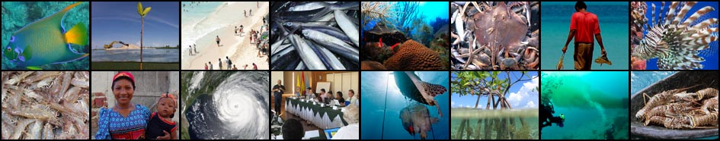
UNDP-GEF Project: CLME+ “Catalysing Implementation of the Strategic Action Programme for the Sustainable Management of shared Living Marine Resources in the Caribbean and North Brazil Shelf Large Marine Ecosystems”
CLME+ Project Inception Workshop and First Steering Committee Meeting, Cartagena, Colombia
26 – 28 January, 2016

Slide 2
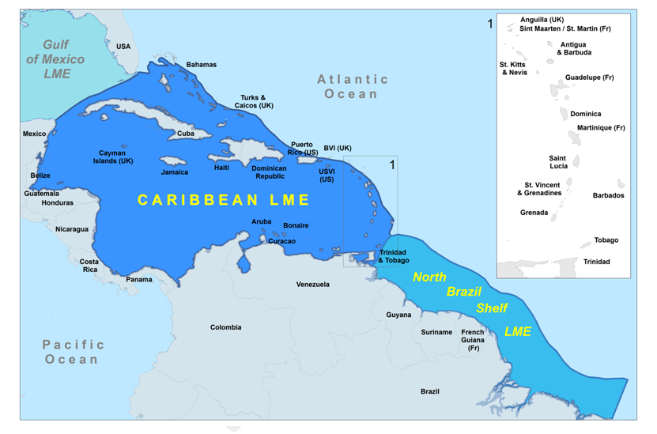
CLME⁺ region = 2 LMEs: the CARIBBEAN LME and the NORTH BRAZIL SHELF LME
25 GEF-eligible countries + 18 overseas territories + USA
Notes:
Scope of CLME+ Project. Encompasses two large marine ecosystems. For those not familiar LME was a concept introduced by NOAA to help countries improved the management of the globally important economic goods and services provided by marine ecosystems. CLME+ encompasses 2 of the 66 designated LMEs.
This area is often considered to be one of the most geopolitically complex region in the world. Government systems, cultural differences and languages.

Slide 3



CLME+ Project
Donor: Global Environment Facility (GEF)
GEF Agency: United Nations Development Programme (UNDP)
Executing Agency: United Nations Office for Project Services
Project Document Submitted to the GEF Secretariat: January 2015
Project Document Endorsed by GEF CEO: March 2015
Project Coordination Unit Established: May 2015
Project Timeline: May 2015 – April 2020 (5 years)
Project Budget: USD 12.5 million (GEF) + USD 134 million (co-financing)

Slide 4
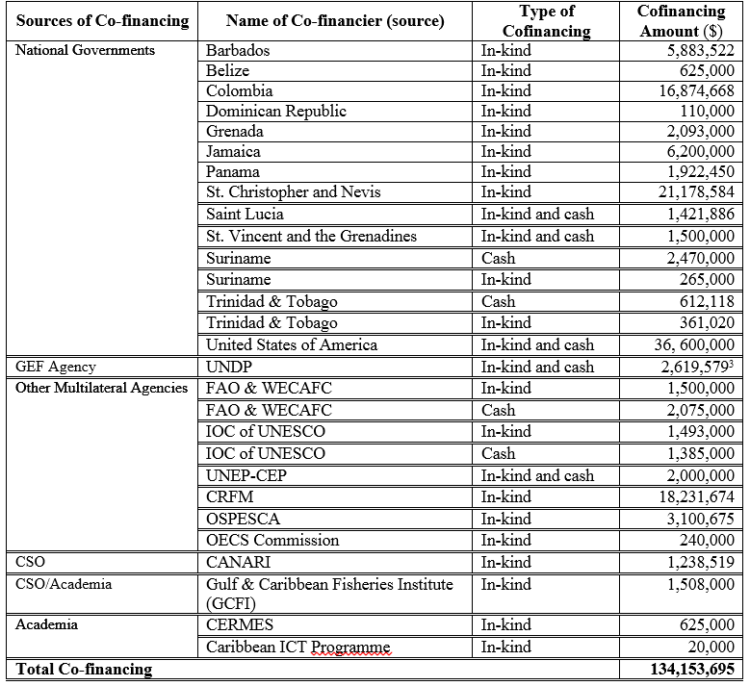
Co-financing Contributions to the CLME+ Project
Note: periodic reporting on materialized levels of co-financing will be required
More info under Agenda Item 11 (Day 2)

Slide 5
Letters of Intent
Letter of Intent – Willingness of organisation to explore opportunities for entering into a formal partnership with the CLME+ Project,
to collaborate in the implementation of the SAP
Letters Received from:
CaribSave
CCAD
Conservation International
The Nature Conservancy
World Wildlife Fund

Slide 6
The LME governance framework
ANALYSIS AND ADVICE
A multi-level policy cycle-based
governance framework
DATA AND INFORM-ATION
DECISION MAKING
REVIEW AND EVALUATION
IMPLEMENT-ATION
Policy cycles must be:
Complete
Linked vertically
Linked laterally
Diversity of policy processes as appropriate
Notes:
6

Slide 7
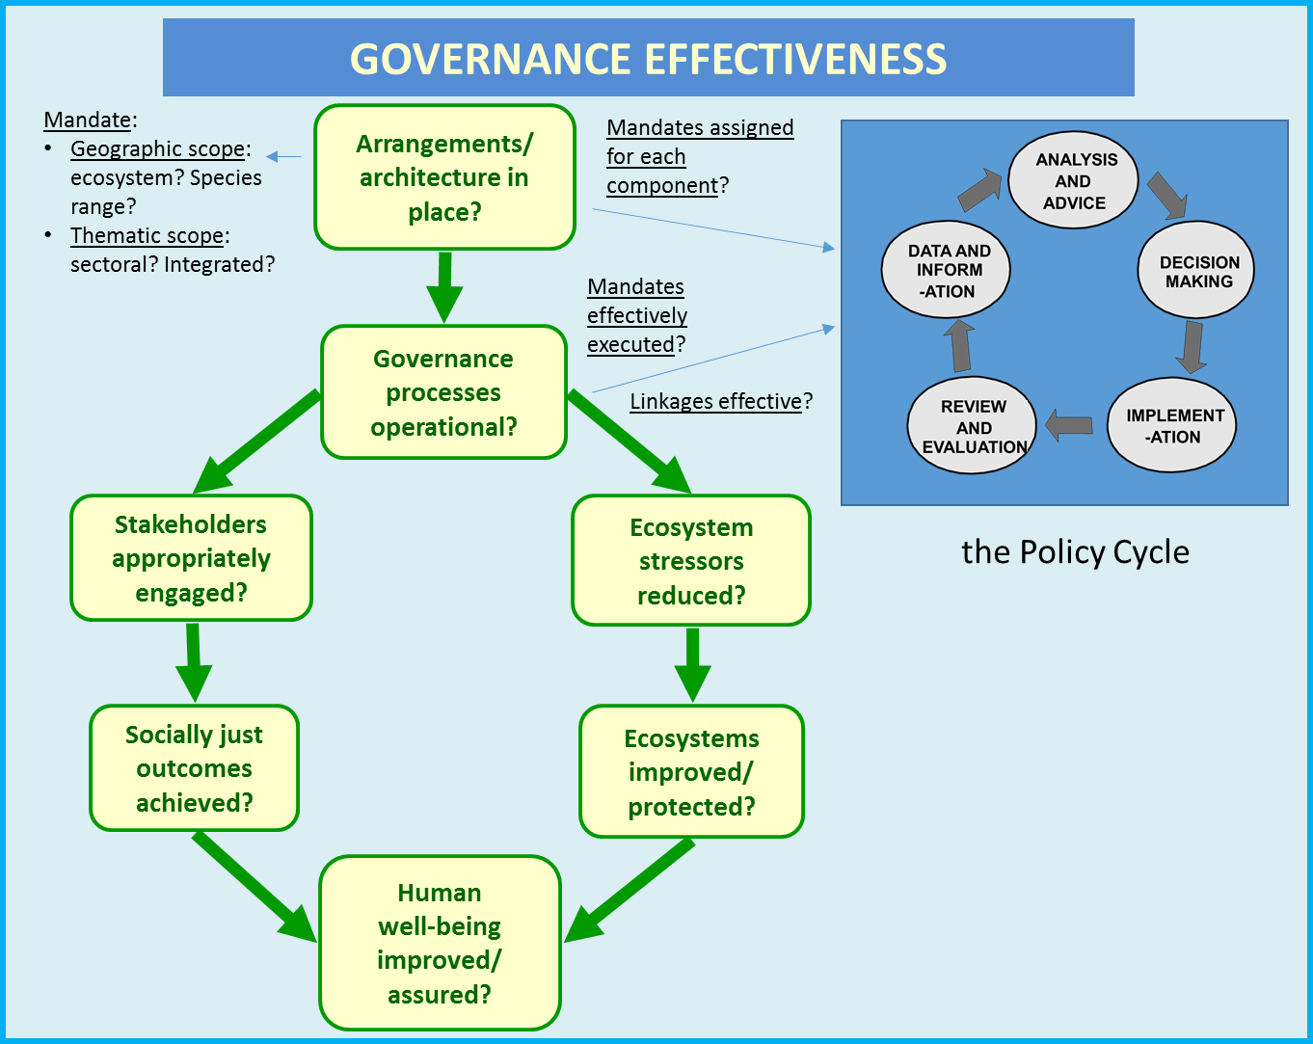
Results Based Planning & Management Framework
GOVERNANCE EFFECTIVENESS ASSESSMENT FRAMEWORK (GEAF; TWAP Project)
used as a results-based planning and assessment framework for overall CLME+ Project and CLME+ Sub-Project (and SAP) implementation
Notes:
As a semi-enclosed Sea, and with its multitude of fragile ecosystems, it can be anticipated that the Caribbean Sea environment (3,3 million km²) is highly susceptible to the inputs of land-based pollution originating from the activities of the more than 100 million people that permanently live in the approximate 2,2 million km² of land that drains into the Caribbean Sea.
Important freshwater and associated sediment and nutrient flows (and potentially pollutant flows) originate from major river basins such as the Amazon and Orinoco (NE South America) and enter into the marine and coastal environment of the NBSLME and –through the North Brazil Current- the CLME.

Slide 8
CLME+ Project
CLME⁺ Project Objective:
Facilitating EBM/EAF in the CLME+
for the sustainable and climate resilient provision of goods and services from shared living marine resources, in line with the endorsed CLME+ SAP

Slide 9
COMPONENTS OF THE CLME+ PROJECT
ENHANCE THE GOVERNANCE ARRANGEMENTS
facilitate
C1
C3
C4
DEMONSTRATE EBM/EAF
(prioritize/select – limited $) building on results from C1&2
FEASIBILITY STUDIES – INVESTMENT NEEDS FOR UPSCALING OF RESULTS
BUILD THE CAPACITY TO MAKE EFFECTIVE USE OF THE ENHANCED ARRANGEMENTS
demonstrate
C2
scale-up, replicate
enable
REGION-WIDE
M&E OF SAP IMPLEMENTATION
C5
track progress, foster synergies, avoid duplication, review/revise approach

Slide 10
COMPONENTS | OUTCOMES
1. Consolidating the institutional, policy and legal frameworks for sustainable and climate-resilient shared living marine resources governance in the CLME+ region | Integrative governance arrangements for sustainable fisheries and for the protection of the marine environment, in line with the endorsed CLME+ SAP
2. Enhancing the capacity of key institutions and stakeholders to effectively implement knowledge-based EBM/EAF for sustainable shared living marine resources use in the CLME+ | Enhanced institutional and stakeholder capacity for sustainable and climate-resilient sLMR management at regional, sub-regional, national and local levels (with special attention to regional and sub-regional organisations with key roles in SAP implementation)
3. Implementing EBM/EAF in the CLME+ region | Progressive reduction of environmental stresses (with particular attention to socially just solutions and the enhancement of livelihoods) demonstrated, across the thematic and geographic scope of the CLME+ SAP

Slide 11
COMPONENTS | OUTCOMES
4. (Pre-)Feasibility assessments to identify major high-priority investment needs and opportunities in the CLME+ region | Financing catalysed for the up-scaling of priority actions for the protection of the marine environment and for ensuring sustainable, climate-resilient livelihoods and socio-economic development from sLMR use in the CLME+
5. Monitoring & assessing progress of and results from the overall implementation of the CLME+ SAP, and experience sharing with the global LME practitioners community | Regional socio-economic benefits and Global Environmental Benefits from SAP implementation are maximised through enhanced collaboration, planning & adaptive management, and exchange of experiences and lessons learnt

Slide 12
Component 1 – Legal, policy and institutional frameworks
Output 1.1 - Decisions on coordination & cooperation arrangements and institutional mandates, in line with SAP Strategies 1 (environment), 2 (fisheries) and 3 (cross-sectoral policy coordination)
Output 1.2 - National Inter-sectoral Coordination (NIC) mechanisms (including science-policy interfaces) in place
Output 1.3. - Regional policies, declarations and/or regulations, and associated national-level legislation and/or plans, are appropriate to enable effective EBM/EAF in the CLME+
Output 1.4 - Data management, access & exchange arrangements support adaptive management and implementation of the CLME+ Project and SAP Linked to Output 5.2 under Component 5
Output 1.5 - Sustainable financing mechanism(s) to ensure short, medium and long-term operations of the sLMR governance arrangements

Slide 13
Component 2- Capacity Building
Output 2.1 - Regional Action Plans for the management, conservation and sustainable use of fishery resources and for the protection of the marine environment
Output 2.2 - Civil Society and Private Sector Action Programmes (C-SAP and P-SAP), that are sensitive to gender concerns
Output 2.3 - Identification of good practices for data & information management
Output 2.4 - Overarching CLME+ Communication Strategy
Output 2.5 - Strategy for the training of selected stakeholders on issues of cross-cutting importance for the SAP Strategies
Output 2.6 - Targeted research strategies to address scientific demands from organizations dealing with fisheries and the protection and sustainable use of the marine environment

Slide 14
Component 3 – Implementing EBM/EAF
Output 3.1 - Well-planned, progressive transition to an ecosystem approach for the Caribbean spiny lobster fisheries (demonstration at the sub-regional level)
Output 3.2 - Well-planned, progressive transition to an ecosystem approach for the shrimp and groundfish (S&GF) fisheries of the NBSLME
Output 3.3 - Well-planned, progressive transition to an ecosystem approach for the Eastern Caribbean flyingfish fisheries
Output 3.4 - Demonstrating the transition to an Ecosystem-Based Management (EBM) approach at the sub-regional/site level in the CLME+ Region
Output 3.5 - Modest small grants support for the implementation of C-SAP and/or P-SAP actions (with special attention to livelihoods)

Slide 15
Component 4 - Feasibility Assessments & Upscaling
Output 4.1 - (Pre-)feasibility reports on major investment needs and opportunities (incl. budget estimates, scope of work, private sector involvement, potential benefits and required timescales)
Output 4.2 - Investment plans (incl. specifications for private sector and civil society involvement) to deal with key issues identified under the CLME TDAs

Slide 16
Component 5 – Monitoring & Assessment
Output 5.1 - Cooperation (incl. through formal and/or informal frameworks and partnerships) among development partners, programmes, projects, initiatives (PPIs) and countries/territories with a stake in the SAP (“CLME+ SAP Partnership”)
Output 5.2 - A prototype CLME+ ecosystem status and SAP implementation M&E mechanism
Output 5.3 - Communication, twinning and knowledge exchange activities targeting the CLME⁺ Partnership and global LME Community of Practice (COP)

Slide 17
Countries that have signed CLME+ Project Document (status: Jan 2016)
COUNTRIES | DATE SIGNED
Belize | 7 April, 2015
Colombia | 30 April, 2015
Costa Rica | 13 April, 2015
Dominican Republic | 14 April, 2015
Grenada | 10 April, 2015
St. Kitts & Nevis | 13 April, 2015
Suriname | 26 March, 2015

Slide 18
Actions for Consideration
The GEF (Agency) requires that all CLME+ participating countries endorse (sign) the CLME+ Project Document
Only those GEF Eligible countries that have signed the Project Document: eligible for future financial support to attend CLME+ Project SCM
Countries and potential partners that have not submitted co-financing commitment letters are encouraged to do so soon

Slide 19
Thank you
http://clmeproject.wordpress.com
CLME+ Project Coordination Unit
Cartagena, Colombia
(57) (5) 664 88 82
info@clmeproject.org

