Slide 1

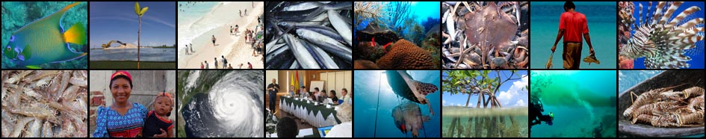
The Interim Coordination Arrangement for Sustainable Fisheries
CLME+ Project Inception Workshop and First Steering Committee Meeting, Cartagena, Colombia
26 – 28 January, 2016

Slide 2
CLME TRANSBOUNDARY DIAGNOSTIC ANALYSES:
3 KEY PROBLEMS throughout the CLME+
UNSUSTAINABLE FISHERIES
CLIMATE
CHANGE
SOCIETAL
CHANGE
POLLUTION
HABITAT DEGRADATION
Notes:
The three transboundary issues have an impact on the integrity of the three ecosystem types that have been identified which in the pelagic, reef and continental shelf.

Slide 3
ROOT CAUSES of the 3 (+1) CLME issues
Weaknesses in GOVERNANCE
limited HUMAN & FINANCIAL resources;
inadequate (ACCESS to) DATA and INFORMATION/KNOWLEDGE
inadequate public AWARENESS and INVOLVEMENT
inadequate consideration of the VALUE of ECOSYSTEM goods & services
POPULATION GROWTH and CULTURAL pressures;
trade and EXTERNAL DEPENDENCY
Notes:
As part of the Casual Chain Analysis, seven main root causes were identified including inadequate access to data and information/knowledge and inadequate consideration of the value of ecosystem goods and services. Yet it was noted that all could be linked back and associated to the main, over-arching root cause, being: weak governance.

Slide 4
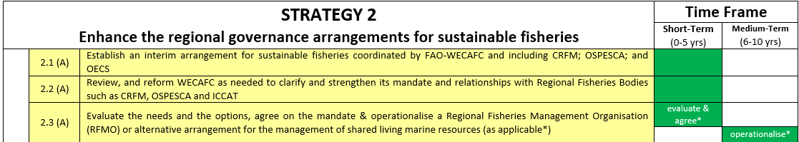
10- year endorsed CLME+ SAP
Notes:
As most people are aware the CLME+ SAP has been endorsed by 30 ministers in 22 countries. The SAP identifies 6 Strategies and 4 sub-strategies. Of major significance to this issue are the governance related actions under Strategy 2, particularly action 2.2 and 2.3.

Slide 5
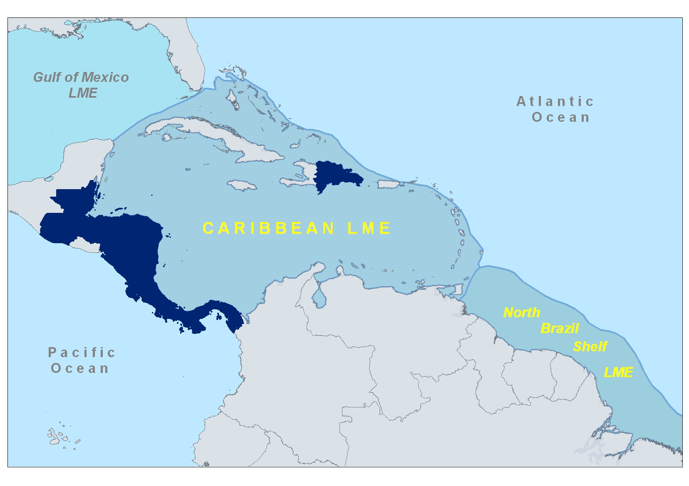
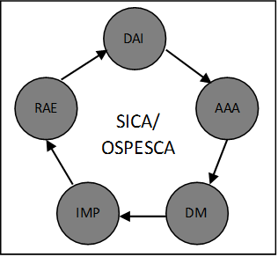
STRATEGY 2 (Sust. Fisheries):
GEOPOLITICAL COMPLEXITY
& SUBSIDIARITY PRINCIPLE
OSPESCA member states
DAI = Data & Information
AAA = Analysis & Advice
DM = Decision-making
IMP = Implementation
RAE = Review & Evaluation
Notes:
So now that we have a common understanding of what governance means to the CLME+ Project and what it encompasses, let us take a look at the different RFBs in the region. Under the Central American Integration Mechanism, SICA, the regional fisheries body OSPESCA has been formally mandated to work across all elements of the policy cycle, within their mandated geographic scope, which is represented in this figure. In this context, for example, and with the support of the first CLME Project, OSPESCA has developed a draft regional spiny lobster management plan.

Slide 6
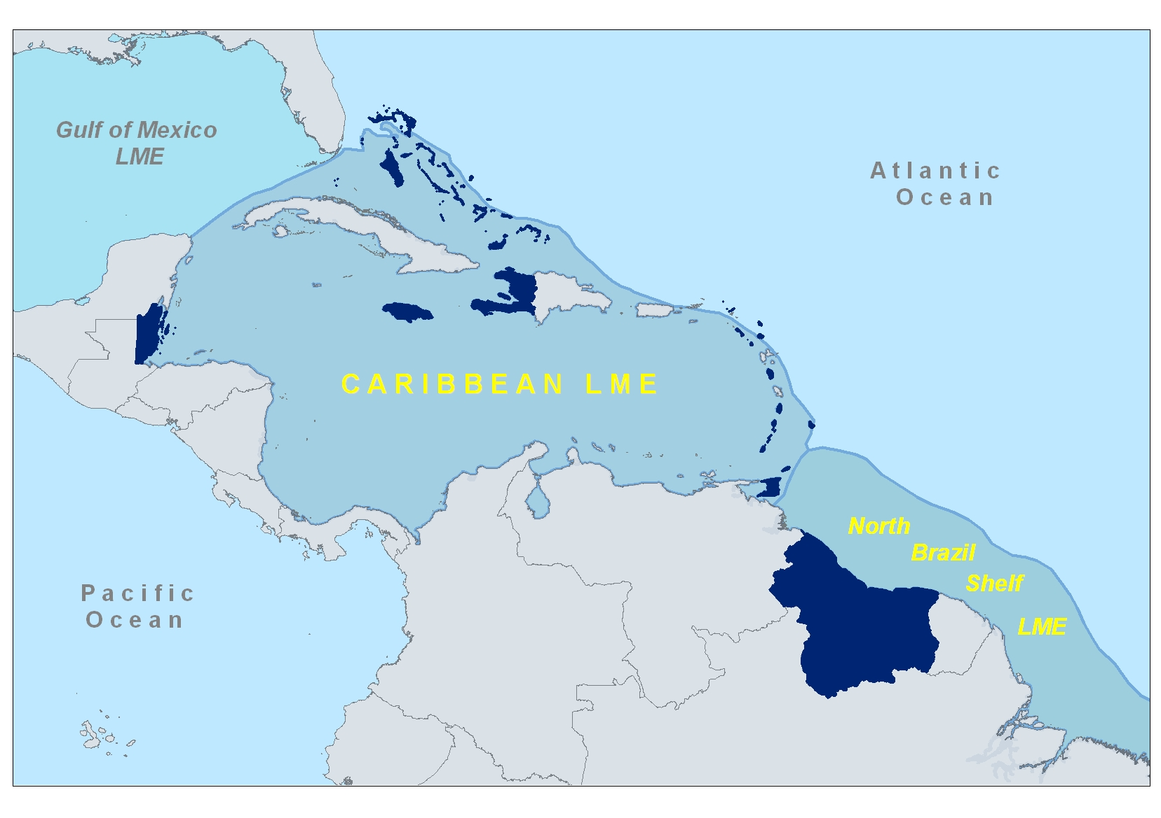
STRATEGY 2 (Sust. Fisheries):
GEOPOLITICAL COMPLEXITY
& SUBSIDIARITY PRINCIPLE
CRFM member states
DAI = Data & Information
AAA = Analysis & Advice
DM = Decision-making
IMP = Implementation
RAE = Review & Evaluation
Notes:
CRFM, the Regional Fisheries Body under CARICOM also has been mandate by its member states to work across all elements of the policy cycle, within their mandated geographic scope, which is represented in this figure.

Slide 7
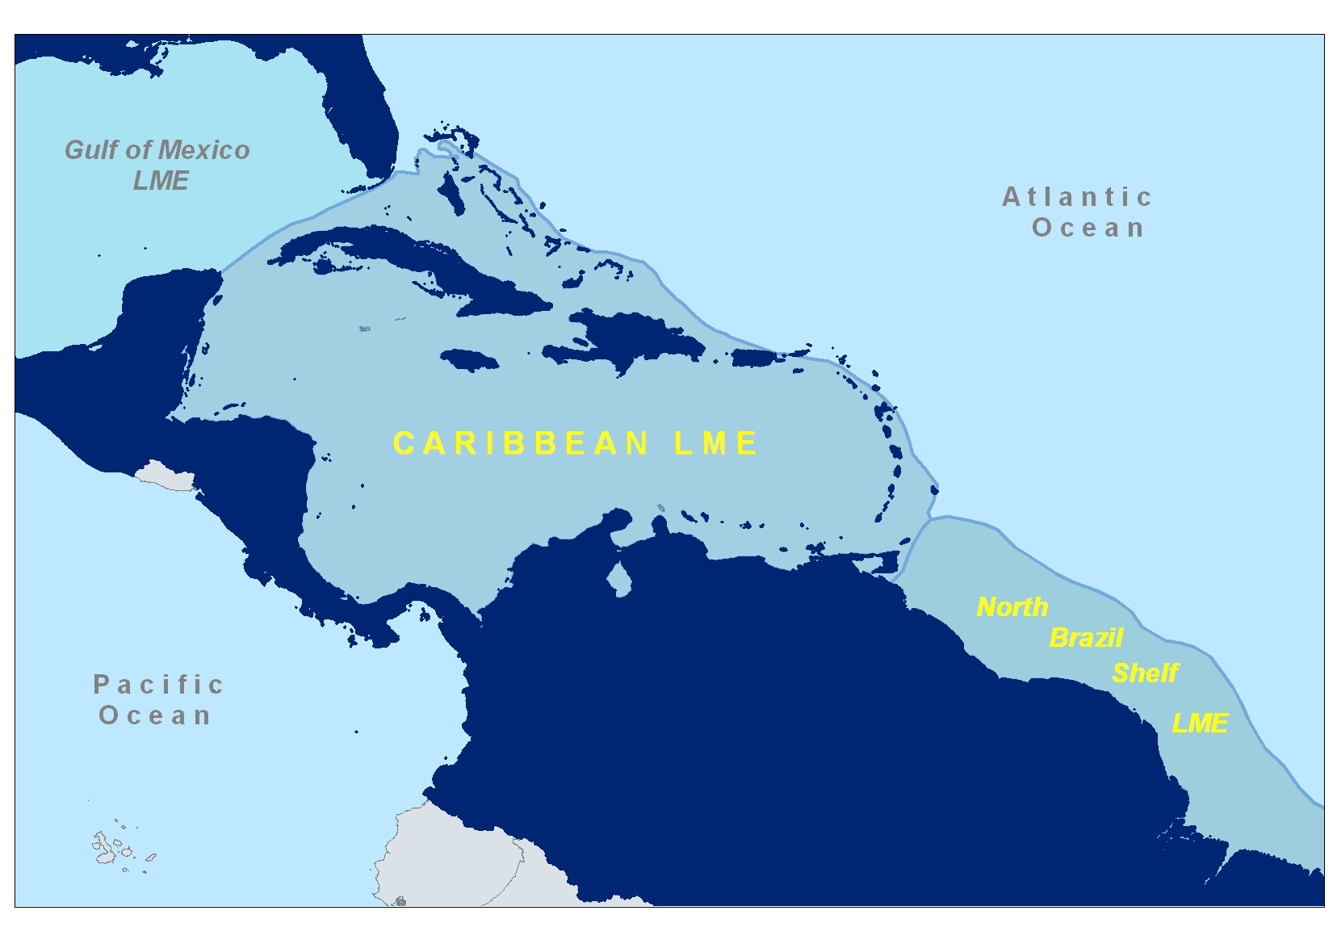
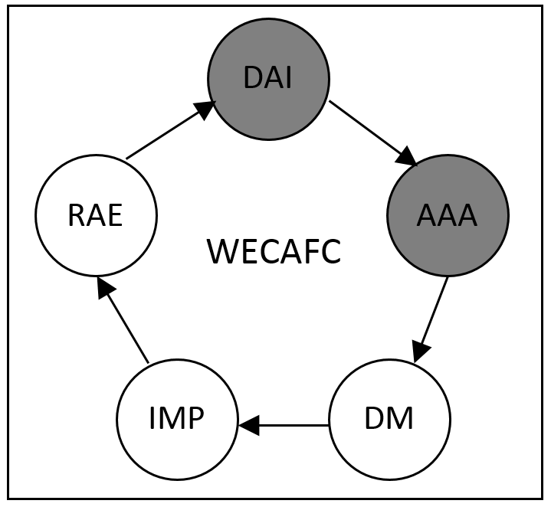
STRATEGY 2 (Sust. Fisheries):
GEOPOLITICAL COMPLEXITY
& SUBSIDIARITY PRINCIPLE
STRATEGY 2 (Sust. Fisheries):
GEOPOLITICAL COMPLEXITY
& SUBSIDIARITY PRINCIPLE
WECAFC geographic scope
DAI = Data & Information
AAA = Analysis & Advice
DM = Decision-making
IMP = Implementation
RAE = Review & Evaluation
Notes:
The third RFB is the Western Central Atlantic Fisheries Commission. Its geographic scope encompasses the full CLME+ and even more, eg Gulf of Mexico however, unlike CRFM and OSPESCA that are mandated to work across the full policy cycle, WECAFC looks at Analysis and Advice and Data and Information.

Slide 8
Interim Coordination Arrangement for Sustainable Fisheries
Objective - Enhance the regional governance mechanisms for sustainable fisheries through the formalization of an interim arrangement to facilitate, support and strengthen the coordination of actions among the organisations for sustainable fisheries in the Western Central Atlantic region.
Areas for collaboration
Priority areas in CRFM-OSPESCA Joint Action Plan
Technical Working Groups (e.g. spiny lobster, queen conch, IUU, shrimp & groundfish)
Implementation of CLME+ SAP and CLME+ Project Document actions and activities related to RFBs mandate and scope

Slide 9
Interim Coordination Arrangement for Sustainable Fisheries
RFBs agree
To work towards harmonization of their respective policy and legal frameworks for fisheries
To cooperate on relevant scientific and fisheries management projects
To establish reciprocal observer arrangements
To share reports of their sessions and meetings of their subsidiary bodies and projects

Slide 10
Status of Interim Coordination Arrangement for Sustainable Fisheries
Memorandum of Understanding
Three meetings undertaken to negotiate Memorandum of Understanding between RFBs (September, October & December)
MOU reviewed by legal departments
Three RFBs have done final review and are in agreement with MOU text
MOU awaiting signature
Initial definition of Work Plan of Interim Arrangement
Initial discussion on work plan (end of October)
Follow-up discussion/meeting (2 December)

Slide 11
Elements of Work Plan of Interim Arrangement
Priority Areas | Nov-Jan | Feb-Apr | May-Jul | Aug-Oct
Conch | Distribution of draft Queen Conch Management & Conservation Plan | National level consultations Review and endorsement of plan at CRFM and OSPESCA governance mechanisms | Review and endorsement at 16 Session of WECAFC | Endorsement of queen conch management & conservation plan at CITES COP
Spiny Lobster | Publication and dissemination of the report of the 1st joint Lobster Working Group meeting | Confirmation of OSPESCA Regulation on Lobster and CRFM declaration to be presented to WECAFC | Endorsement of the harmonized lobster measures by 16 Session of WECAFC | Joint awareness raising campaign on spiny lobster measures
IUU |  | 1st meeting of the IUU Working Group

Slide 12
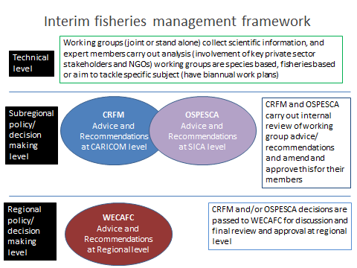
Interim Coordination Arrangement for
Sustainable Fisheries

Slide 13
Thank you
http://clmeproject.wordpress.com
CLME Project Coordination Unit
Cartagena, Colombia
(57) (5) 664 88 82
info@clmeproject.org

