Slide 1

2nd PSC meeting, sub-agenda item 5.2
Agenda Item 5.2: Overall Financial Implementation Overview
Catalyzing implementation of the Strategic Action Programme for the Caribbean and North Brazil Shelf LME’s (2015-2020)

Slide 2
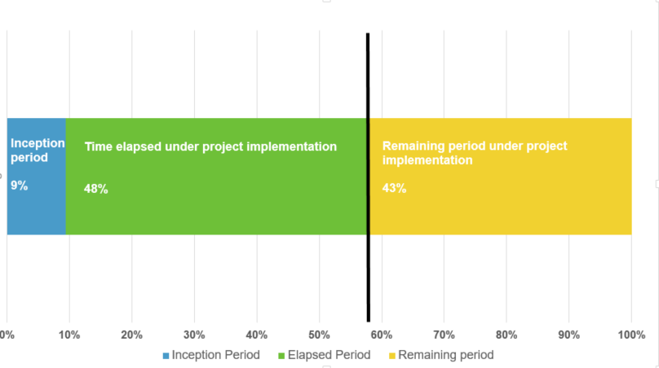
Total implementation of GEF fund
2nd PSC meeting, sub-agenda item 5.2
Having reached half the duration of the project, 47% of the total GEF fund has been spent or transferred to partners which involves a total amount of 5.86 MM
May 2015
Today
April-August 2020

Slide 3
Monthly implementation of GEF funds (1000’s of USD)
The peaks in financial implementation correspond to the payment of scheduled installments under the CLME+ Co-Execution Agreements (CEAs), which started in 2016, were higher during 2017 and put on hold in 2018. 50% of the Project Budget depends on the agreements.
UN Environment 2nd installment,
FAO IAA 1st installment
& OSPESCA (Spiny lobster) 2nd installment
UN Environment 1st installment, WECAFC Meeting, Communication Strategy Workshop
CRFM (Flyingfish) 2nd instalment, CANARI 3rd and 4th installment and CERMES 3rd installment
CRFM (Flyingfish)
1st installment
OSPESCA (Spiny Lobster),
CRFM (Communication Specialist)
& GCFI (Research Strategies)
1st installments
GCFI (Res Strat)
2nd
installment
CANARI and CERMES 1st and 2nd
installments
OECS
2nd installment and
GCFI 3rd
installment
GCFI Small contract,
PEG meeting,
PCU Office equipment
Steering Committee Meeting
OECS
1st installment

Slide 4
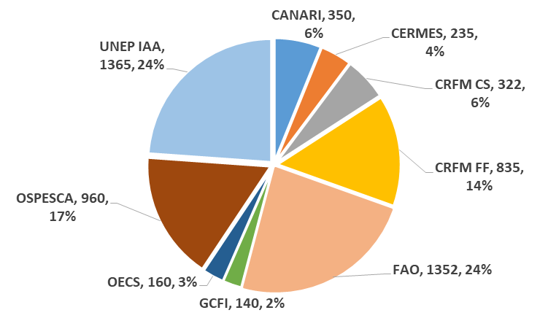
Implementation per partner
co-execution agreements (1000’s of USD)
2nd PSC meeting, sub-agenda item 5.2
UNEP and FAO are responsable of almost 50%
of the Budget allocated to co-execution agreements

Slide 5
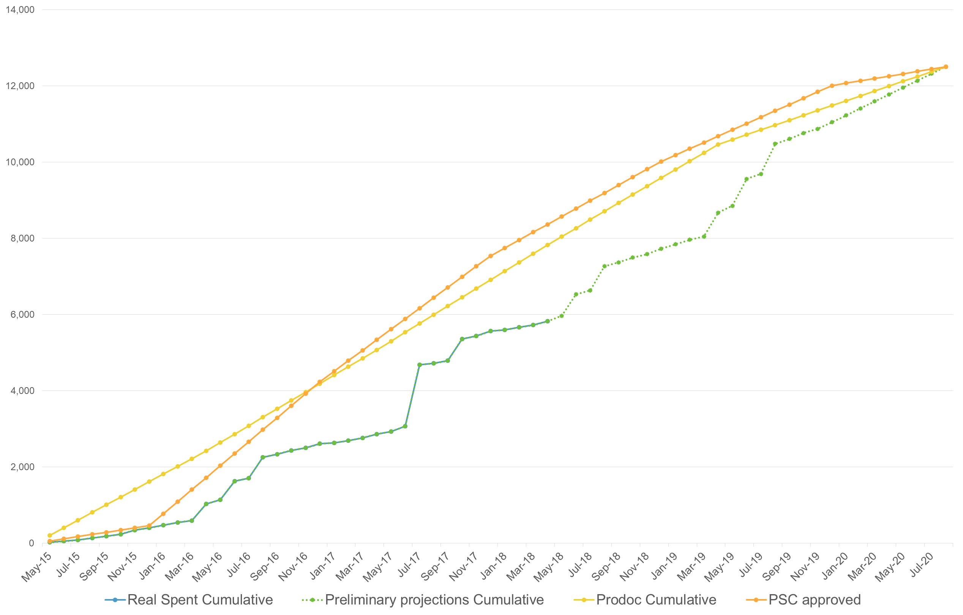
Financial Implementation vs ProDoc and PSC-approved budget (1000’s of USD)
We are here
5.5 MM
expenditure
objective 2018-2019
2 MM
current gap

Slide 6
Budget implementation of GEF funds per year
As the CEAs were signed later than expected, work on the project activities were also delayed from 2015 to 2017
Expected formalization of inter-agency agreements
2015 2016 2017 2018 2019 2020
Initial expected budget
implementation
4% 34% 60% 80% 96% 100%
16% gap : 2 MM
Real + current
expected budget
implementation
3% 24% 44% 64% 89 % 100%
2015 2016 2017 2018 2019 2020
Real formalization of inter-agency agreements
Implementation longer than anticipated
Turn-over of human resources

Slide 7
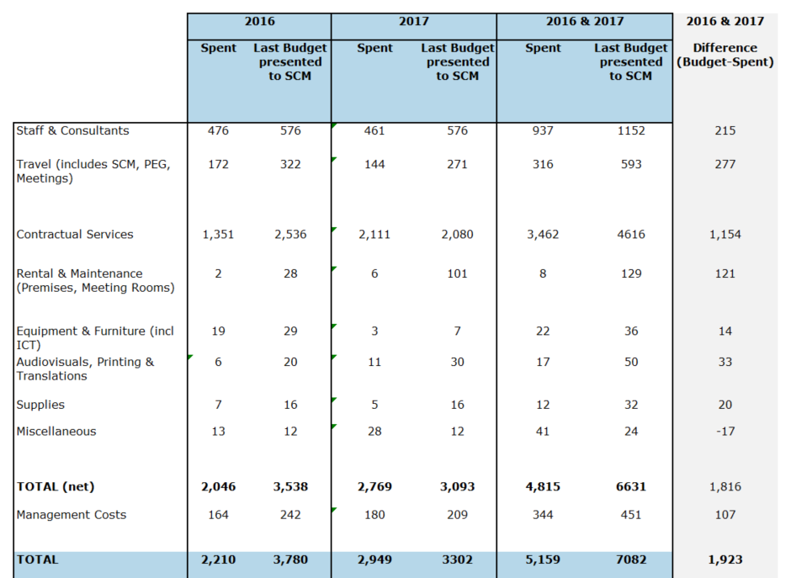
Project’s performance 2016-2017
The implementation challenges impacted on the expenditure level. Main difference between real perfomance and the initital Budget approved for these years appears in Contractual Services

Slide 8
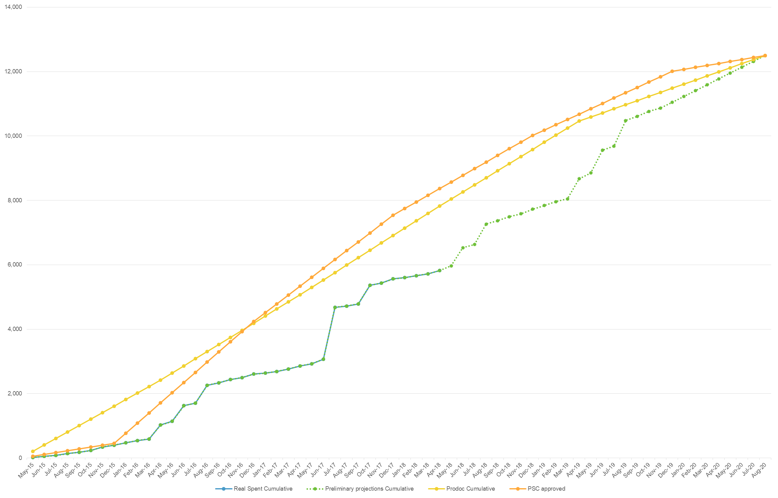
Main PCU expenditures 2015-2018
We’re here
5.5 MM
in 18 months:
2.6MM Co-execution
agreements
1.3 MM HR &
consultancies
(committed)
1.1 MM Events with
countries,
workshops,
meetings

Slide 9
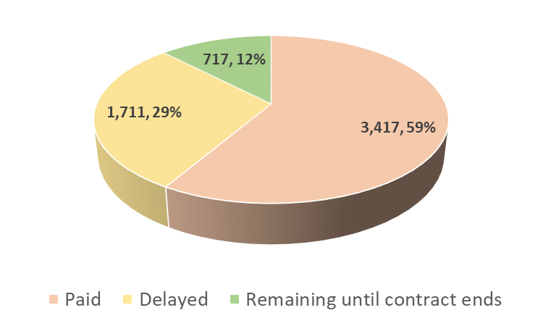
Status of expenditure level
of co-execution agreements (1000’s of USD)
2nd PSC meeting, sub-agenda item 5.2
59% of partners’s installments were already transferred.

Slide 10
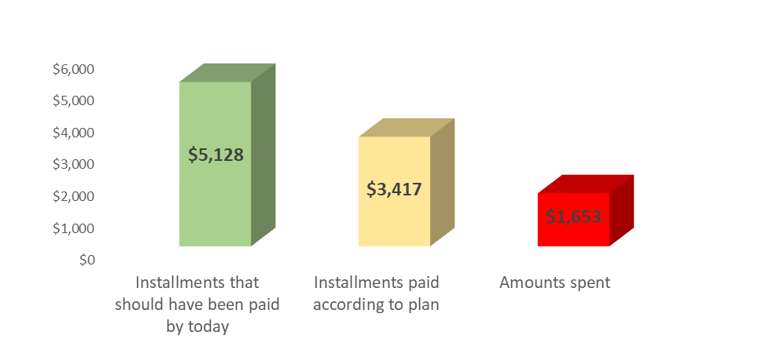
Status of expenditure level
of co-execution agreements (1000’s of USD)
2nd PSC meeting, sub-agenda item 5.2
Just a percentage of the funds transferred are effectively spent by partners.
33% of installments on hold due to slow implementation and 53% of the paid installments are still not paid
Two problems:
Delay in implementation
versus initial planning
Not enough expenditure
level over the funds transferred
-33%
-53%

Slide 11
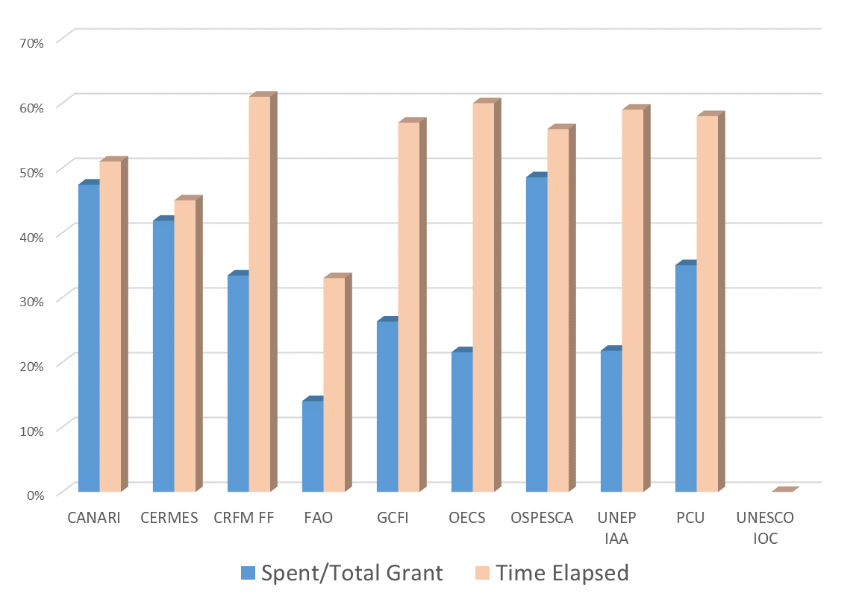


Implementation per partner
co-execution agreements (1000’s of USD)
It’s expected that financial implementation is approximately proportional to the time elapsed under each co-execution agreement

Slide 12
Implementation per partner
co-execution agreements (1000’s of USD)
Since the last PEG meeting by the end of 2017, there was an improvement of most of partners’ performances, however it’s evident that is necessary to speed up the implementation during 2018 and 2019.

Slide 13
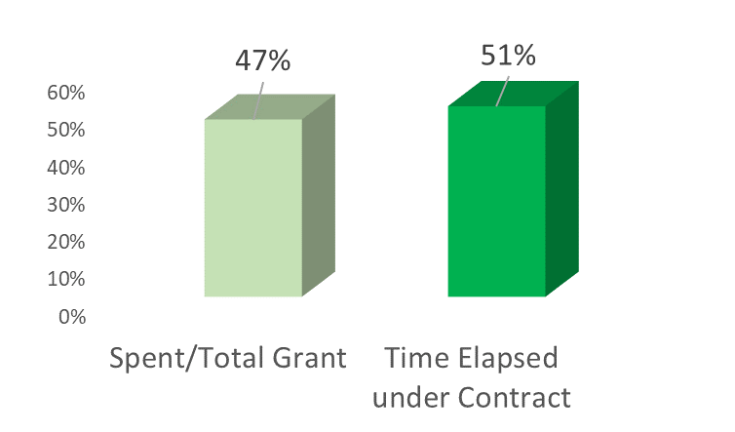
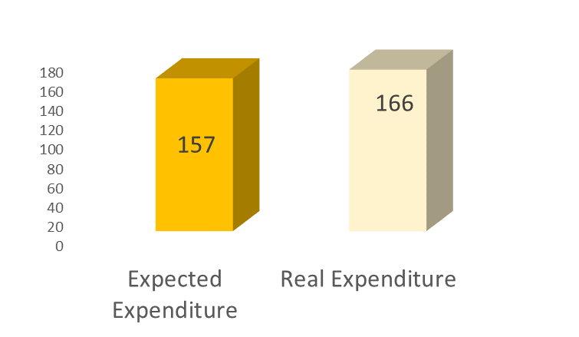
Implementation per partner
co-execution agreements (1000’s of USD)
CANARI
On track
On track

Slide 14
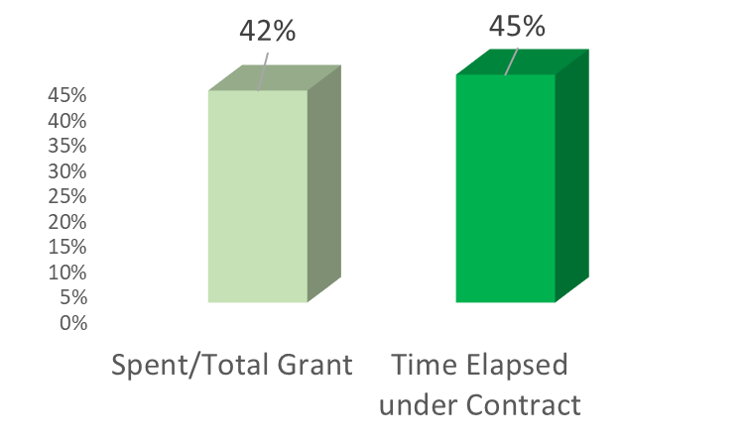
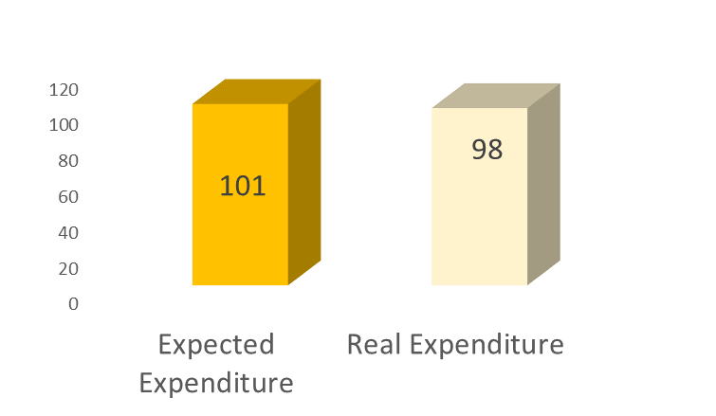
Implementation per partner
co-execution agreements (1000’s of USD)
CERMES
On track
On track

Slide 15
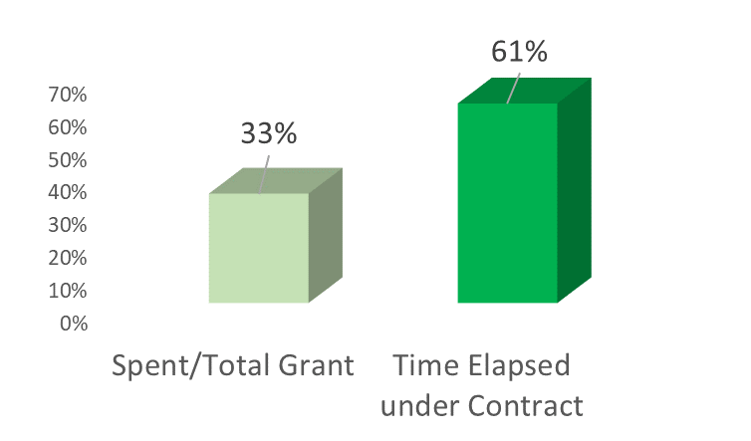
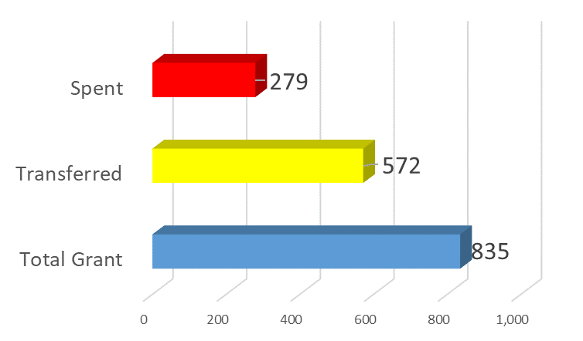
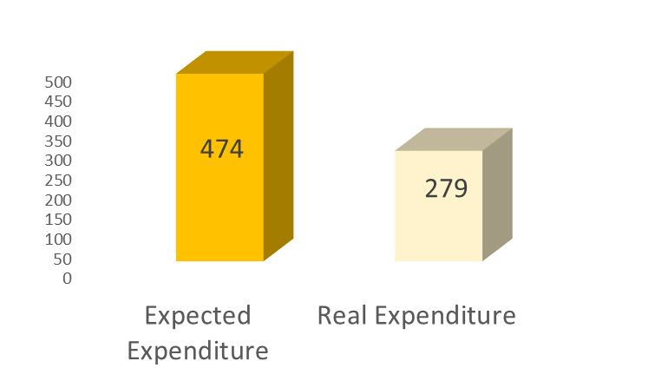
Implementation per partner
co-execution agreements (1000’s of USD)
CRFM
Financial
implementation risk
Financial
implementation risk

Slide 16
Implementation per partner
co-execution agreements (1000’s of USD)
FAO
Financial
implementation risk
Financial
implementation risk

Slide 17
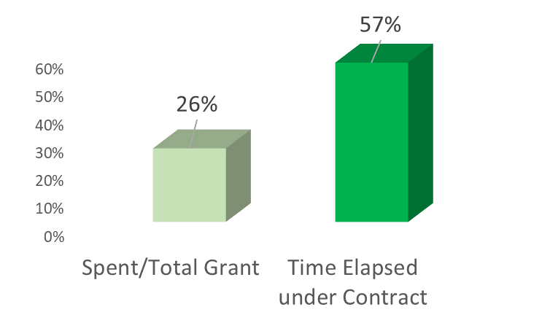
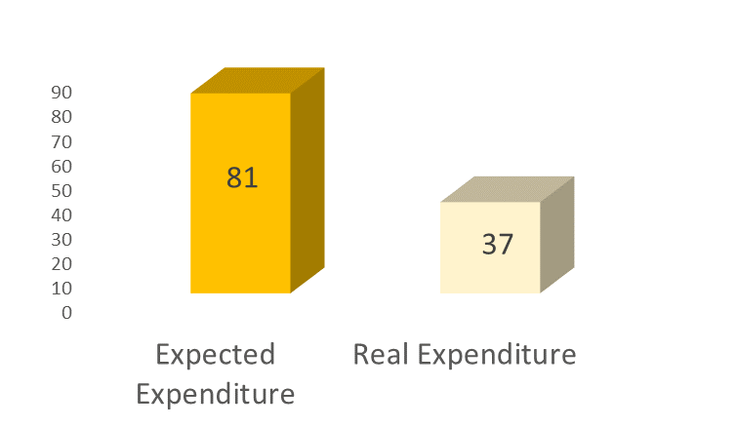
Implementation per partner
co-execution agreements (1000’s of USD)
GCFI
Financial
implementation risk
Financial
implementation risk

Slide 18
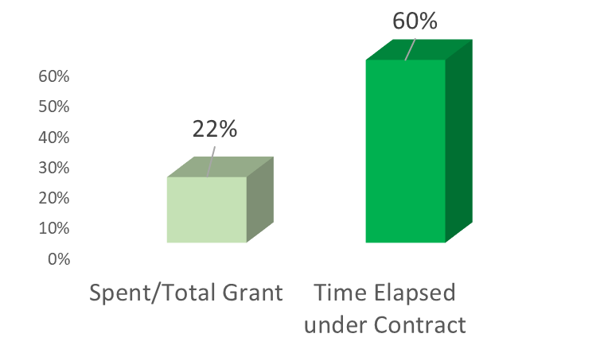

Implementation per partner
co-execution agreements (1000’s of USD)
OECS
Financial
implementation risk
Financial
implementation risk

Slide 19
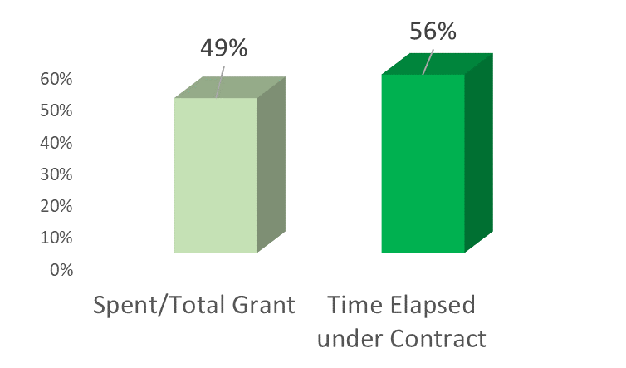
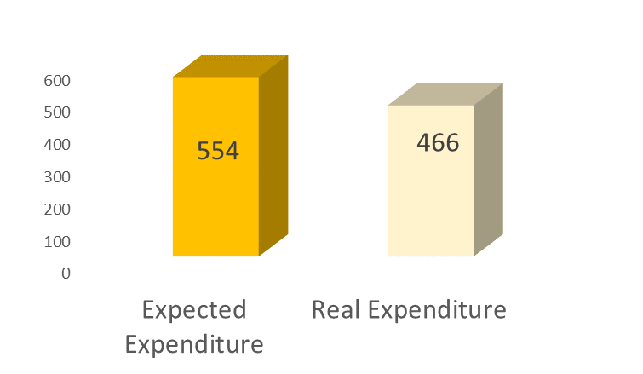
Implementation per partner
co-execution agreements (1000’s of USD)
OSPESCA
On track
On track

Slide 20
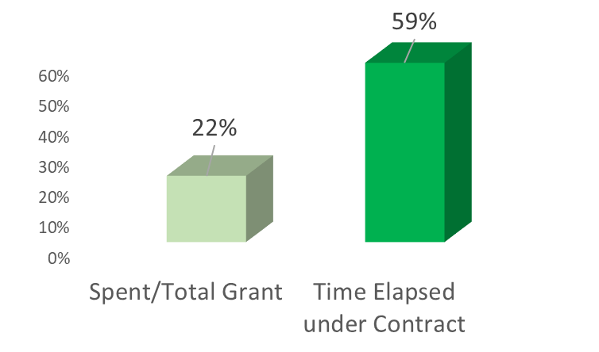
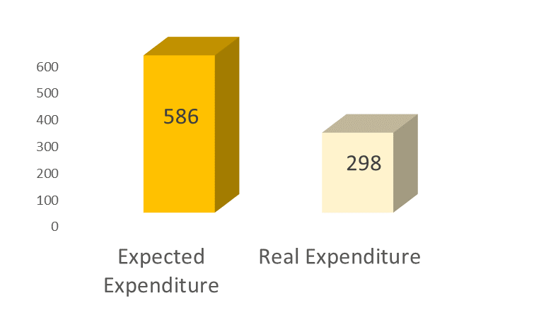
Implementation per partner
co-execution agreements (1000’s of USD)
UNEP
Financial
implementation risk
Financial
implementation risk

Slide 21
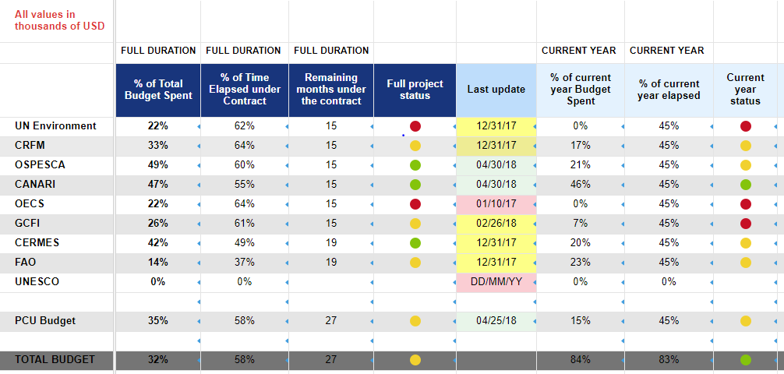
Current monitoring of implementation
https://www.clmeproject.org/intranet/financial-dashboard/

Slide 22
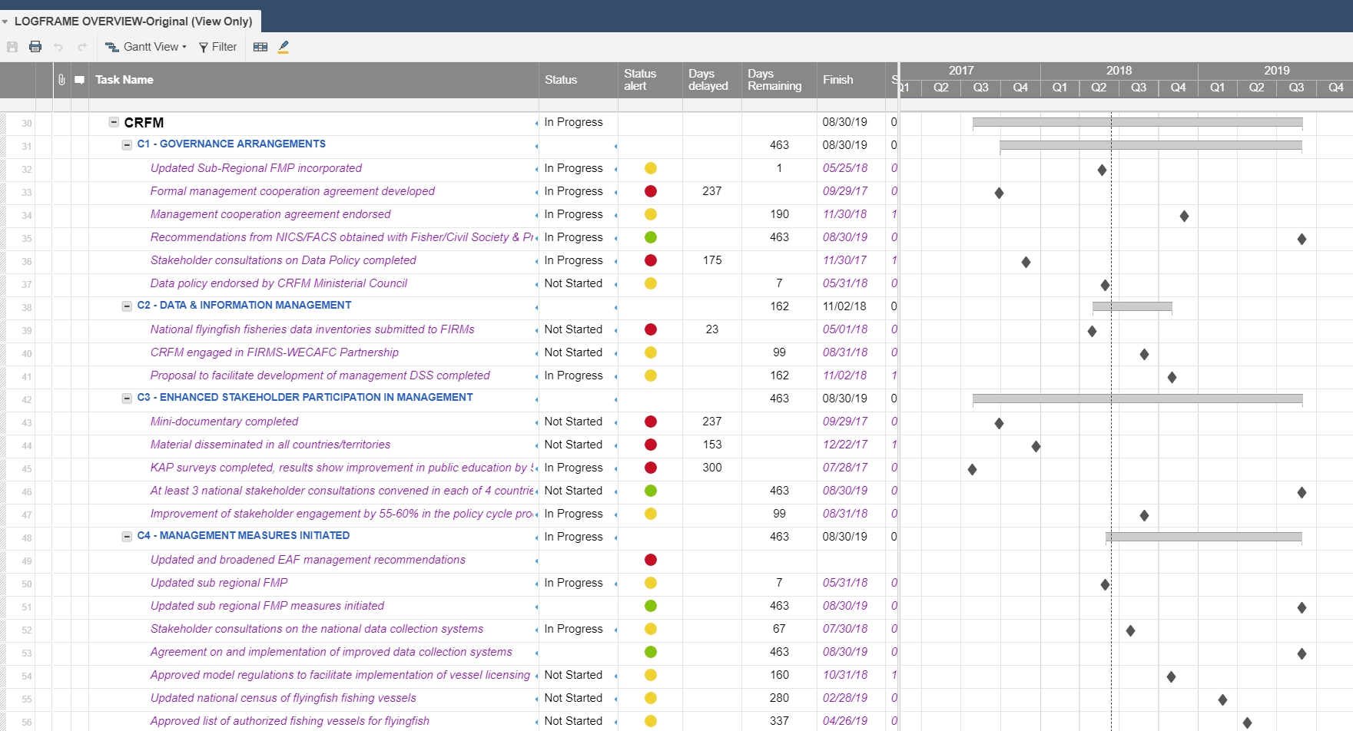
Current monitoring of implementation
https://www.clmeproject.org/intranet/logframe-overview/

Slide 23
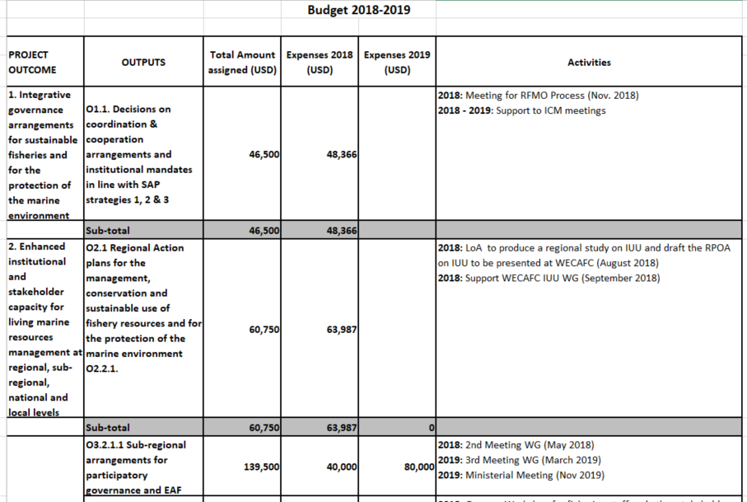
Good practices in Project Reporting
FAO
Budget per activity is detailed
(meeting, consultancy, etc)
Specify month of implementation
Compare expenditure progress with initial Budget
Diferentiate allocations per year

Slide 24


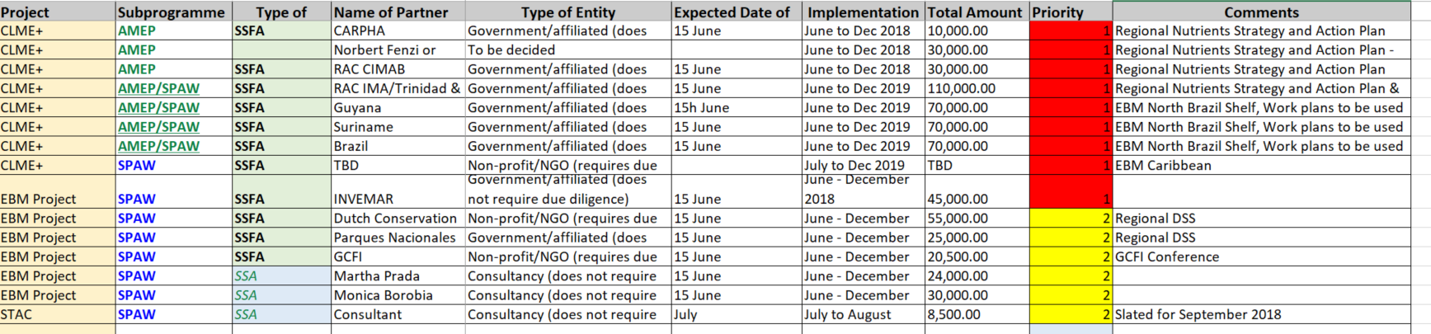
Good practices in Project Reporting
UNEP
Budget per activity and responsable parter is detailed
(meeting, consultancy, etc)
Specify priority of implementation

Slide 25

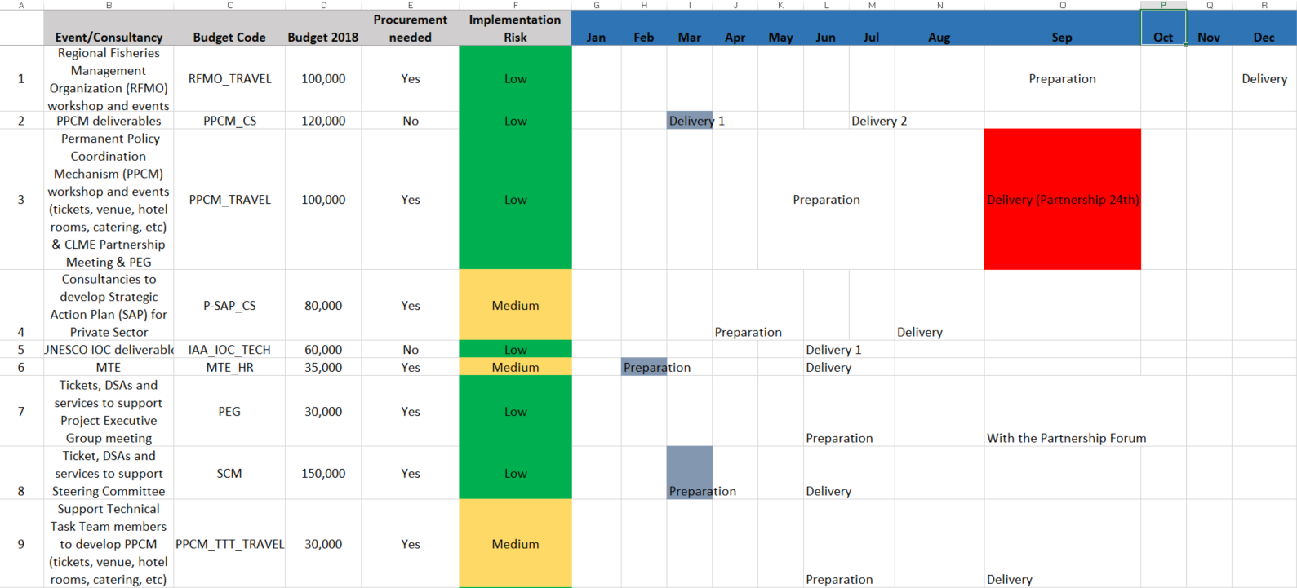
Good practices in Project Reporting
PCU
Budget per activity is detailed
(meeting, consultancy, etc)
Identify risk of implementation and corrective measures
Specify month of implementation

Slide 26
Financial recommendations
regarding budget monitoring
-Continue and enhance the use of online project planning tools and progress dashboards on the CLME+, specially for
the Partners with high implementation risks
-Strength the use of periodic reporting model (good practices) adopted by the co-executing agencies UNEP and FAO
-While monitoring, link the technical implementation of milestones with financial implementation and expenditure level performance

Slide 27
2nd PSC meeting, sub-agenda item 13.2
Agenda Item 13.2: Proposed Budget Revision
Catalyzing implementation of the Strategic Action Programme for the Caribbean and North Brazil Shelf LME’s (2015-2020)

Slide 28
Budget implementation of GEF funds per year
As the CEAs were signed later than expected, work on the project activities were also delayed from 2015 to 2017.
Expected formalization of inter-agency agreements
2015 2016 2017 2018 2019 2020
Initial expected budget
implementation
4% 34% 60% 80% 96% 100%
16% gap : 2 MM
Real + current
expected budget
implementation
3% 24% 44% 64% 89 % 100%
2015 2016 2017 2018 2019 2020
Real formalization of inter-agency agreements
Implementation longer than anticipated
Turn over of human resources

Slide 29
Main PCU expenditures 2015-2018
We’re here
5.5 MM
in 18 months:
2.6MM Co-execution
agreements
1.3 MM HR &
consultancies
(committed)
1.1 MM Events with
countries,
workshops,
meetings

Slide 30
Project’s performance 2016-2017
The implementation challenges impacted on the expenditure level. Main difference between real perfomance and the initital Budget approved for these years appears in Contractual Services

Slide 31
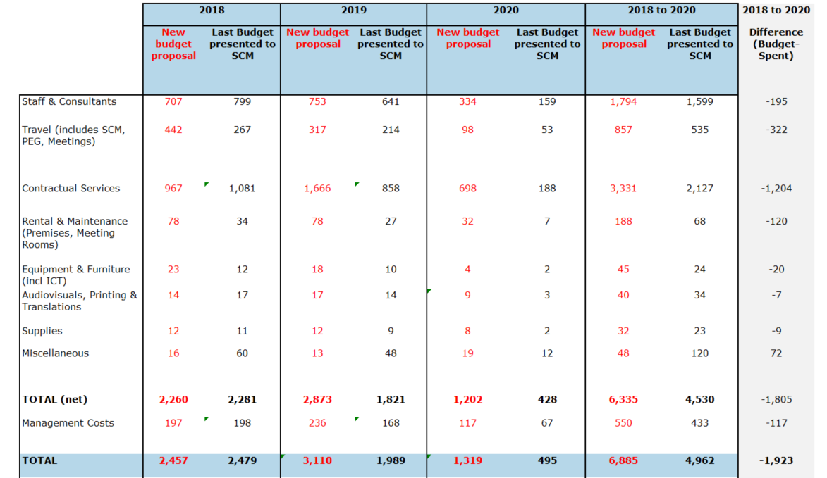
Project’s performance 2018-2020
The slower-than-expected project implementation rates during the 2016-2017 biennium, leading to under-expenditures for the PSC-approved 2016-2017 budget, now demand a reallocation of funds to the 2018-2020 period to ensure that all project outputs can be successfully delivered by project end.

Slide 32
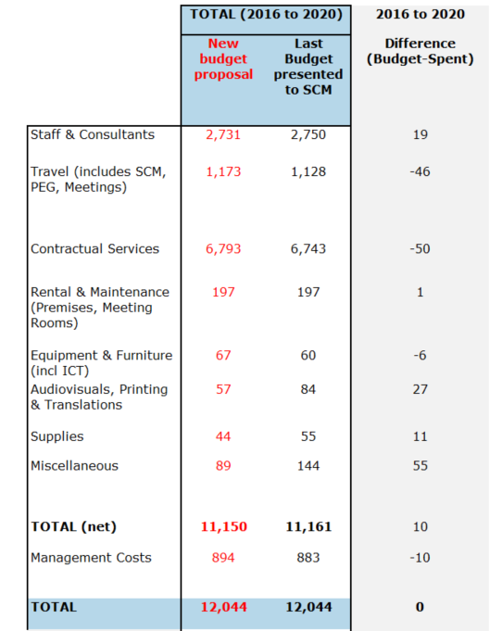
Total Revised Budget 2016-2020
The anticipated increase in expenditure levels under Contractual Services in the last three years of the project compensates the initial delays of the first two years, the initial difference gap is significantly reduced to an anticipated USD 50K deviation by project end.

Slide 33
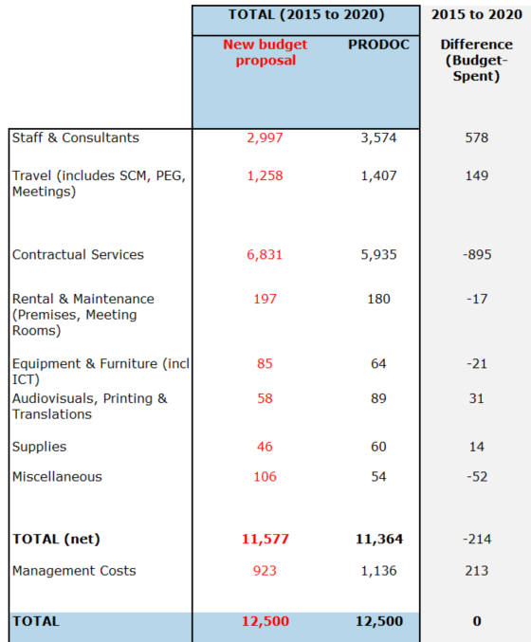


Total Revised Budget 2015-2020
The proposed budget reprogramming which is now being submitted for approval by the PSC does not increase the total budget value which was approved at PSCM1, and is done in such a way that full use of the available funds is anticipated by project end.
Communication Specialist contract through CRFM
Savings in Staff salaries
Meetings and events through UN LTA’s and contracts

Slide 34
Financial recommendations
regarding budget monitoring
-Continue and enhance the use of online project planning tools and progress dashboards on the CLME+, specially for
thePartners with high implementation risks
-Strength the use of periodic reporting model (good practices) adopted by the co-executing agencies UNEP and FAO
-While monitoring, link the technical implementation of milestones with financial implementation and expenditure level performance

Slide 35
Project “no-cost” extensión context
Project extension
Initial timeline PEG pre-agreement
Initial project closure: April 2020
New project closure: August 2020
In February 2017, as a pre-agreement, the PEG proposed a 4 months no-cost extension to compensate delays in the inception phase
This pre-agreement is pending to be approved by the SCM and processed by UNDP/UNOPS
Budget requirements: already incorporated in proposed revised 2018-2020 budget
Initial Co-execution agreement closure: August 2019
New Co-execution agreement closure: December 2019

Slide 36
Project extensión scenario
Project extension
PEG pre-agreement With project extension
Possible Actions :
Option 1: Decide to extend the project based on current risks
Option 2: Decide to postpone the decision until end of year/Q1 2019 and condition the extension to partner’s performance by Dec 2018 (to then be authorized inter-sessionally by SCM).
Current project closure: August 2020
Potential project closure: December 2020
USD 174 839*
Approximate cost of a 4-month extension (personnel costs, office costs and UNOPS fees)
Current Co-execution agreement closure: December 2019
Potential co-execution agreement closure: April 2020
*Includes UNOPS fee of 6.5%
*No need to increase UNOPS fee due to HR costing provided that no major reallocation of personnel occurs (e.g. new RPC)

Slide 37
Project extensión scenario:
Collaboration of partners with
higher implementation risks
-In case the extension is approved, the PCU and co-executive partners should fund the entire cost of it
-Partners with higher implementation risks (like PCU, UNEP and FAO) should maintain reserves (funds not committed under legal agreements) until final decision regarding the extension
-PCU suggests maintain reserves of 60-70K per partner

Slide 38
2nd PSC meeting, sub-agenda item 13.2
Thank you
Catalyzing implementation of the Strategic Action Programme for the Caribbean and North Brazil Shelf LME’s (2015-2020)

