Slide 1

APPLICATION OF THE GOVERNANCE EFFECTIVENESS ASSESSMENT FRAMEWORK (GEAF) TO THE CLME+ SAP
Robin Mahon and Lucia Fanning
Centre for Resource Management and Environmental Studies (CERMES)
University of the West Indies, Cave Hill Campus
CLME+ Project Steering Committee, Panama, June 18-19, 2018
Catalyzing implementation of the Strategic Action Programme for the Caribbean and North Brazil Shelf LME’s (2015-2020)

Slide 2
Output 5.2. under the CLME+ Project Results Framework
‘a prototype CLME+ ecosystem status and SAP implementation M&E mechanism will be developed during CLME+ Project implementation, and progressively expanded and improved throughout the project’s duration’.

Slide 3
The CLME+ Project Document adopted the
“Governance Effectiveness Assessment Framework” (GEAF)
Systematic use for monitoring and evaluation under the CLME+ Project and its Sub-Projects.
GEAF is an important tool for SAP Monitoring and Evaluation
Especially evaluation of progress with(Sub)Strategies and the over-arching SAP Objectives.

Slide 4
The SAP GEAF indicators
GOVERNANCE EFFECTIVENESS ASSESSMENT FRAMEWORK
Arrangements/ architecture in place?
GOVERNANCE ASSESSMENT SEQUENCE
Indicators to monitor SAP implementation at a strategic level
Governance processes operational?
Good governance
Stakeholders appropriately engaged?
Ecosystem stressors reduced?
Socially just outcomes achieved?
Ecosystems improved/ protected?
Effective governance
Human
well-being improved/ assured?

Slide 5
GOVERNANCE EFFECTIVENESS ASSESSMENT FRAMEWORK
IN THE CLME+ PROJECT
Strategic level monitoring and evaluation tool to inform policy making at regional and subregional levels
5-year intervals
Not a management tool
Three sets of GEAF indicators
Fisheries
Pollution
Habitats and biodiversity

Slide 6
Number of indicators in each category, for each transboundary issue
Indicator category | Fisheries | Pollution | Habitat degradation | Total Regional
Governance architecture | 3 | 3 | 3 | 9
Governance process | 7 | 6 | 6 | 19
Ecosystem pressure | 3 | 4 | 3 | 10
Ecosystem state | 1 | 1 | 4 | 6
Stakeholder engagement | 8 | 6 | 12 | 26
Social justice | 8 | 3 | 2 | 13
Human well-being | 7 | 4 | 4 | 15
Total | 37 | 27 | 34 | 98
Minimum set of indicators to provide a clear view of progress

Slide 7
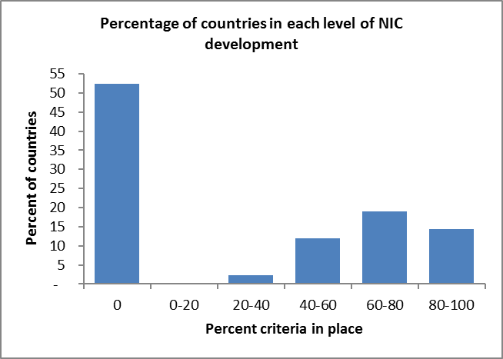

ARCHITECTURE - NATIONAL INTERSECTORAL COMMITTEES
Criteria for scoring
Involve state actors
Involve non-state actors (NGOs, CBOs and academia)
Involve private sector
Promote an enabling environment
Have a clear mandate
Document activities
Regular review, evaluation, learning and adaptation
Integrate sectors and actors at the national level
Function as national - regional linkage

Slide 8
FISHERIES - PROCESS

Slide 9
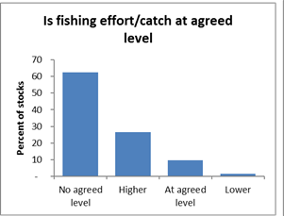
FISHERIES - SYSTEM PRESSURE
Is fishing effort/catch at the agreed upon level for the region/subregion? Percentage of stocks in each category: 0 = no agreed level 1 = effort/catch higher 2 = at agreed level 3 = effort/catch lower
Is the use of destructive gear minimised for each of the key fisheries? Percentage of stocks in each category: 0 = Not an issue 1 = Destructive gear not minimised 2 = Destructive gear minimised
Has IUU fishing been minimised Percentage of stocks in each category: 0 = Not an issue 1 = IUU not minimised 2 = IUU minimised

Slide 10
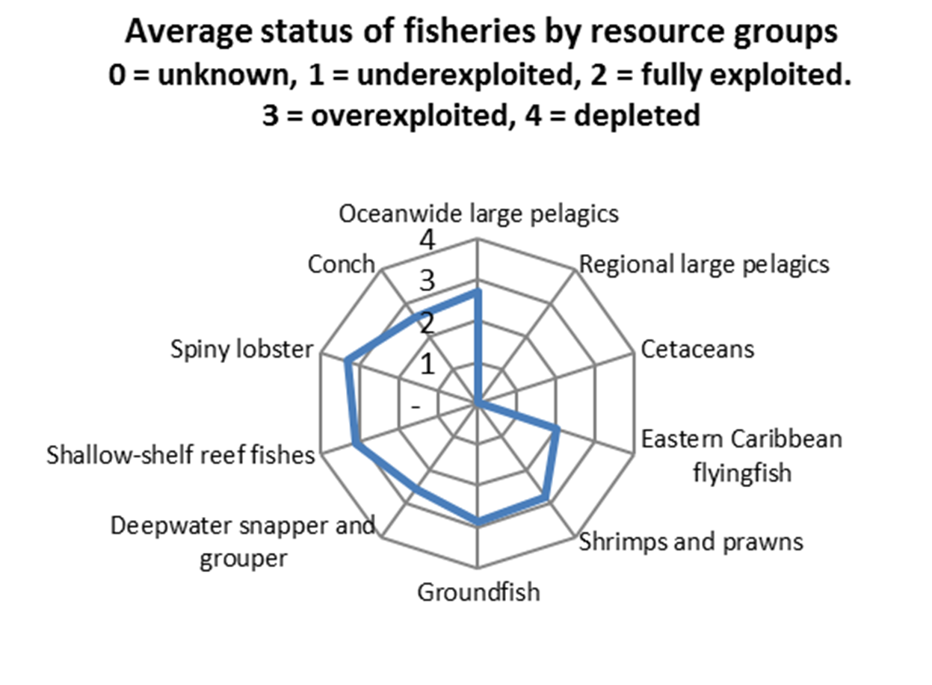
FISHERIES - SYSTEM STATE

Slide 11
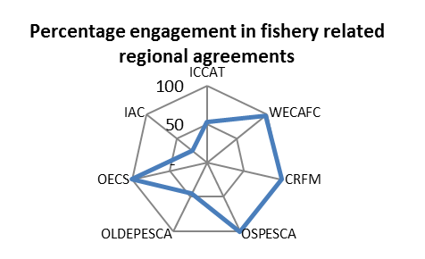
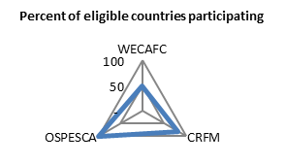
FISHERIES - STAKEHOLDER ENGAGEMENT IN PROCESSES
F27. Countries participating in fisheries processes
F28. Other regional IGOs engaged?
F29. Regional fisheries NGOs engaged?
F30. IGOs participating in NGO processes?
F31. Regional private sector engaged?
F32. Regional environmental NGOs engaged?

Slide 12
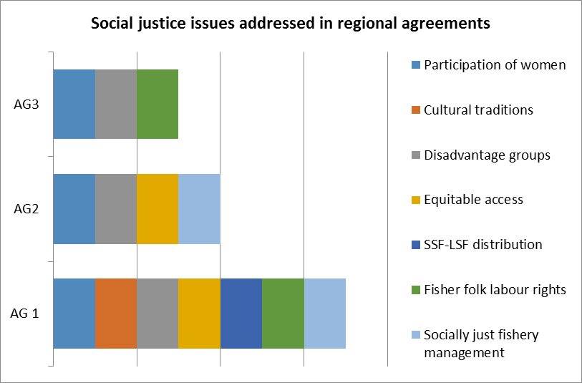
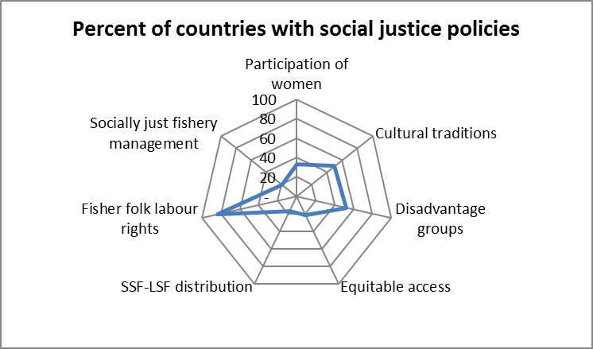
FISHERIES - SOCIAL JUSTICE
F33. Regional fisheries agreements refer to social justice issues
F34. National policies for participation of women?
F35. National policies for preservation of cultural traditions?
F36. National policies for disadvantaged groups?
F37. National policies for equitable access to the resource?
F38. National policies for distribution between SSF and LSF?
F39. National policies for fisher folks labour rights?
F40. National measures to reduce fishing pressures socially just?

Slide 13
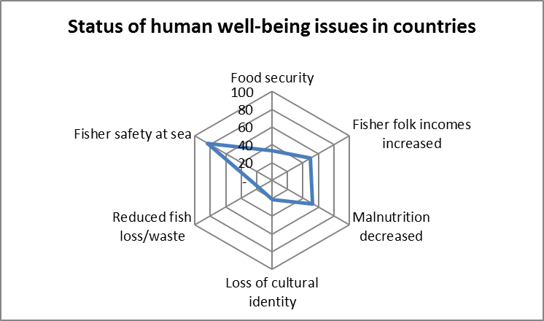
FISHERIES – HUMAN WELL-BEING
F41. Regional fisheries agreements refer to human well-being issues.
F42. Food security been improved/assured?
F43. Fisher folk incomes increased?
F44. Malnutrition in fishing communities decreased?
F45. Loss of cultural identity reduced?
F46. Measures to reduce fish loss/waste?
F47. Measures for fisher safety at sea

Slide 14
CURRENT ACTIVITIES
Interaction is ongoing with:
Project Partners to determine data and information availability
Lead agencies of the four CLME+ Subprojects to develop a GEAF approach for monitoring advances towards EBM/EAF.
SOMEE Report to include GEAF indicators and supporting text.

Slide 15
WAY FORWARD AND NEXT STEPS
Indicator development, data gathering and entry will continue until all baseline data have been obtained, both at regional level and for the CLME+ EBM/EAFSubprojects.
Expected to be finalized by the end of the first quarter of 2019.
Uptake of GEAF outputs into SOMEE with supporting narrative and documentation will continue throughout SOMEE development.

Slide 16
The PSC is invited to
note the progress with the development of the GEAF indicator framework, and
encourage key IGOs and countries from the CLME+ region to provide feedback on the GEAF as it is being further developed, as well as
provide the data needed to complete the baseline and the evaluation of SAP implementation progress to date.

Slide 17
THANK YOU
Catalyzing implementation of the Strategic Action Programme for the Caribbean and North Brazil Shelf LME’s (2015-2020)

