Slide 1

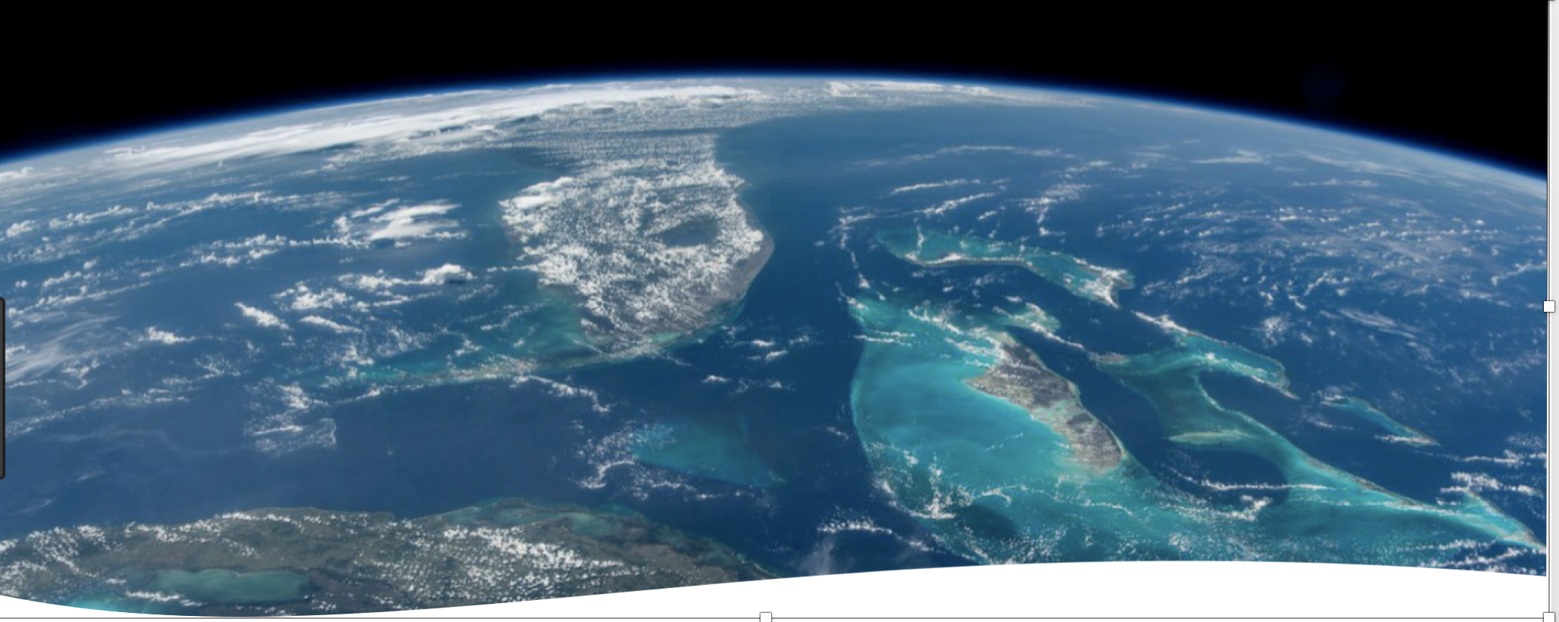
PANAMA JUNE 2018
Catalyzing implementation of the Strategic Action Program for the Caribbean and North Brazil Shelf LME’s (2015-2020)
MID TERM EVALUATION
PRELIMINARY FINDINGS AND RECOMMENDATIONS
By Andrea Merla
UNOPS consultant
By Andrea Merla, UNOPS consultant

Slide 2
PURPOSE OF THE MID TERM EVALUATION
The MTR will assess progress towards the achievement of the project objectives and outcomes as specified in the Project Document and assess early signs of project success or failure with the goal of identifying the necessary changes to be made in order to set the project on-track to achieve its intended results. The MTR will also review the project’s strategy, its risks to sustainability.
The MTR will provide evidence-based information that is credible, reliable and useful.

Slide 3
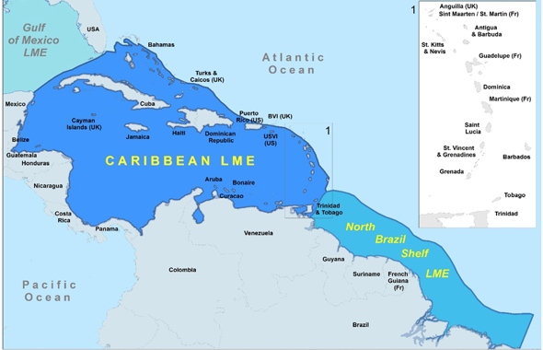
TIMING OF THE MID TERM EVALUATION
Contract signed Field mission SC Meeting Drafting of the MTR report Delivery of Final Report
May 2018 1st week of June Panama October 2018

Slide 4
THE PROJECT STRATEGY: FROM OUTCOMES TO IMPACTS
Objective: Facilitating EBM/EAF in the CLME⁺ for the sustainable and climate-resilient provision of goods and services from shared living marine resources, in line with the endorsed CLME⁺ SAP
Outcomes | Assumptions and Drivers | Intermediate state | impacts
 |  |  | Reduced environmental threats | Environmental benefits
SHORT TERM
MEDIUM TERM
LONG TERM

Slide 5
The project outcomes
After the project
ASSUMPTION:
ALL COUNTRIES & STAKEHOLDERS REMAIN COMMITTED TO SAP VISION
IMPACTS:
STRESS ON
FISHERIES
REDUCED
FISHERIES
DEGRADATION TRENDS REVERSED AND CLIMATE RESILIENCE ENHANCED
GLOBAL ENVIRONMENTAL BENEFITS ACCRUE FROM MULTI COUNTRY COOPERATION
OVERARCHING
REGIONAL GOVERNANCE
FACILITATED
2. ENHANCEMENT OF CAPACITY
& POLICY TOOLS PROVIDED
3. EFFECTIVENESS OF EBM AND EAF DEMONSTRATED IN PILOT SITES
4. PRIORITY INVESTMENT NEEDS IDENTIFIED
5. CURRENT STATE AND
MONITORING
PROTOCOLS DEFINED
INTERMEDIATE
STATE:
REPLICATION OF SOUND EBM PRACTICES
ICM OR EQUIVALENT BODY TAKES OVER COORDINATION OF SAP IMPLEMENTATION
DRIVERS:
FULL RECOGNITION
BY ALL STAKEHOLDERS OF THE NEED FOR ACTION
INCENTIVES PROVIDED BY REGIONAL COOPERATION
SHORT TERM
MEDIUM TERM
LONG TERM

Slide 6
PROJECT ARCHITECTURE
MOVING TOWARDS AN AMBITIOUS OBJECTIVE
ACCELERATING SAP IMPLEMENTATION
1. INTERIM COORDINATION MECHANISM
2. POLICY TOOLS (STRATEGIES)
5. TOOLS FOR ENABLING MONITORING PROGRESS TO BROADER ADOPTION AND IMPACTS
1. PERMANENT POLICY COORDINATION MECHANISM
Global Partnership for the implementation of the CLME+ Strategic Action Program”.
REGION WIDE ARRANGEMENTS FOR SUSTAINABLY FINANCED MECHANISMS FOR ECOSYSTEM BASED MANAGEMENT OF LIVING MARINE RESOURCES
CLME⁺ implementation partnerships with: COUNTRIES, UNDP, FAO-WECAFC, UNEP CEP, IOC of UNESCO CRFM, OSPESCA, CANARI, UWI-CERMES, NOAA, OECS, GCFI
Prospective talks on partnerships with: TNC, WWF, CI, IUCN (BIOPAMA), Caribsave, Smithsonian, UNEP ROLAC, CCAD, CCCC, CARPHA, IMO, World Bank, a.o.; Declarations of Intent from TNC, WWF, CI, CCAD.
Prospective talks with dependent territories and other partners (private sector, etc.)
1. COMMUNICATION WITHIN AND BEYOND THE CLME+ PARTNERSHIP
4. INVESTMENT NEEDS IDENTIFIED
3. COUNTRIES TEST EBM/EAF EFFECTIVENESS

Slide 7
COMPLEX EXECUTION ARRANGEMENTS REFLECTING THE GEOGRAPHIC AND POLITICAL DIVERSITY OF THE REGION, AND ITS MULTIPLE LEVELS OF MARINE GOVERNANCE FRAMEWORKS
21 PROJECT BENEFICIARY COUNTRIES:
GEF-eligible countries: Antigua and Barbuda, Barbados, Belize, Brazil, Colombia, Costa Rica, Dominica, Dominican Republic, Grenada, Guatemala, Guyana, Haiti, Honduras, Jamaica, Mexico, Panama, St. Kitts and Nevis, Saint Lucia, St. Vincent and the Grenadines, Suriname, Trinidad and Tobago. Non-GEF-eligible country: United States of America
EXECUTING PARTNERS: INTERGOVERNMENTAL BODIES
WECAFC (FAO), OSPESCA, CRFM, OECS, UNESCO IOC, CAR/RCU (UN
ENVIRONMENT)
CLME & NBSLME
13 CONTINENTAL COUNTRIES
14 SIDS
14 TERRITORIES
4 REGIONAL POLITICAL ECONOMIC GROUPINGS: OECS, CARICOM, SICA, ACS
UNDP
GEF
AGENCY
UNOPS
EXECUTING AGENCY
PCU
(UNOPS)
EXECUTING PARTNERS: NGOS AND RESEARCH INSTITUTIONS
CERMES, CANARI, GCFI, CNFO
Procurement
Responsible vis a vis UNDP
Responsible vis a vis GEF
Overall Coordination and execution of some activities
COMMUNICATION FLOW IS UNSATISFACTORY

Slide 8
Notwithstanding the complexity and diversity of the region, multi country cooperation in the application of EBM/EAF is crucial for the continuing health of the transboundary living marine resources
of the two LMEs

Slide 9
TIMELINE
PROJECT DOCUMENT
ENDORSED BY GEF
PROJECT BECOMES OPERATIONAL
1ST STEERING COMMITTEE
2ND STEERING COMMITTEE
FORESEEN PROJECT COMPLETION
MARCH 4TH 2015
JAN.26TH 2016
JUNE 18TH 2018
AUGUST 2020
MAY 2015

Slide 10
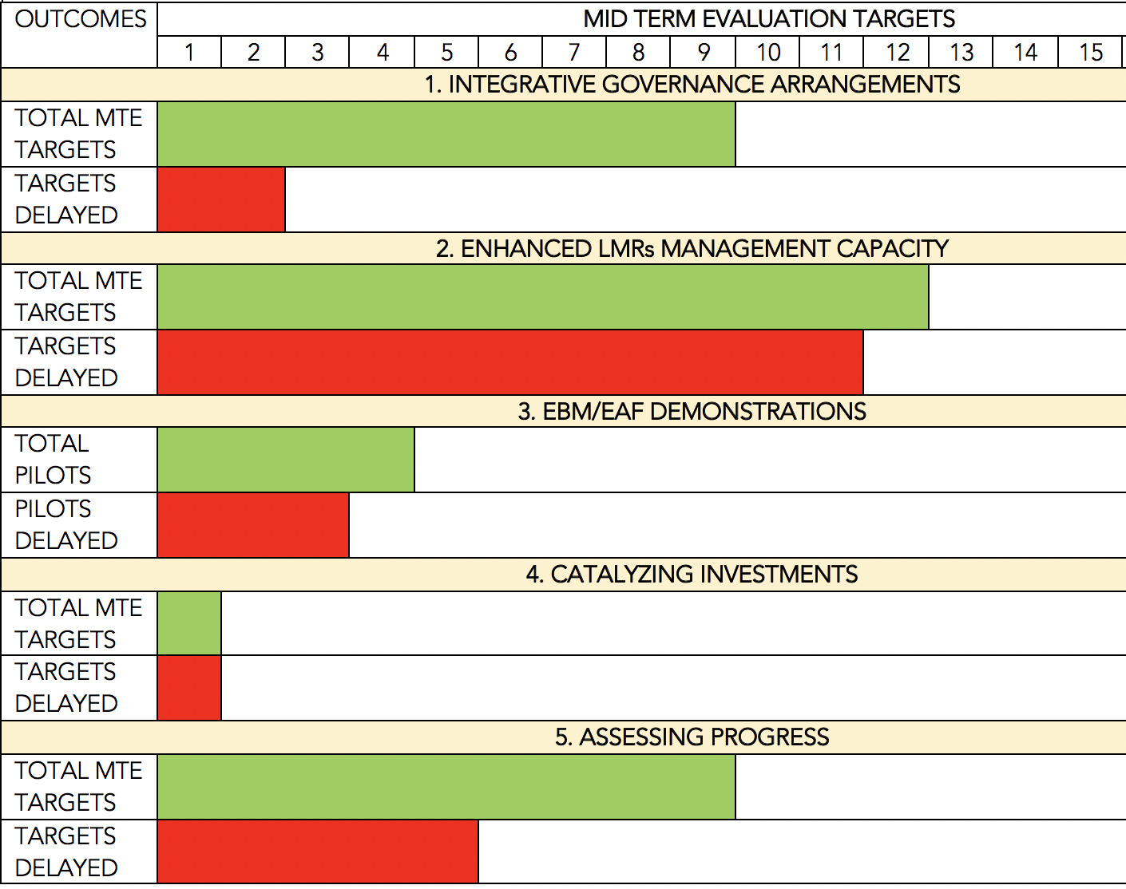
MEETING PROJECT
MID TERM TARGETS
OF THE TOTAL 33 MID TERM TARGETS, ONLY 12 HAVE BEEN MET
3 OF THE 4 PILOT SUB-PROJECTS ARE SERIOUSLY DELAYED

Slide 11
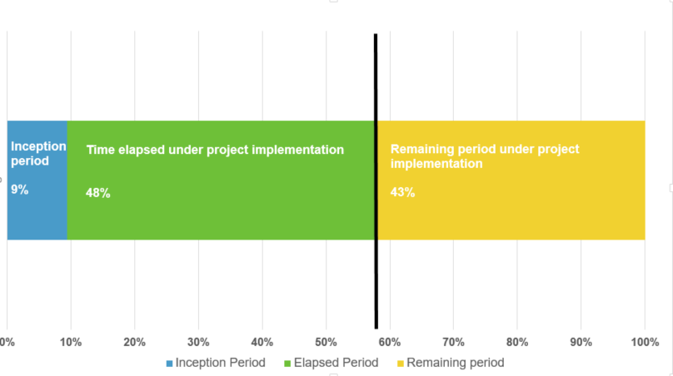
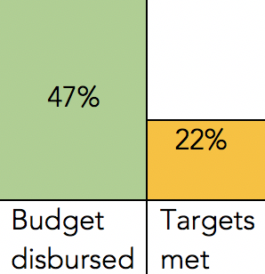
DISBURTSEMENT OF OF GEF FUNDS
May 2015
Today
August 2020
At Mid Term, 47% of the total GEF fund has been spent or transferred to partners, and only 22% of the total 56 targets has been met

Slide 12
DISBURSEMENTS of GEF FUNDS (1000’s of USD)
UN Environment 2nd installment,
FAO IAA 1st instalment
& OSPESCA (Spiny lobster) 2nd installment
UN Environment 1st installment, WECAFC Meeting, Communication Strategy Workshop
CRFM (Flying fish) 2nd instalment, CANARI 3rd and 4th instalment and CERMES 3rd instalment
OSPESCA (Spiny Lobster),
CRFM (Communication Specialist)
& GCFI (Research Strategies)
1st installments

Slide 13
COUNTRY OWNERSHIP AND PARTICIPATION
PROJECT NATIONAL FOCAL POINTS
COUNTRY REPRESENTATIVES IN THE GOVERNING G BODIES OF REGIONAL INTERGOVERNMENTAL ORGANIZATIONS: WECAFC (FAO), OSPESCA, CRFM, OECS, UNESCO IOC, CAR/RCU (UN ENVIRONMENT)
NATIONAL GEF FOCAL POINTS
PARTICIPATE TO STEERING COMMITTEE MEETING AND TO PROJECT EXECUTION DECISIONS
OVERSEE TECHNICAL AND FINANCIAL PROJECT PERFORMANCE
ENDORSE THE PROJECT DOCUMENT AND BASED ON ACHIEVEMENTS MAY ENDORSE FOLLOW UP ACTIONS
PARTICIPATE IN THE DECISION MAKING PROCESSES FOR THE ADOPTION OF POLICIES AND DOCUMENTS PROMOTED/PRODUCED BY THE PROJECT
NEED FOR IMPROVED COMMUNICATION

Slide 14
RECOMMENDATIONS
The need for an extension: ongoing discussion. The key consideration that should guide the discussion: will countries have sufficient time to take informed decisions on all major outputs?
Even considering an extension, there needs to be a substantial acceleration in delivery from all actors, starting from the UNOPS Headquarters to all Executing Partners, in particular the major ones: FAO and UN Environment.

Slide 15
RECOMMENDATIONS
Ensure that all outputs which are key for the success of the project are fully delivered:
overarching governance and related management tools and policies (State of the Environment reporting system and monitoring of key indicators; various strategies );
broadened partnership among countries and economic sectors;
agreement on priority investments, reflecting the impacts on the LMRs of the conflicts at the food security, coastal and marine environment nexus. Focus on the key investment: Alternative livelihoods

Slide 16
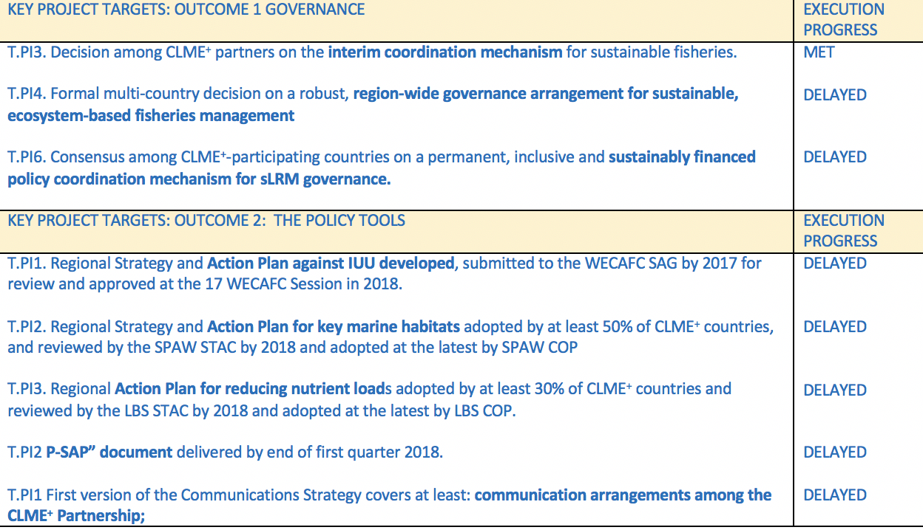

Slide 17
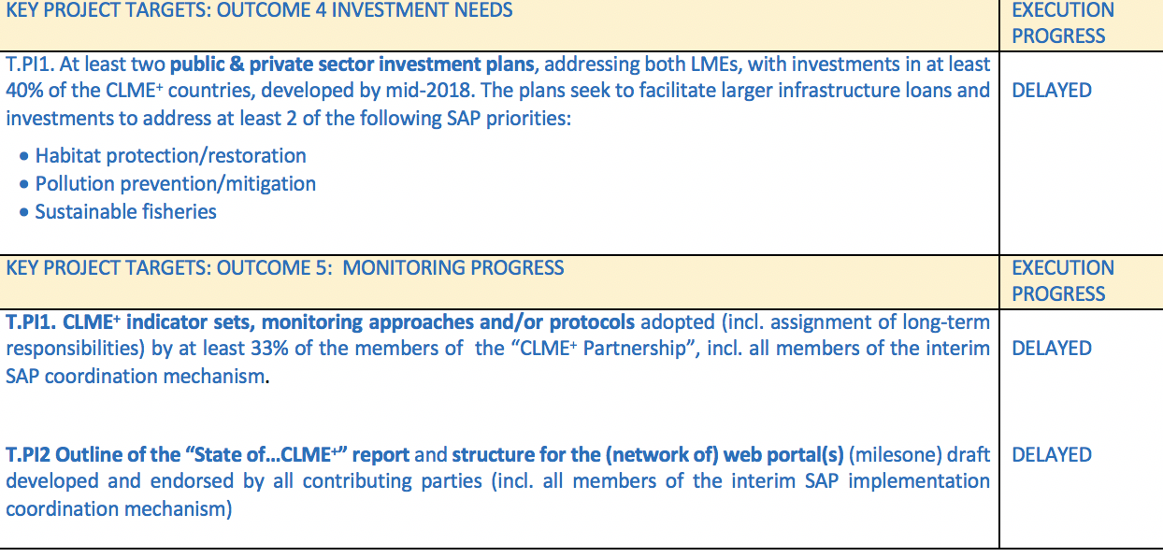

Slide 18
RECOMMENDATIONS
THE ACHIEVEMENT OF THE PRINCIPAL PROJECT OUTCOME – COUNTRIES TAKING CONCRETE STEPS TO MOVE TOWARDS COORDINATED AND SUSTAINABLE REGION-WIDE ECOSYSTEM BASED APPROACHES FOR THE MANAGEMENT OF THEIR SHARED LIVING MARINE RESOURCES – MIGHT BE IN JEOPARDY UNLESS BENEFICIARY COUNTRIES SHOW THEIR COMMITMENT TO PURSUE THIS LONG TERM GOAL BY TAKING SWIFT AND BOLD DECISIONS CONCERNING THE LENGTH OF THE EXTENSION, AND THE POSSIBLE REDISTRIBUTION OF PROJECT FUNDING. SUCH SUSTAINED COMMITMENT WILL LIKELY OPEN THE WAY TO FURTHER GEF SUPPORT.

Slide 19

RECOMMENDATIONS
Consider moving towards the full adoption of the source to sea approach to the governance of LMEs, bringing the coastal zone and basins draining to the sea into the Cartagena Convention framework and mechanisms.

Slide 20
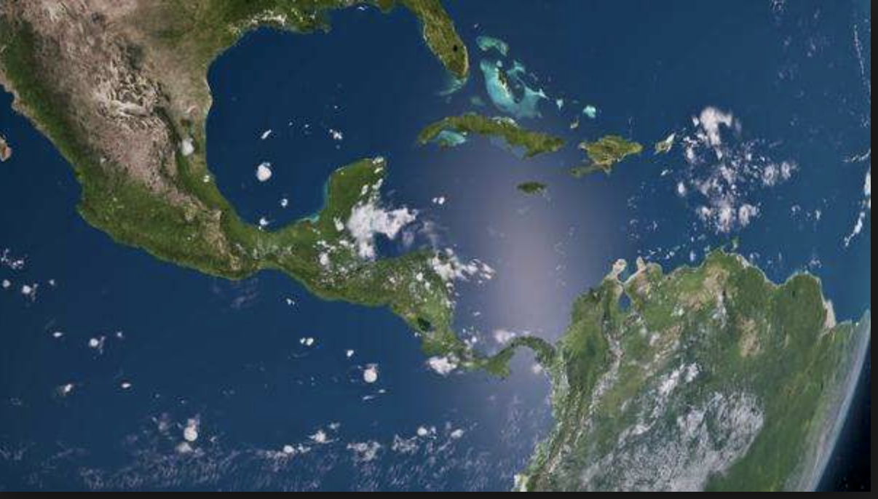
THANK YOU

