Slide 1

Mid-Term Project Steering Committee Meeting, 18-20 June 2018, Panama
Agenda Item # 9
The CLME+ Partnership & Alliance
Catalyzing implementation of the Strategic Action Programme for the Caribbean and North Brazil Shelf LME’s (2015-2020)

Slide 2
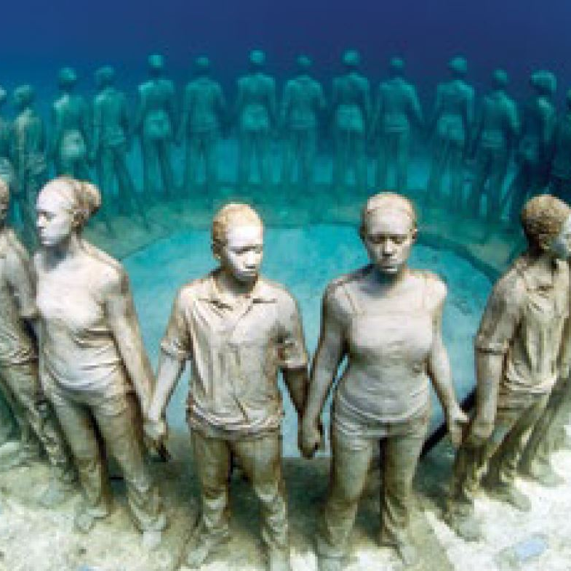

Outline
Mandate
Existing global experiences
Partnership & Alliance explained
Partnership: Core and Subscribing Members
Terms of Reference (TORs)
Current Status
Prospective Partnership Members
1st CLME+ Partnership Forum – September 2018

Slide 3
MANDATE
The CLME+ SAP
The CLME+ SAP
“has been developed as an umbrella Programme (…).
By enhancing the cooperation and coordination across the region and among organisations, countries, sectors and people, it will establish the enabling conditions for substantial synergies.”

Slide 4
MANDATE
The CLME+ PROJECT DOCUMENT
“Insufficient communication, coordination and information exchange among primary stakeholders and among the myriad of existing and planned projects, activities and initiatives in the region constitutes an important barrier to fully achieving societal and environmental benefits.
The establishment of a “Global Partnership for the implementation of the CLME+ Strategic Action Programme” (the “CLME+ Partnership”) is therefore explicitly called for under
COMPONENT 5 of the CLME+ Project Results Framework

Slide 5
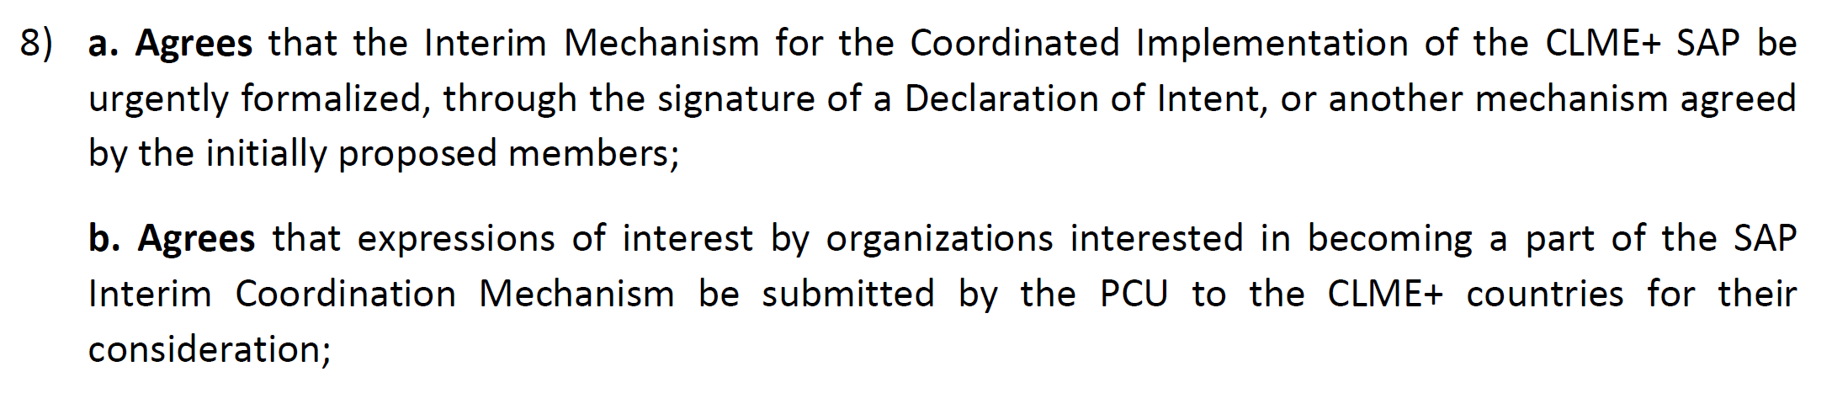
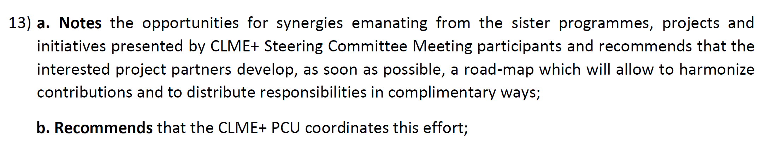
MANDATE
DECISIONS FROM THE 1st CLME+ PROJECT STEERING COMMITTEE

Slide 6
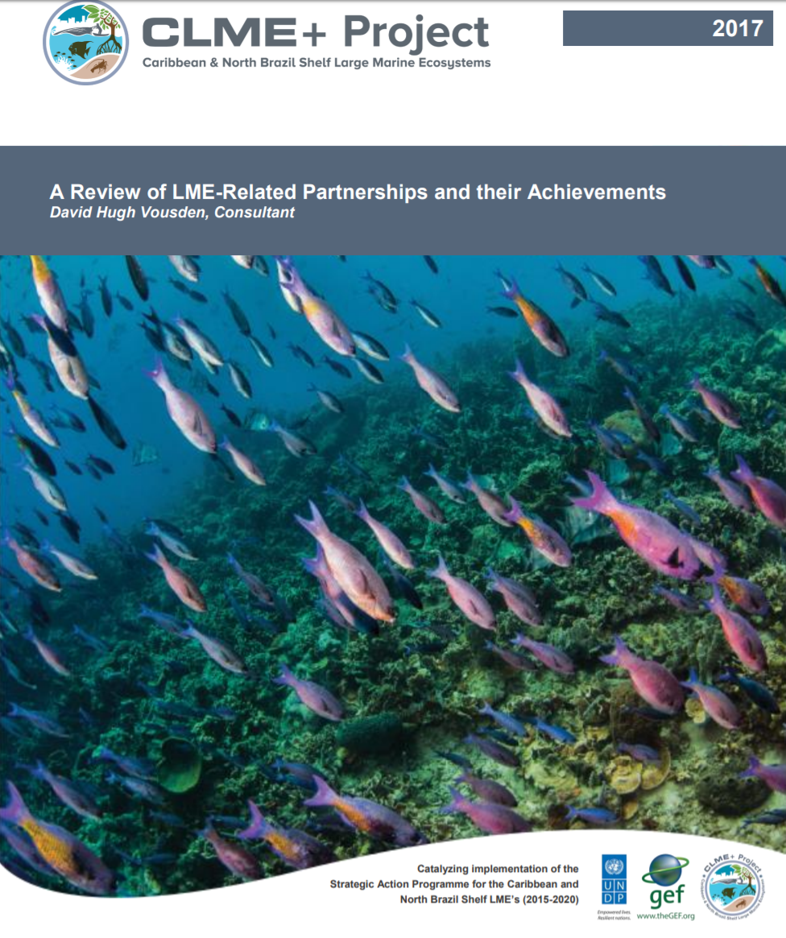
REVIEW OF EXISTING EXPERIENCES
Sargasso Sea Alliance/Commission
Partnerships in Environmental Management for the Seas of East Asia (PEMSEA)
Western Indian Ocean Sustainable Ecosystem Alliance
MedPartnership
SIDS Partnership
OSPAR
Antarctic Ocean Alliance
Antarctic and Southern Ocean Coalition
High Seas Alliance
Deep Sea Conservation Coallition
ALLFISH

Slide 7
PEMSEA = Partnerships in Environmental Management of the Seas of East Asia
A partnership of public, civil society, corporate and other stakeholders.
PEMSEA MEMBERSHIP
Country Partners: Cambodia, China, Indonesia, Japan, Laos, North Korea, Philippines, South Korea, Singapore, Thailand, Timor-Leste, Vietnam
Non-Country Partners: ASEAN Center for Biodiversity, Conservation International Philippines, Coastal Management Center, IOC Sub-Commission for the Western Pacific, International Ocean Institute, International Environmental Management of Enclosed Coastal Seas Center, International Union for Conservation of Nature (Asia Regional Office), Korea Environment Institute, Korea Maritime Institute, Korea Ocean Research and Development Institute, Northwest Pacific Action Plan, Ocean Policy and Research Foundation, Oil Spill Response, Plymouth Marine Laboratory, Swedish Environmental Secretariat for Asia, UNDP/GEF Small Grants Programme, UNEP Global Programme of Action, UNDP/GEF Yellow Sea LME Project.

Slide 8

GLOBAL PARTNERSHIP & ALLIANCE
FOR THE SUSTAINABLE MANAGEMENT,
USE AND PROTECTION
OF THE CARIBBEAN
AND NORTH BRAZIL SHELF
LARGE MARINE ECOSYSTEMS

Slide 9
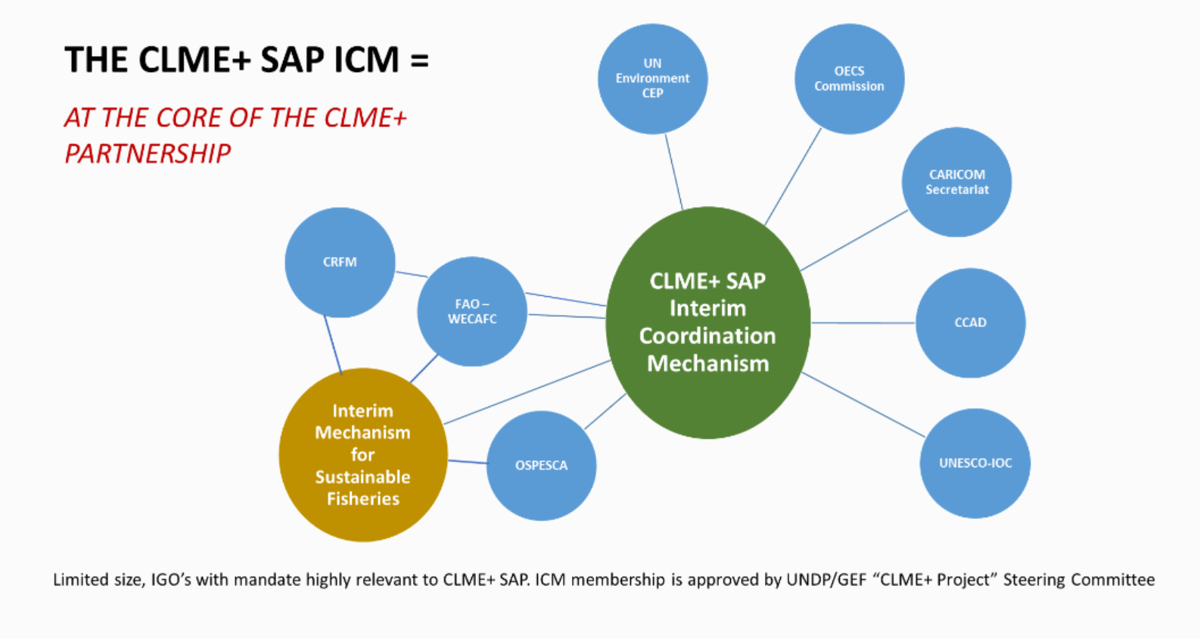
At the Core of the CLME+ PARTNERSHIP
established July 2017:

Slide 10
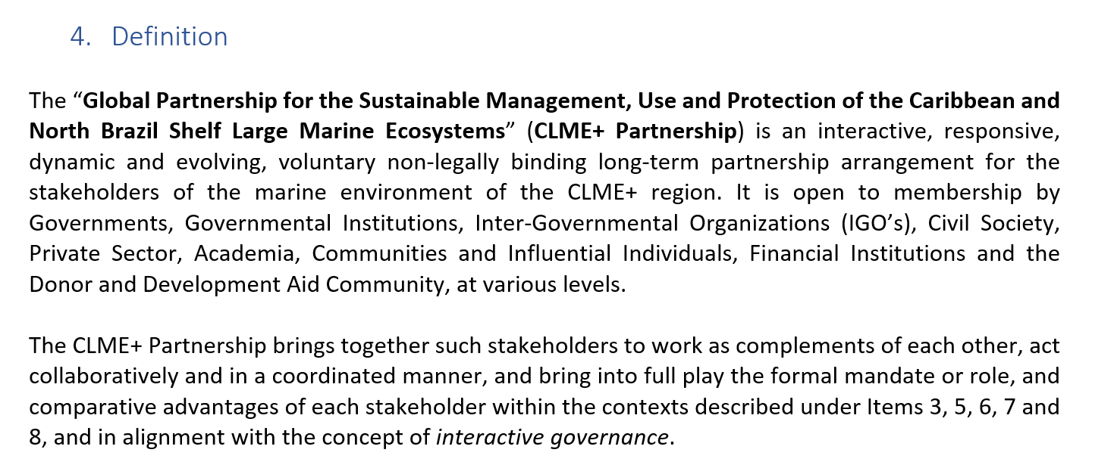
PARTNERSHIP TORs

Slide 11
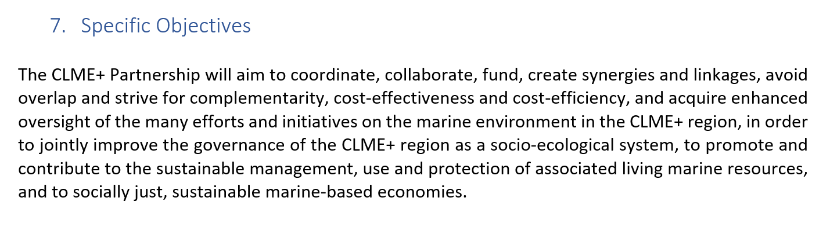
PARTNERSHIP TORs

Slide 12
THE CLME+ PARTNERSHIP
“subscribing” members (online pledge + TORs)
Partners who FORMALLY AGREE to
collaborate and coordinate
with the Core Membership
THE CLME+
PARTNERSHIP
CLME+ SAP, C-SAP, P-SAP
Programmes, Projects & Initiatives
Regional Action & Investment Plans
Work Programmes of the ICM/RGF’s IGO’s
CLME+ SOMEE
CLME+ HUB
Core membership
NGO’s,
Private Sector,
Development Banks, Donor community…
CLME+ SAP Interim Coordination Mechanism (ICM)
+
countries that endorsed the SAP

Slide 13
PARTNERSHIP TORs
MEMBERSHIP:
“Core Members”:
ICM members
Countries that have endorsed the CLME+ SAP
“Subscribing Members”:
By invitation:
ICM Secretariat (CLME+ PCU) invites prospective member
Based on recommendations from/requests by the ICM/Countries?
Prospective members submit online Membership request
Secretariat screens & approves memberships

Slide 14
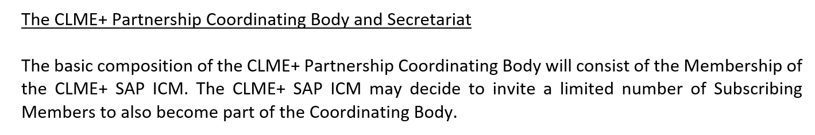
THE CLME+ PARTNERSHIP
COORDINATING BODY: CLME+ SAP ICM
SECRETARIAT: CLME+ PCU, for the duration of the CLME+ Project
PARTNERSHIP TORs: developed by PCU/Secretariat
ENDORSED by ICM
MEMBERSHIP FORM: developed by PCU/Secretariat
ENDORSED by ICM

Slide 15
SUBSCRIBING MEMBERS
Subscription & Acceptance process:
Save in the case of the Core Members, who can become members by virtue of either their endorsement of the CLME+ SAP or their participation in the CLME+ SAP ICM, Membership of the CLME+ Partnership is formalized through the online registration by the prospective member of a pledge, called the “CLME+ Partnership Membership Pledge”, and the subsequent acceptance of this pledge by the Secretariat. For this purpose, the Secretariat will provide the prospective member with access to an online registration form.
Modalities for:
renewal / expiration
withdrawal / removal
defined under the Partnership TORs

Slide 16
SUBSCRIBING MEMBERS
FIRST ROUND OF INVITATIONS (PROPOSAL FOR ICM/PSC):
UN ORGANIZATIONS: UNDP GEF, UN Environment ROLAC, UN ECLAC, UNDP SGP
other IGO’S: ACS/CSC, 5Cs, CARPHA, CBC, COMMONWEALTH?
DEVELOPMENT BANKS: WORLD BANK, IADB
DONORS/FUNDS: GEF, CBF (EU?) (BILATERALS?)
NGO’S/ACADEMIA: UWI-CERMES, CANARI, GCFI, TNC, WWF, CI, IUCN, INVEMAR,…
PRIVATE SECTOR: CNFO, ???
PROJECTS???
INFLUENTIAL INDIVIDUALS:
OTHERS?
Blue Innovation Institute?

Slide 17
THE CLME+ PARTNERSHIP
LAUNCHING THE PARTNERSHIP:
ESTABLISH CLME+ SAP ICM
ACCEPTANCE OF TORS BY MIC/CORE MEMBERSHIP
ACCEPTANCE OF SUBSCRIPTION FORM BY MIC/CORE MEMBERSHIP
COMMUNICATE LAUNCH TO SELECTED PROSPECTIVE PARTNERS, AND PROVIDE OPPORTUNITY TO SUBSCRIBE
IMPLEMENT CLME+ HUB SOLUTIONS ALLOWING PARTNERSHIP MEMBERS TO FEATURE THEIR WORK
M&E MECHANISM
LINK WITH OTHER GLOBAL INITIATIVES/COMMITMENTS?

Slide 18
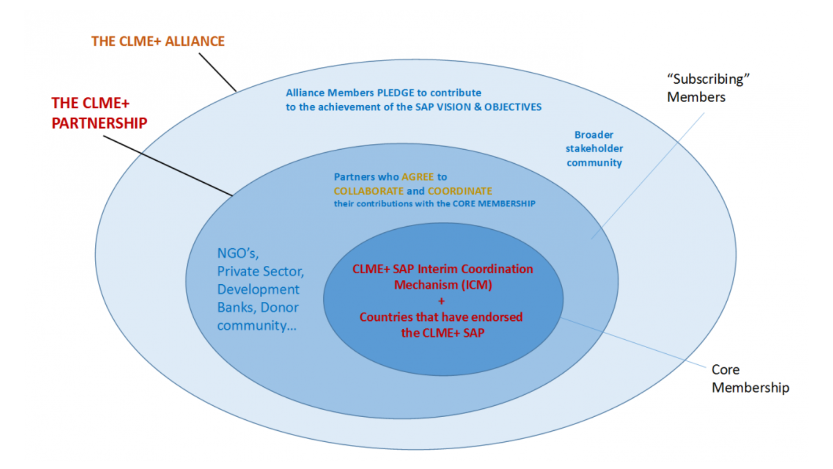
THE CLME+ PARTNERSHIP vs. (&) ALLIANCE

Slide 19
ALLIANCE and PARTNERSHIP
PLEDGE / SUBSCRIPTION FORM (non-Core Members)
[name prospective member]:
subscribes to the long-term vision for the CLME+ region, articulated in full under the 10-year CLME+ Strategic Action Programme (CLME+ SAP) as: “healthy marine ecosystems (….) which (…) maximizes (…)the provision of goods and services (…) enhanced livelihoods and human well-being”;
commits to support implementation of the United Nation’s 2030 Agenda for Sustainable Development, in particular (but not limited to) incremental progress towards SDG 14 (…);
pledges to actively contribute to the improved health of the marine ecosystems in the CLME+ region and the sustainable use and/or protection of associated living resources, as well as to support, and/or undertake actions, to ensure the continuity of essential ecosystem services provided by the region’s marine environment;

Slide 20
PARTNERSHIP only
agrees to become a Subscribing Member of the CLME+ Partnership, and hereby commits to engage, actively support and/or collaborate with the Core Membership and other Subscribing Members towards the achievement of the Partnership’s Mission, Goal and Objectives;
acknowledges that the Terms of Reference (TORs) for the Global Partnership for the Sustainable Management, Use and Protection of the CLME+ region (…) establish and specify the general conditions that govern the Membership and operations of the CLME+ Partnership;
accepts (…) to respect and act in accordance with these ToRs;
understands that (…) the Partnership relies on the spirit of mutual trust and respect, and on open dialogue as well as on collaboration among multiple stakeholders (…);
commits to this spirit and shared values;

Slide 21
1st CLME+ PARTNERSHIP FORUM
24-25 September 2018: PPCM & SFP consultation with CLME+ countries
26-27-28 September 2018: Partnership Forum
Keynotes
Plenaries
Work Sessions:
CLME+ SOMEE
Regional Action & Investment Plans
Private Sector Engagement
MSP
…
TWINNING WITH PEMSEA SUPPORTED THROUGH IW:LEARN

Slide 22
THANK YOU
Patrick Debels
CLME+ Regional Coordinator
PatrickD@unops.org
Catalyzing implementation of the Strategic Action Programme for the Caribbean and North Brazil Shelf LME’s (2015-2020)

