Slide 1
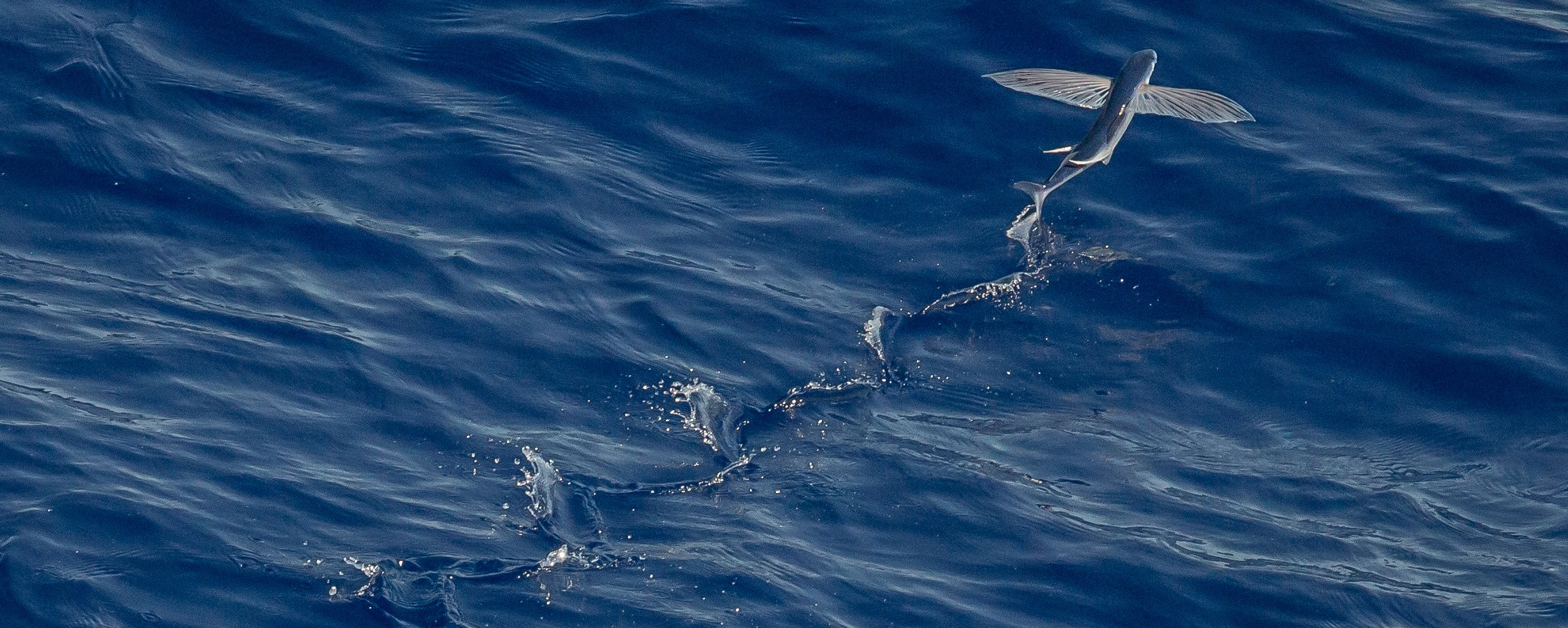

Mid-Term Project Steering Committee Meeting, 18-20 June, Panama
CLME⁺ Sub-Project # 3:
EAF for the Eastern Caribbean Flyingfish
    CRFM report to second meeting of CLME+ PSC
Catalyzing implementation of the Strategic Action Programme for the Caribbean and North Brazil Shelf LME’s (2015-2020)

Slide 2
Introduction
Overview of Organisation
The CRFM is an inter-governmental organization that was inaugurated on March 27, 2003, in Belize City, where it is headquartered, following the signing of the “Agreement Establishing the CRFM” on February 4, 2002.
The goal is to establish appropriate measures for: the conservation, management, sustainable utilisation and development of fisheries resources and related ecosystems; building of capacity amongst fishers and optimisation of the social and economic returns from their fisheries; and promotion of competitive trade and stable market conditions.
The mission is to promote and facilitate the responsible utilization of the region’s fisheries and other aquatic resources for the economic and social benefits of the current and future population of the region.

Slide 3

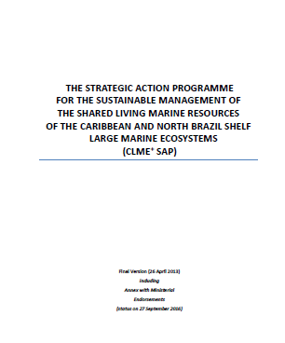
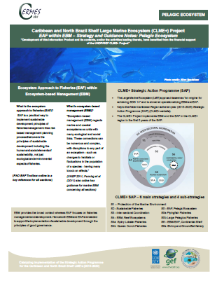
Introduction
Component #: 3 Implementing EBM/EAF in the CLME⁺ region
Output 3.3. (O3.3.) Well-planned, progressive transition to an ecosystem approach for the eastern Caribbean flyingfish fisheries

Slide 4
Status technical implementation:
Status financial expenditure
On track | Moderate Delays | Major Delays
X
On track | Moderate Delays | Major Delays
 | X
Notes:
The apparent/possible delays in expenditure are a function of the contractual arrangements for payments to consultants

Slide 5
Project Implementation Overview
Category | Ratio
Completed | 1/47 of targets
On track | 39/47 of targets
Low risk of not completing on time | 3/47 of targets
High risk of not completing on time | 3/47 of targets
High risk of target not being achieved | 1/47 of targets
Notes:
Note: Context for determining on track is whether the target will be achieved by end-of-project (this, given that sub-project timeline was not as actually stated in overall project logframe)
CRFM engagement in FIRMS-WECAFC Partnership is occurring and on-going; so, as the target has been stated, it can be considered “completed”
Initial (baseline) KAP surveys for output 3.1 and 3.2 are completed, but as stated the target is still “on track”

Slide 6
Achievements to Date
Achievements
Review and analysis of FMP implementation, completed and utilised to provide a basis for further development of recommendations
Preliminary suite of recommendations proposed for Updating the Eastern Caribbean Flyingfish Fishery Management Plan
CRFM engagement in FIRMS-WECAFC Partnership is on-going
DRAFT CRFM-France Cooperation Agreement prepared
Updated stakeholder identification and analysis of key regional and selected national stakeholders in the Caribbean four-wing flyingfish fishery

Slide 7
Achievements to Date
First series of Stakeholder consultative processes, in 4 flyingfish countries, held to facilitate stakeholder input regarding recommendations and cooperation agreement
Communication Plan and Action Plan to enhance stakeholder education and participation
Initial (baseline) KAP surveys completed
Preliminary list of Indicators/reference points, for incorporation into the GEAF-based M&E framework, have been proposed as part of the CLME+ SAP M&E development process

Slide 8
Achievements to Date
Activities in progress
Draft management cooperation agreement being reviewed by in-country consultative process in 4 flyingfish countries (also circulated among participants at the 16th meeting of the Caribbean Fisheries Forum for comments)
Proposal for further development of data policy (with draft outline) being reviewed through in-country consultative process in 4 “flyingfish countries”. Further development of policy on-going
Implementation of Communication Plan to enhance stakeholder education and participation is on-going

Slide 9
Achievements to Date
Pilot version of an online, keyword searchable, bibliographic database provided to Barbados, Trinidad and Tobago and Grenada Fisheries Divisions for initial testing
Discussion is on-going to facilitate further testing of online, keyword searchable, bibliographic database via uploading to/hosting on the CRFM website
In-country consultative process being utilised to contribute to further development of stress reduction measures and indicators

Slide 10
High Risk Targets
Output | High risk of not completing on time | High risk of target not being achieved
Output # 1.2 Active cooperation between CRFM and France at the political level regarding flyingfish (FF) conservation and management, through active participation in negotiation and flyingfish management meetings |  | Active cooperation at the political level during SPY4, reflected in the cooperation arrangements laid out in the updated FMP
Notes:
It may still be possible to get participation of the OTs in the Sub-Committee and/or Council, but this may occur after sub-project is closed
Hence “active participation at the political level” is not likely to be achieved, notwithstanding that technical cooperation is still possible

Slide 11
High Risk Targets
Output | High risk of not completing on time | High risk of target not being achieved
Output # 1.3 Engagement of National Inter-sectoral Committees (NICs) and Fisheries Advisory Committees (FACs) | Annual meetings convened with NICs and FACs Recommendations from NICS/FACS, obtained with Fisher/Civil Society & Private Sector participation, formulated in at least the major harvesting States Participation by French OTs in at least 2 Ministerial Sub-Committee and/or Ministerial Council Meetings during the Sub-Project lifespan
Notes:
NICs/FACs are not really operational in the countries, hence the likelihood of having meetings is low, however the solicitation of recommendations from stakeholders can still take place, though not through these mechanisms. It is in this context the risk is stated as one of completion rather than achievement, given that the target is really to get recommendations from stakeholders

Slide 12
Challenges Being Experienced
# | Challenge | Mitigative Measure | By When
1 | OTs have not participated in any of the meetings within the CRFM governance structure | This will be feasible after the cooperative agreement comes into effect | After approval of Cooperative agreement
2 | NICs/FACs effectively inactive | Recommendations have to be obtained from stakeholders through alternative consultative processes, including “mini-consultations” | Ongoing
3 | Slow response by countries | Constant reminders and communication to multiple targets: sub-project focal points. CFOs, PSs | Ongoing

Slide 13
Financial Implementation
Agency name | 2018 Budget | Amount spent up to April 2018 | 2019 Budget | Risk of not achieving budget objective | Proposed remedial actions
CRFM | 684,788 | 279,114 | 90,090 | Very low | None seen as being necessary

Slide 14
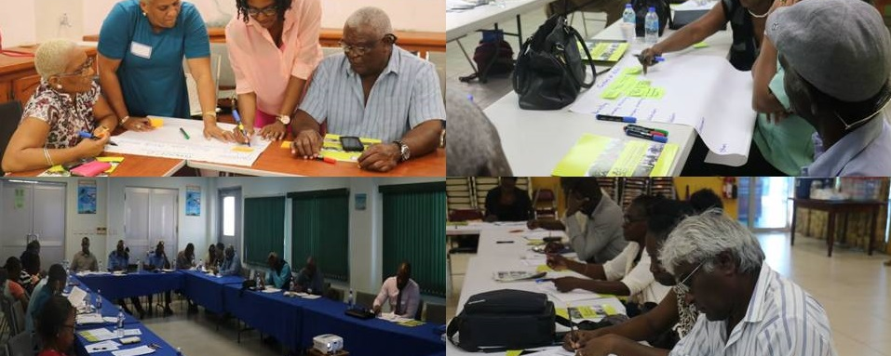
Mid-Term Project Steering Committee Meeting, 18-20 June, Panama
Thank you for your attention
Catalyzing implementation of the Strategic Action Programme for the Caribbean and North Brazil Shelf LME’s (2015-2020)

