Slide 1

CLME+ Project Analysis Results
and Justification for a Proposed Project Extension
Thursday, 28 February 2019
Catalyzing implementation of the Strategic Action Programme for the Caribbean and North Brazil Shelf LME’s (2015-2020)

Slide 2

A REMINDER:
THE PROJECT (DEVELOPMENT) OBJECTIVE
Facilitate Ecosystem-Based Management (…) in the CLME⁺, in order to ensure the sustainable and climate-resilient provision of goods and services from shared living marine resources.
PREPARE COUNTRIES & ORGANIZATIONS
(main Project)
TEST EBM/EAF
(Sub-Projects)
CONSOLIDATE GOVERNANCE ARRANGEMENTS
AND UPSCALE ACTIONS!
(next Project(s))
Catalyzing implementation of the
10-year Strategic Action Programme
for the Caribbean and North Brazil Shelf LME’s
Notes:
Before we start, it is important to be reminded about what the CLME+ Project aims to achieve. The Project Objective is to facilitate Ecosystem-Based Management (EBM) and the Ecosystem Approach to Fisheries (EAF) in the CLME+ region. The Project therefore has as expecte outcomes: (a) creating the capacity among countries and organizations to facilitate EBM/EAF, and (b) the testing of EBM/EAF through a number of Sub-Projects. All of this with the aim of (c) achieving consolidated arrangements for integrated ocean governance by the end of the Project. These must then allow to (d) substantially upscale actions on EBM/EAF in the post-Project era. The Project therefore also contemplates the mobilization of new projects/funds so that activities continue beyond the Project end.

Slide 3
A REMINDER:
THE PROJECT STRUCTURE (COMPONENTS)
COMPONENTS OF THE CLME+ PROJECT
ENHANCE THE GOVERNANCE ARRANGEMENTS
facilitate
C1
C3
C4
DEMONSTRATE EBM/EAF
(prioritize/select – limited $) building on results from C1&2
FEASIBILITY STUDIES – INVESTMENT NEEDS FOR UPSCALING OF RESULTS
BUILD THE CAPACITY TO MAKE EFFECTIVE USE OF THE ENHANCED ARRANGEMENTS
demonstrate
C2
scale-up, replicate
enable
REGION-WIDE
M&E OF SAP IMPLEMENTATION
C5
track progress, foster synergies, avoid duplication, review/revise approach
Notes:
This slide depicts the 5 Components of the Project. Components 1, 2 and 5 relate to enhancing the capacity of organizations and governments; Component 3 provides means to test EBM/EAF through Sub-Projects, and under Component we plan and prepare for the major up-scaling of work after the Project End.

Slide 4
Decisions Mid-Term Project Steering Committee Meeting
AGENDA ITEM 13 – CLME+ PROJECT WORKPLAN AND BUDGET
Takes note of the delays that occurred during the Project Inception Phase, as well as of the recommendation from the PEG to agree to an initial extension of the project duration till 31 August 2020, to accommodate such initial delays
Agrees to such initial extension of the project duration till 31 August 2020, to accommodate the delays which occurred during the Project Inception Phase
Approves the amendments to the CLME+ Project Results Framework in alignment with this initial extension, as outlined under CLME+ Project Steering Committee Meeting Document AgendaItem13v180703, and requests that this document be disseminated to the PSC together with the Meeting Decisions
Notes:
This slide and the next 2 slides outline decisions of the Project Steering Committee in relation to the CLME+ Project Work Plan and Budget during the CLME+ Mid Term Steering Committee Meeting which took place in June 2018.

Slide 5
Decisions Mid-Term Project Steering Committee Meeting
AGENDA ITEM 13 – CLME+ PROJECT WORKPLAN AND BUDGET
Approves the CLME+ revised budget for the period 1 January 2018 – 31 August 2020 as presented
Agrees to defer a decision related to a further extension for the CLME+ Project to accommodate further delays during the 2016-2018 period until the first quarter of 2019, with the understanding that such decision will be based on the review by the Project Steering Committee of the assessment provided by the PCU of implementation progress by 31 December 2018.
Urges the Co-Executing Partners to submit the information on implementation progress under such revised plans to the PCU by latest 31 December 2018

Slide 6
Decisions Mid-Term Project Steering Committee Meeting
AGENDA ITEM 13 – CLME+ PROJECT WORKPLAN AND BUDGET
a. Requests that the PCU submits a report to the Project Steering Committee during January 2019, detailing, as applicable, (a) the proposed length of the extension, (b) the proposed associated budget revisions, and (c) detailing the anticipated impacts of such revisions on the CLME+ Project Outputs, and requesting their consideration of such proposals
b. Agrees that the Project Steering Committee be given one month from the date of delivery of the PCU’s report to review the proposals and provide their agreement in writing, and acknowledges that any member country that does not respond in writing within the specified timeframe will be understood to be in agreement with the recommendation outlined by the PCU.

Slide 7
Analysis Methodology
PCU requests Co-Executing Agencies (CEAs) to undertake an analysis of activities & financial performance, submitting progress reports and revised implementation plans
PCU reviews CEAs Progress Reports & proposed revised implementation plans (technical and financial)
PCU analyzes the status of PCU- implemented activities and budget and plan on way forward
PCU proposes a revised project implementation plan (technical & financial) to ensure that CLME+ Project objective & outcomes are successfully met
PCU discusses, and where applicable, revises the proposed plan with Project Executive Group
PCU submit s Report outlining proposal to PSC for consideration & approval
PCU undertook analysis of CLME+ Project results framework
PCU integrates all analysis results in one spreadsheet for consolidated review
November 18
January 19
February 19
March 19
Notes:
This slide depicts the steps involved and the associated timeline of the analysis undertaken by the PCU to determine the status of the CLME+ Project implementation and in proposing the “way forward”.

Slide 8
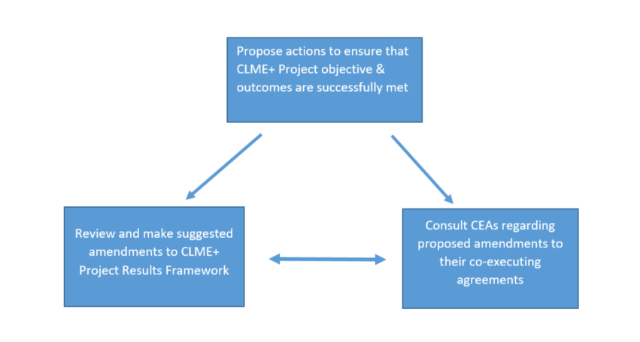
Analysis Methodology
Notes:
In order to ensure that CLME+ Project objectives and outcomes are successfully met, the CLME+ PCU undertook a review of the CLME+ Project Results Framework to determine what milestones and targets needed to be amended. The CLME+ PCU also undertook talks with the Co-Executing Agencies (CEA’s) to discuss the status of the co-executing agreements and the required amendments to such agreements to reflect proposed changes to the Project Results Framework.

Slide 9
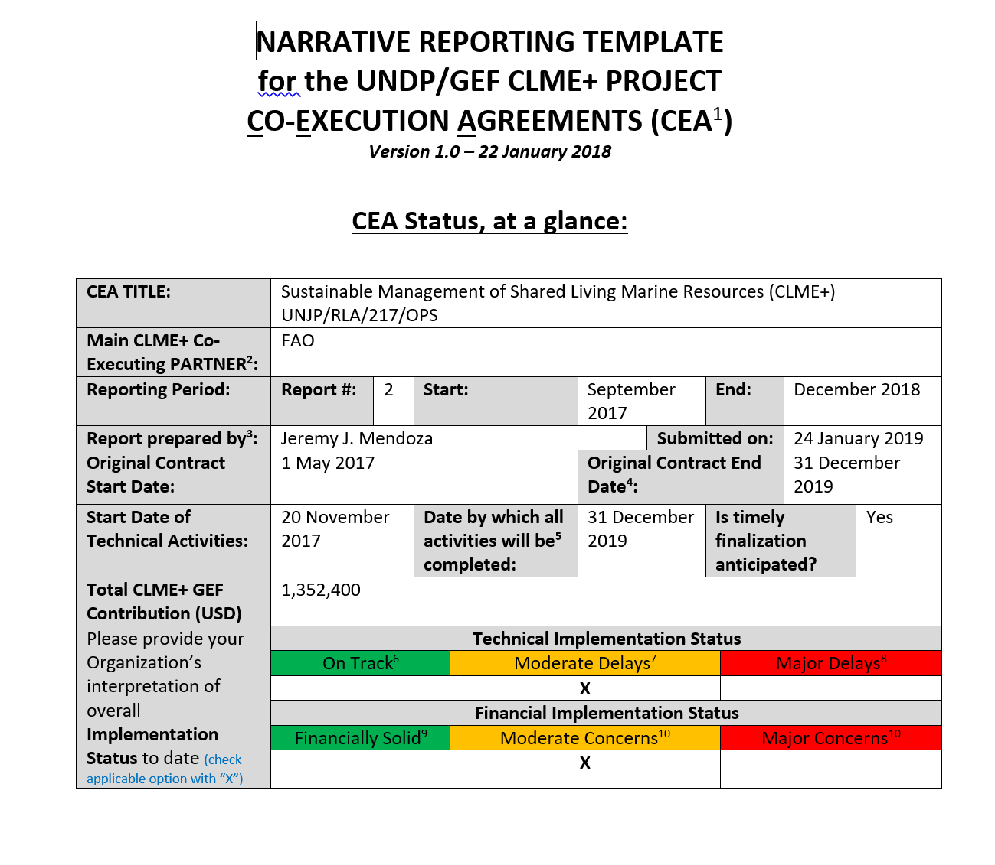
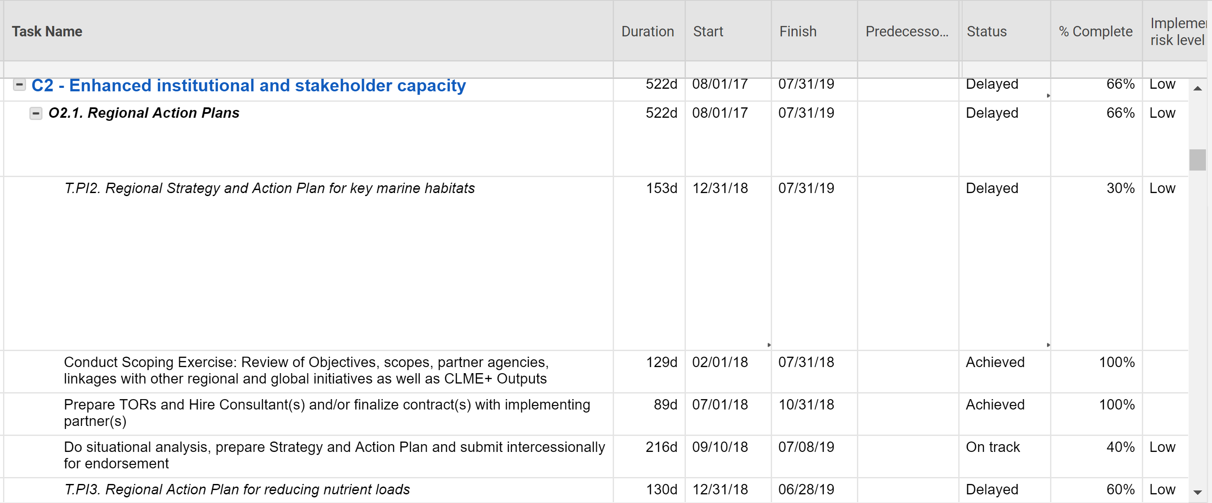
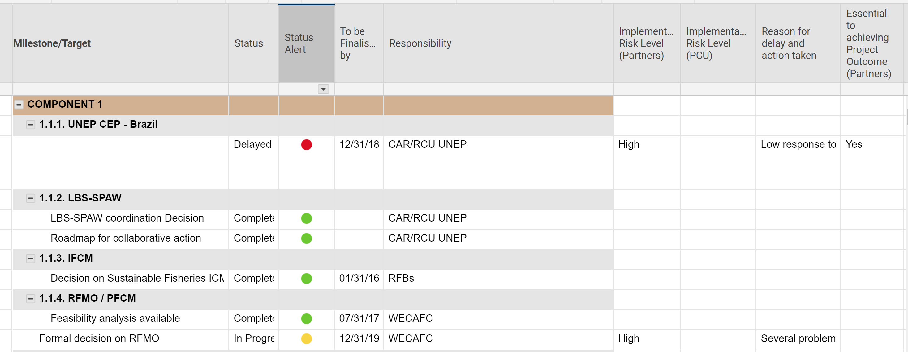
Technical Analysis - Tools
CEA Logframe Smartsheet
CEA Narrative Report (technical components)
Integrated Logframe Smartsheet
Notes:
The screenshots on the slide depict the tools which were used to undertake the technical analysis. Co-Executing Agencies (CEAs) are contractually required to submit a narrative report on the status of their activities every 6 months. The CEA Logframe Smartsheet, which details the activities to be completed, are updated at least every 3 months. The information obtained from the review of the Narrative Report and the Logframe Smartsheet was then used to inform the Integrated Logframe Smartsheet, which included all the milestones and targets outlined under the CLME+ Project Results Framework.

Slide 10
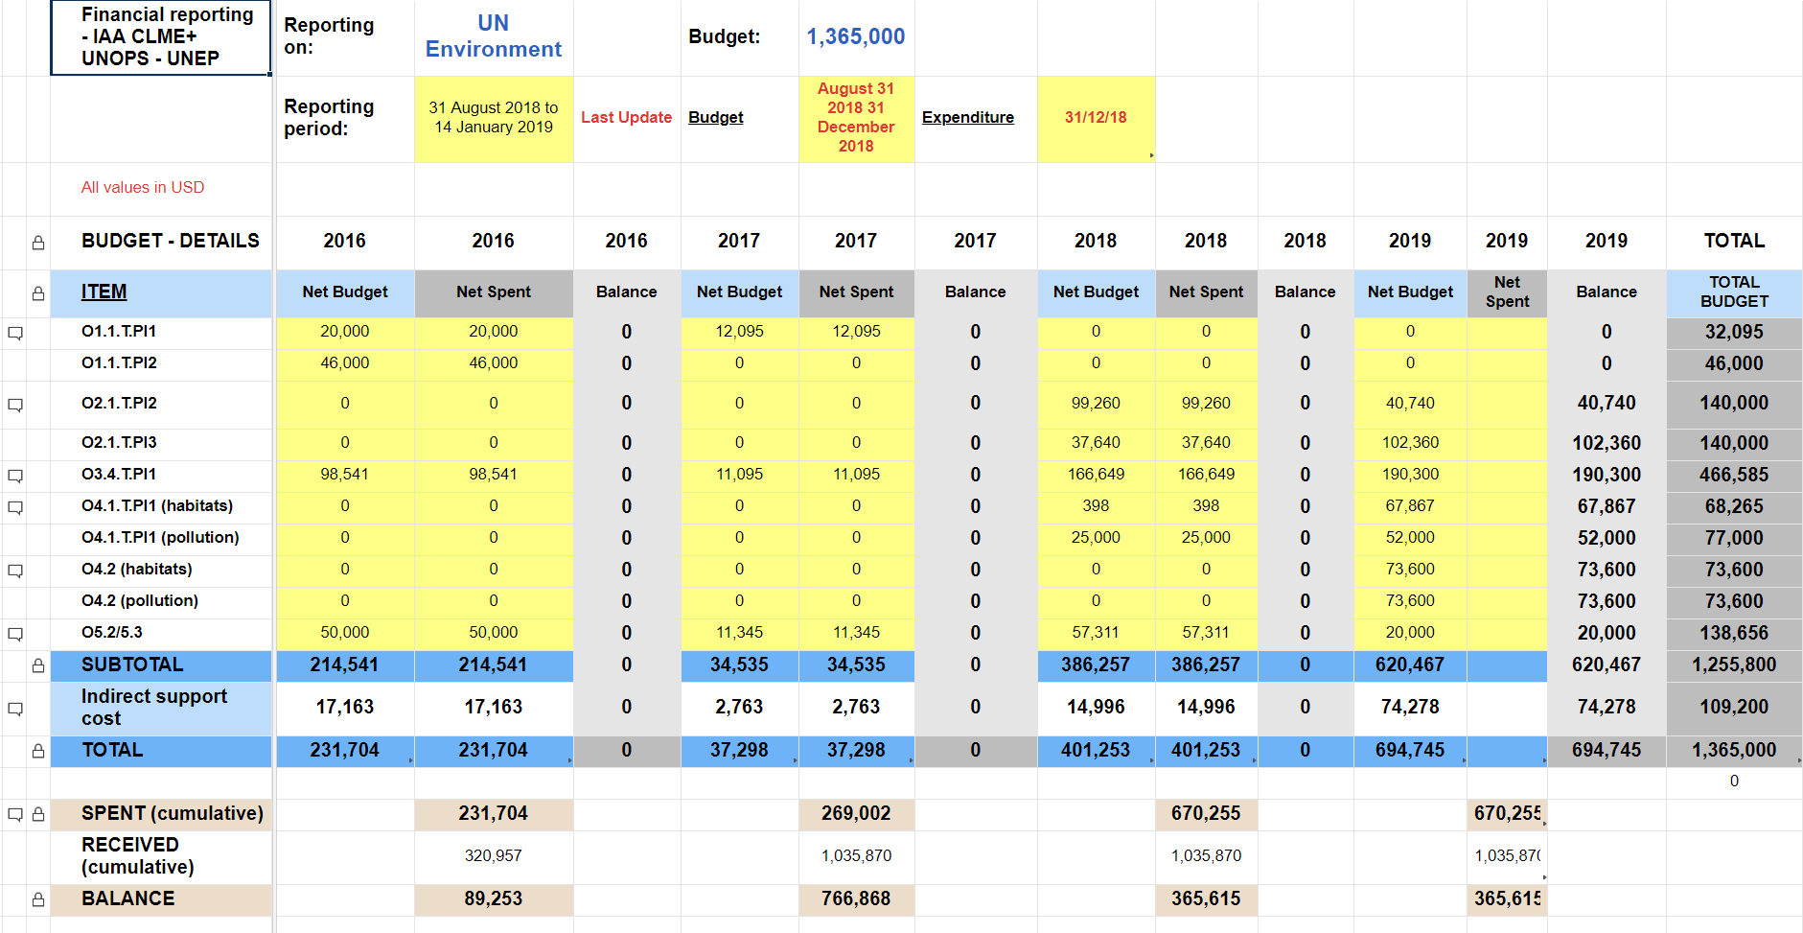
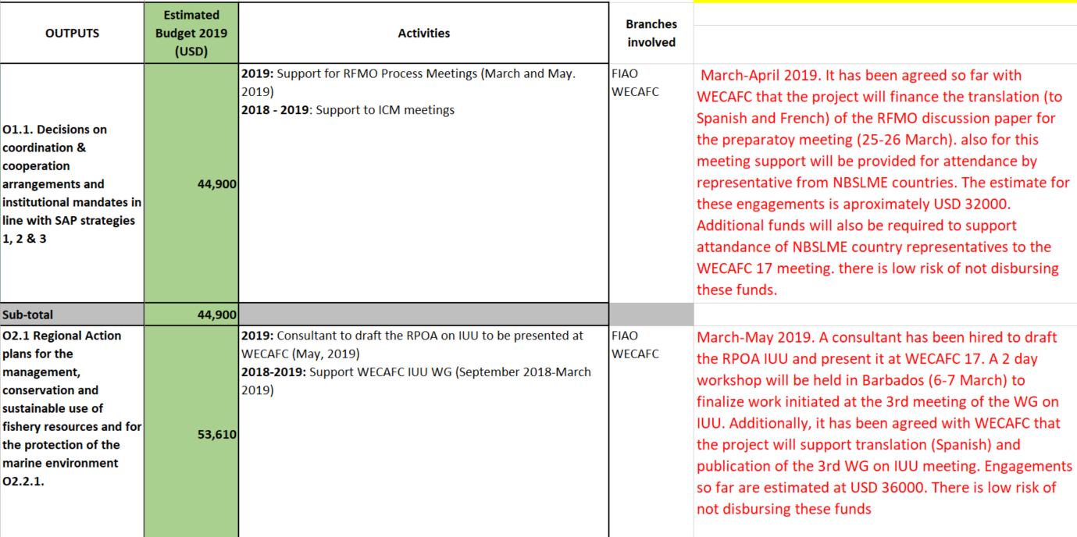
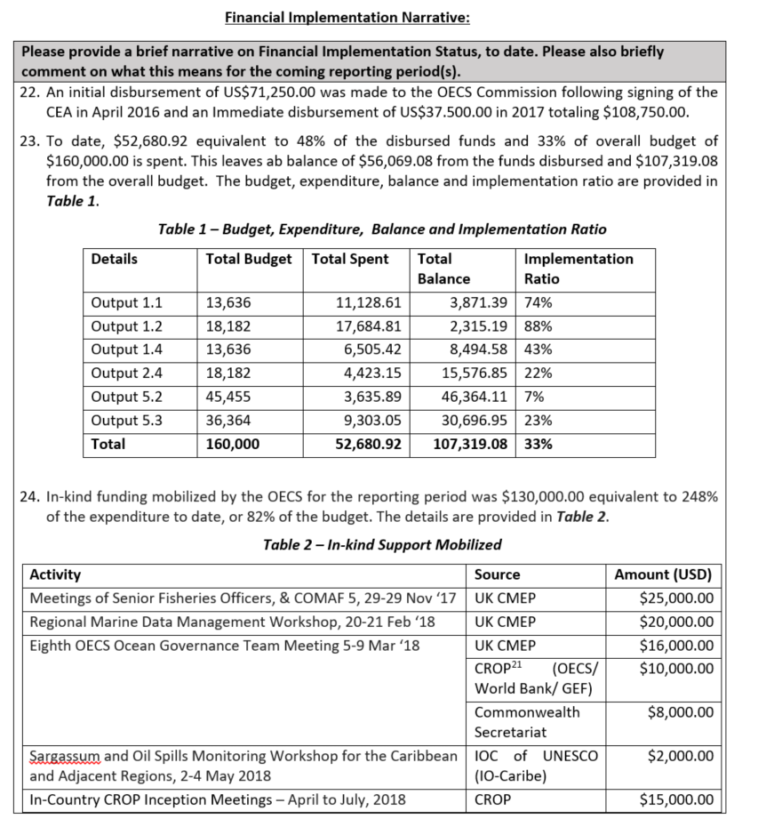
Financial Analysis - Tools
CEA Finance Smartsheet
CEA Detailed Commitments Report
CEA Narrative Report
(financial components)
Notes:
The screenshots on the slide depict the tools which were used to undertake the financial analysis. The CEA Financial Smartsheet, which details expenditure performance against annual Budget item, are updated at least every 3 months and discussed with partners accordingly. Due to the risks identified, a Detailed Commitments Report has also been requested, in order to have an extra level of details and commitments from partners regarding their upcoming activities and their related risks. With those additional details, we count with a broader scope of partners performance and we can enhance the monitoring much closer and promote further accountability. The information obtained from the review of the Narrative Report and the Financial Smartsheet was then used to complement the technical analysis.

Slide 11
Technical Analysis Results - Overview
Status Project Milestones and Targets
Analysis below includes all targets under Components 1, 2, 4 and 5 but excludes targets defined under Component 3
Percentage of delayed targets calculated using total incomplete targets and not total number of targets
Milestones and Targets | Number of targets | Percentage
Total number of milestones and targets in Project Logframe | 73
Milestones and targets Met | 19 | 26%
Milestones and targets Not Met | 54 | 74%
Milestones and targets at Risk (not met and unlikely to be met on time) | 27 | 50%
This is
in the absence of
a Project extension
2018 year end targets and milestones not met | 8 | 30%
Targets and milestones experiencing delay in process and unlikely to be met on time | 19 | 70%
Notes:
This slide provides an overview of the results of the technical analysis. The information above relates to Project Components 1,2, 4 and 5, but excludes Component 3 – i.e. the Sub Projects. The results related to the Outputs under Component 3 are presented in another slide. A total of 73 milestones and targets were identified. Of these 73 identified, 19 milestone and targets have been successfully met. This leave 54 milestones and targets which have not been met as yet. Of these 54 milestones and targets which have not been met, 27 milestones and targets are considered to be at risk. At risk in this instance means that these targets were to either have already been met and have not, or that they are to be met at a date in the future, but due to delays already being experienced it is unlikely that they will be met on time.

Slide 12
Technical Analysis Results - Overview
Status CLME+ Project Flagship Outputs
Output | Status
O1.1 Permanent Coordination Mechanism | On track
O1.5 Sustainable Financing Plan | On track
O2.1 Regional Action Plans (nutrients, habitats & unsustainable fisheries) | Delayed
O2.2 P-SAP | Delayed
O4.2 Investment Plans (nutrients, habitats & unsustainable fisheries) | Delayed
O5.2 SAP M&E Framework | Delayed
O5.3 SOMEE developed* | Delayed*
Notes:
The Outputs listed in this slide are considered to be the flagship outputs of the project, specifically outputs which define what the CLME+ Project is seeking to achieve. The results of the analysis show that of these 7 flagship outputs, 4 are delayed and successful delivery is likely to require additional time beyond the current delivery date specified in the Results Framework approved by the PSC at the June 2018 meeting. A 5th output (flagged with the *) has accumulated substantial progress delays and de-scoping will be required to keep delivery within the currently approved delivery date.

Slide 13
Technical Analysis Findings- Component 3
Output | Status | Responsible Agency
O 3.1 EAF Spiny Lobster Sub Project | On track to be completed by Aug 2019 | OSPESCA
O3.2 EAF Shrimp & Groundfish Sub Project | Delayed, sub project activities commenced in 2019, unlikely to be finalised by Dec 19 | FAO
O3.3 EAF Flyingfish Sub Project | To be completed by Dec 2019 | CRFM
O3.4 North Brazil Shelf EBM Sub Project | Delayed, sub project activities commenced in 2019, unlikely to be finalised by Dec 19 | UN Environment - CEP
Notes:
Achievement of the Project Objective – “Facilitating EBM/EAF in the CLME+ ..” is linked to the successful implementation of Component 3. The analysis of Component 3 which includes the sub-projects indicate that activities associated with two of the sub-projects, Output 3.2 being implemented by FAO and Output 3.4 being implemented by UN Environment CEP, have only just commenced. Agreements with participating countries were only finalized in late 2018 and many contracts with consultants have only been recently finalized. In light of this, it is unlikely that all activities to be implemented under these two sub-projects will be completed by the end of 2019.

Slide 14
Technical Analysis Findings
“Current” Co Executing Agreements Start and End Dates
Agency | Start Date | Original End Date
CANARI | 15 December 2016 | 31 August 2019
CERMES (responsible for preparing project experience notes) | 22 December 2016 | 31 December 2019
CRFM | 18 April 2016 | 31 August 2019
FAO | 07 July 2017 | 31 December 2019
GCFI | 01 August 2016 | 31 August 2019
OECS | 26 April 2016 | 31 August 2019
OSPESCA | 15 August 2016 | 31 December 2019
UN Environment | 14 June 2016 | 31 August 2019
UNESCO-IOC | 24 September 2018 | 31 December 2019
Notes:
The CLME+ PCU also undertook a review of the start and end dates of the co-executing partners, co-executing agreements (CEA) which are listed above. It should be noted that the CEA with FAO commenced in July 2017 and the one with IOC in September 2018. It should further be noted that CERMES CEA’s end date went beyond the end date of the other CEAs which commenced in 2016 as they are responsible for pulling together the lessons learnt and best practices from the other CEAs to develop the project experience notes which are a requirement of the donor, the GEF.

Slide 15
Finance implementation of total budget
Considering the remaining implementation period, having 43% of the total budget pending to be spent is representing a risk for successful Project implementation
57%
Notes:
From the total GEF grant of US$ 12.5MM, the project has spent 57% (7.1MM) by end of 2018. At the same time, the time elapsed under the current duration of the project represents 69% of the total duration.

Slide 16
Responsibilities and allocation of not implemented Budget
Big portion of the funds still to be implemented is responsibility of partners with high risk of implementation
Distribution of not implemented Budget
1.6 MM
1.9MM
Plus 9% of total Budget already transferred but not spent (1.1MM)
PCU’s not implemented Budget
Notes:
Considering the total unspent Budget to date, 37% of it corresponds to Budget to be spent by co-executing partners , 33% corresponds to PCU Budget for programmatic activities and the other 30% corresponds to PCU fixed operational costs (personnel and office).
From the partners’ not implemented Budget, 47% of it is responsibility of FAO, 18% on UNEP, 14% on CRFM and 21% of the remaining co-executing partners
It’s important to note that, additionally, 1.1MM of the funds already transferred by the PCU to the co-executing partners has not been spent yet.
From the PCU not implemented programmatic Budget, half of it is allocated to events and meetings and the other half to pending consultancies.

Slide 17
Partner’s financial implementation progress
Performance of some partners has improved, but not enough to reach the adequate implementation pace considering the time elapsed under contract
Notes:
There has been moderate progress from partners in terms of financial execution since the last PSC meeting . While it is acknowledged that partners have allocated major parts of their commitments to 2019, there is an important risk for some of them (salmon color area) because they will face important challengues to implement the remaining Budget before the current end date of their Co-Executing Agreements, while for other partners (yellow area) a medium risk exists since most of them will have to implement half of their total budget in the upcoming 8-12 months.

Slide 18
Consolidated partner’s financial implementation
Maintaining the (already increased) 2018 partners implementation pace, an extension of the period for implementation of technical activities under the Co-Executing Agreements (CEAs) that goes well beyond current CEA end dates will be required in some cases
46%
5%
2020
Notes:
Looking at the figures of the previous slide in a consolidated way, we can observe that the expenditure rate over total budget has increased up to 46% by the end of 2018. However, this figure will be insufficient if the implementation pace is not substantially increased in 2019. Even though, most of the partners have allocated most of their activities in 2019, it’s necessary to acknowledge the operational risk of implementing 54% of the remaining budget in a single year.

Slide 19
PCU financial implementation
Implementation of the budget directly allocated to the PCU has improved in the last months of 2018, but ful implementation will require additional time
Notes:
PCU financial implementation has increased during the last period of 2018, however it will be challenging to implement the remaining budget if an extension is not considered. It needs to be noted of course, both here and in the case of the CEA’s, that financial implementation is tied to the execution of project activities and the delivery of project outputs. We need to bear in mind in this context that it has been repeatedly flagged that country-buy in for the flagship CLME+ Project Outputs is an essential condition for project success and sustainability of project outcomes. Providing the space for such country engagement in the production and delivery of Project Outputs demands time.

Slide 20
Budget results 2018
This slide compares real 2018 Budget execution to the 2018 Budget Plan that was approved by the PSC. We observe savings in project expenditure and, especially, delays in the implementation of co-execution agreements (CEA’s). The latter has led to parts of these CEA budgets now being moved to the 2019 and 2020 Budget Plans, and saved and re-programmed resources are being allocated to facilitate the proposal of an extension of the project period
Notes:
The slide summarizes the project expenditure figure of 2018 compared with the last Budget approved at the PSC meeting. The spent amount was 864K lower than the approved budget. There are differences in budget execution in 2018 (versus the last approved budget) due to savings in project implementation and, especially, delays in the implementation of co-execution agreements, which have been reclassified to the budgets of the following years and serve as the main funding source of the proposed extension period

Slide 21
CLME+ Mid Term Evaluation Conclusions
Delays in Implementation – Only a small % of mid-term targets were met. Even with the application of mitigation measures remaining time is insufficient to ensure successful conclusion of project
Future Sustainability/Country Ownership – Sustainability of Project Outcomes depends on the adoption and internalization of project outputs by the countries and IGOs. The final decision of many outputs lies with the countries.
Notes:
This slide outlines the main conclusions of the Mid Term Evaluator.

Slide 22
CLME+ Mid Term Evaluation Recommendations
CLME+ Project extension should exceed four month and be in the order of 12 months
Executing Partners give priority to achievement of outcomes & focus on the critical targets
Countries take the lead through their National Focal Points for the Project
Priority placed on effective communication mechanisms to, from and within the countries streamlined
Seek the involvement of development banks and other major donors: this dialogue could be part of the definition of the SAP Investment Plans under Component 4
Notes:
This slide outlines the main recommendations of the CLME+ Project Mid Term Evaluator.

Slide 23
PCU Analysis Conclusions
Project Outcomes and Outputs are still achievable but delayed within the current timeline
Many CLME+ targets are linked to countries endorsement or approval before they can be successfully met and this will require time
Activities associated with two of the Sub-Projects under Component 3 have only just commenced and in the PCU’s opinion there is a high risk that activities will not be fully completed by December 2019
Three quarters of all* project milestones and targets are still to be met. Half of these are unlikely to be met within the time outlined in the revised CLME+ Project Results Framework of June 2018
Notes:
The slide summarises the conclusions of the analysis undertaken by the CLME+ PCU on the implementation status of the CLME+ Project.
*Excluding component 3

Slide 24
PCU Analysis Conclusions
At least 8 milestones and targets* which were to be achieved by December 2018, have not been achieved
Most Co-Executing Agreements will need to be amended, as more time is required to allow them to successfully complete the activities outlined under the agreements
Partners have showed moderate progress in the financial implementation. Whereas it is acknowledged that most funds were committed for implementation in 2019, the PCU observes substantial operational and financial risks since more than half of their total budget would need to be spent in a single year if the current timeline is maintained.
Notes:
The slide summarises the conclusions of the analysis undertaken by the CLME+ PCU on the implementation status of the CLME+ Project.
*Excluding component 3

Slide 25
PCU proposal revised implementation plan

Slide 26
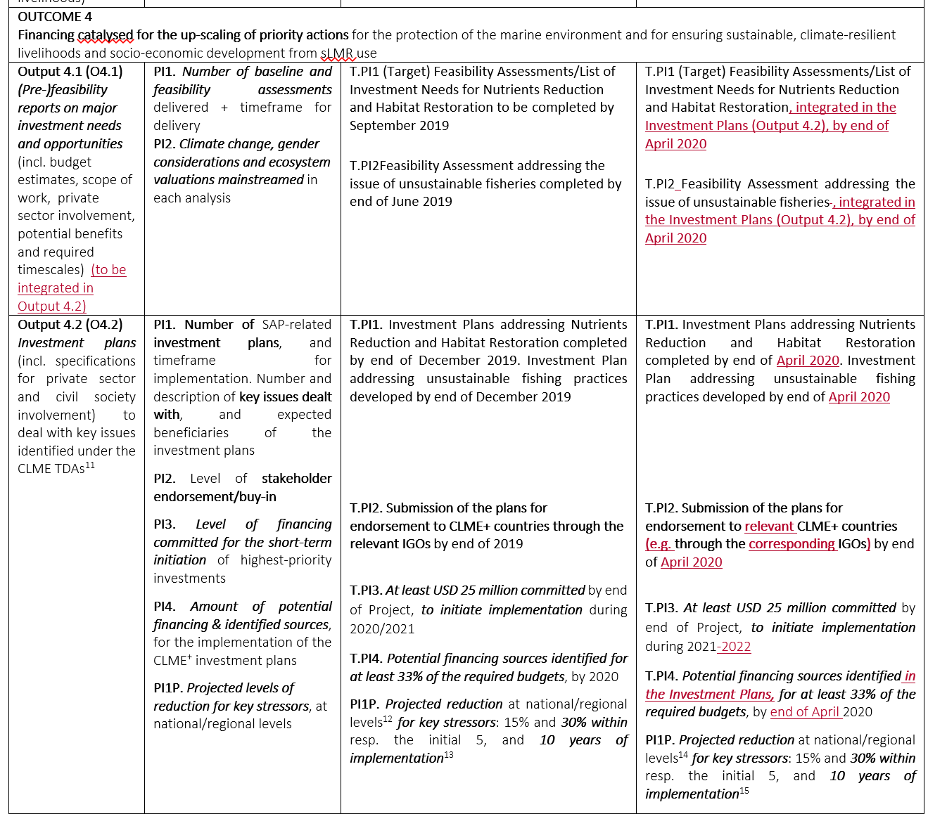
Screenshot showing an example of the Proposed Amendments to CLME+ Project Results Framework
The CLME+ PSC is requested to review and express their agreement with the proposed changes to the CLME+ Results Framework, contained in full in the submitted Word Document
The revised framework forms the basis for the proposed duration of the Project extension
Notes:
Based on the conclusions of the analysis undertaken by the CLME+ PCU and the proposed way forward, the CLME+ Project Results Framework was reviewed and proposed amendments were made to some project outputs, indicators, targets and milestones (including the associated timelines - see the track changes in the submitted Word Document). Please note that there were no proposed amendments to any of the project outcomes. The results from this exercise were used to determine the new project end date that will be required to allow for the successful completion of all essential project activities. The CLME+ PSC is invited to review and approve the proposed amendments to the CLME+ Project Results Framework in the attached word document.

Slide 27
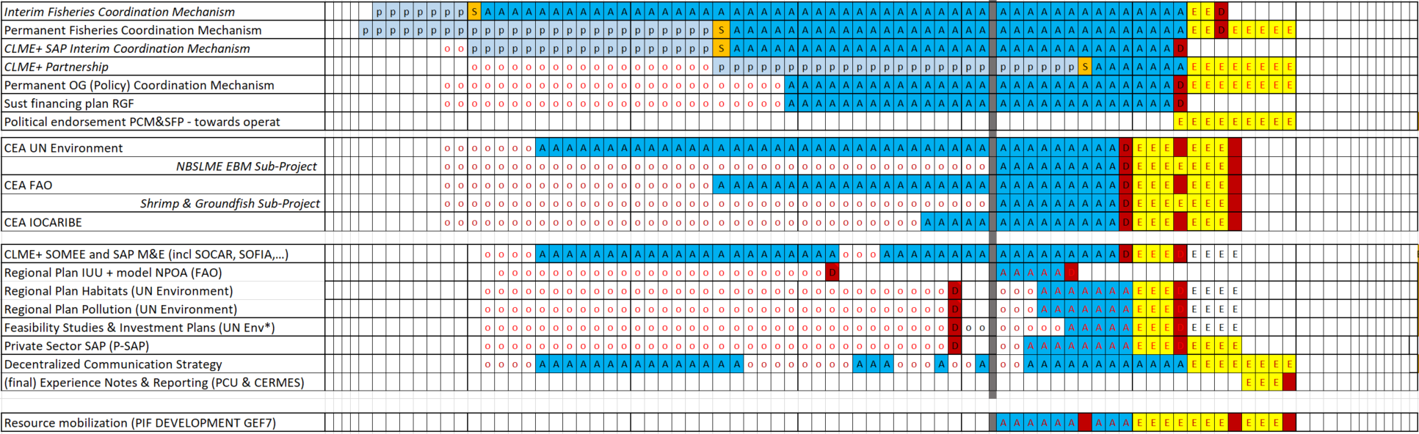
PROPOSED MODIFICATIONS TO DELIVERY DATES FOR SOME OF THE KEY OUTPUTS UNDER THE CLME+ PROJECT RESULTS FRAMEWORK
CEA = Co-Execution Agreement
Notes:
This slide summarizes some of the main changes to the Project timeline for the implementation of Project activities, and delivery of Project outputs. This is based on an assessment (a) originally planned versus real start dates (red dots) for Project activities; (b) past implementation capacity and speeds; (c) time currently remaining till orignally planned delivery dates (blue cells to the right of the vertical grey bar), as well as (d) the critical need to secure sufficient time for country participation and buy-in during the production of key Project Outputs. The slide shows the proposed extra time (yellow) for, a.o. work on the identification and endorsement of solutions for the Permanent Coordination Mechanisms for Ocean Governance, for of the EBM and Shrimp and Groundfish Sub-Projecs till August 2020, the addition of extra months for the final delivery of Regional Action and Investment Plans, resource mobilization, and for the consolidation and reporting on all technical work and outputs delivered under the Project. (the Gantt Chart in this slide does not yet show the operational/administrative Project closure period)

Slide 28
Proposed Amendments to Co Executing Agreements End Dates
Agency | Original End Date | Revised End Date
CANARI | 31 August 2019 | 31 December 2019
CERMES (responsible for preparing project experience notes) | 31 December 2019 | 30 October 2020
CRFM | 31 August 2019 | 31 December 2019
FAO | 31 December 2019 | 31 August 2020
GCFI | 31 August 2019 | 30 April 2020
OECS | 31 August 2019 | 31 December 2019
OSPESCA | 31 August 2019 | 31 December 2019
UN Environment | 31 August 2019 | 31 August 2020
UNESCO-IOC | 31 December 2019 | 31 August 2020
Notes:
Based on the results of the analysis regarding the status of CLME+ Project Outputs and the associated milestones and targets, many which are being implemented by co-executing agreements (CEAs), the CLME+ PCU is proposing the following amendments to the end dates of the co-executing agreements. The CLME+ PSC is invited to give their approval to these amended end dates for the CEAs.

Slide 29
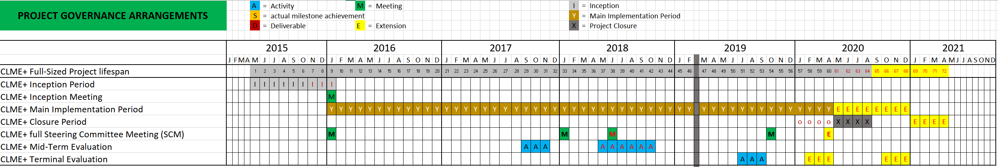
initial delays in inception period
Final Project End Date
(for PSC approval)
Approved initial extension of 4 months to accommodate for delays in inception phase
Additional (and final) extension to accommodate for further implementation delays
original project end date
Third & Last (physical)
Project Steering Committee Meeting
Administrative project closure period
Final End Date for all Sub-Project (technical) activities
Final end date for all technical project activities (incl. experience notes
& final technical report(s))
Notes:
This slide provides an overview of the new CLME+ Project implementation timeline, with the 4-month Operational Project Period now shifted beyond the new end date for Technical Project Activities. The proposed extension comes down to the addition of 8 extra months to the project duration (beyond the initial 4-month extension which was already previously approved by the PSC to accommodate for delays in the project’s initial phase).

Slide 30
CLME+ PCU Proposed Way Forward
Revised CLME+ Project Logframe reflects reduced scope for some outputs and additional time to achieve Project Outputs & Outcomes (with keen eye for the interlinked nature of many outputs)
Revised CLME+ Project budget facilitates implementation of the revised Logframe and its new timeline
End date of all Technical Project Activities (currently April 2020) moved to 31 December 2020
Project Operational Closure of 4 months: January 2021 – April 2021
New end date for CLME+ Project: 30 April 2021
Notes:
This slide outlines the PCU’s proposed way forward to address the issues outlined in the previous slides – PCU’s Analysis Conclusions for the review and consideration for the CLME+ PSC.

Slide 31
Budget revisión 2019 - 2021
Resources to fund the Project Extension have been identified and will primarily be sourced primarily from Project savings within the Project Coordination Unit
Fee revision to cover increment in UNOPS management costs remains within limits of allowed Management Cost (stipulated in ProDoc)
Notes:
This slide outlines the Budget proposed for the period 2019-2021 taking in consideration the new proposed project timeline. Unspent funds from the PSC-approved 2018 Budget Plan have been reallocated to the upcoming years.
Details of the deviations are explained in slide 33.

Slide 32
CLME+ PCU Proposed Way Forward
PSC approval of the revised Project implementation plan (timeline, revised Results framework and budgets)
Amend Co-Executing Agreements as required.
Monitor the detailed financial objectives and implementation dates committed by co-executing partners, analyzing the progress at least every quarter.
If further delays are observed by September 2019 against the revised project implementation Plan, the PCU will submit to the PEG and PSC a further de-scoping proposal together with an associated proposal for budget reallocation.
Notes:
This slide outlines the PCU’s proposed way forward to address the issues outlined in the previous slide – PCU’s Analysis Conclusions for the review and consideration for the CLME+ PSC.

Slide 33
Budget revision
Notes:
This slide outlines the proposed revision of the total project Budget. The table of the left shows the proposed Budget versus the last Budget Plan approved by the SCM. The table to the right compares the proposed revised Budget versus the Budget Plan in the Project Document.
Comments 1 Increase in total HR budget due to the proposed extension period of 8 months and the decision to incorporate the new Communication Specialist as HR and not contractual services (even with those increases, total revised HR cost are still lower than those anticipated in the Prodoc Budget 2 Communication Specialist is expected to be recruited not through an external contract but as UNOPS personnel. In addition, savings in implementation of events were allocated as HR expenditure to self-finance the extension period 3 PCU has reduced Rental costs due to the host agreement with IOC UNESCO. Contingency Buffer allocated to this budget line has been reduced as the project is reaching its final stage. Due to internal administrative re-interpretation, meeting room costs for events are now considered as part of Travel costs 4 PCU has identified the need of higher and more specialized demands of translations services. 5 Explained in point 10 6 Savings in Staff Salaries and Consultancies 7 Big portion of the travel/meeting expenditures are allocated through contract with travel agencies as a way to reduce both costs and administrative work load 8 Savings in point 1 and 2 are reallocated as contracts for implementing project activities. As well, consultancies are preferibly implemented as contracts rather than HR since it implies lower management fees 9 Explained in point 4 10 The overall management fee does not surpass the established ProDoc Budget. Additional allocation to the HR budget due to the extension implies higher management fees, the longer implementation period also involves an increase in LMDC and the reallocation of NP CMDC as management costs. However, the total management cost is still below the related ProDoc budget

Slide 34
CLME+ Project Steering Committee Decision for Approval
Takes note of the results and conclusions of the analysis undertaken by the CLME+ Project Coordination Unit on CLME+ Project implementation status till the end of December 2018, as well as the proposed way forward
Agrees to an extension of the project duration till 30 April 2021, to accommodate the delays experienced to date
Approves the amendments to the CLME+ Project Results Framework in alignment with the Project extension of 30 April 2021, as outlined under the document – file name entitled “UpdatedResultsFramework_v190226”
Approves the CLME+ revised budget for the period 2019 - 2021 as presented in this power point presentation - slide entitled “Budget revision 2019-2021” (slide number 31)
Urges the co-executing partners to fulfill the committed objectives
Requests that Co-Executing Partners continue to use the specified and agreed monitoring tools to provide an update on CEA implementation status every month for partners with higher responsibility over the Budget, and every quarter for the other partners.

Slide 35
Thank you
Catalyzing implementation of the Strategic Action Programme for the Caribbean and North Brazil Shelf LME’s (2015-2020)

