Slide 1

Project Steering Committee Meeting Oct 2020
Agenda Item 8: CLME+ PROJECT REVISED WORKPLAN (extension)
Catalyzing implementation of the Strategic Action Programme for the Caribbean and North Brazil Shelf LME’s

Slide 2
CLME+ PROJECT: THE WAY FORWARD
Project extension of 3 months (pre-)approved at June PSCM
formal processing of extension request was “kept on hold”, with the following rationale:
    Added uncertainty/risks/challenges for project execution due to COVID19
    Novelty of COVID: by May/June no consolidated policies/instructions yet vis-a-vis project extensions (initial feedback: “max 3 months”)
    Time remaining for final decision: extension request to be formally processed by end of October 2020
CLME+ PCU Strategy:
    in Sept/Oct 20: evaluate progress against June 20 PSCM approved Work Plan/Results Framework, assess risks (incl. Sustainability, Continuity)
    based on findings: either confirm 3M extension, or update extension request, for approval at October PSCM and subsequent UNDP processing

Slide 3
SITUATION ANALYSIS
Limited, but some further delays against dated targets in the June-approved Results Framework, accentuated or caused by COVID
      Some can be recovered, e.g. UNEP Sub-Project
      Some require additional time to implement budget and achieve outputs, e.g. FAO Sub-Project and some PCU outputs (e.g. SOMEE,...)
Many targets, to be delivered “by Project End”: challenging, in context of sustained uncertainty (COVID, PCU HR capacity, procurement processes, required review processes (country/IGO inputs...) !
In this context: CRITICAL/CENTRAL to CLME+ PROJECT: the COORDINATION MECHANISM
Single-most important, and potentially far-reaching, expected achievement of CLME+ Project/contribution to CLME+ SAP implementation
Very good momentum achieved: June PSCM decision + August-Sept work of MOU drafting Working Group
BUT: what is the minimum to be achieved by Project End (conservative)? And what should we aspire for (ambitious)?

Slide 4
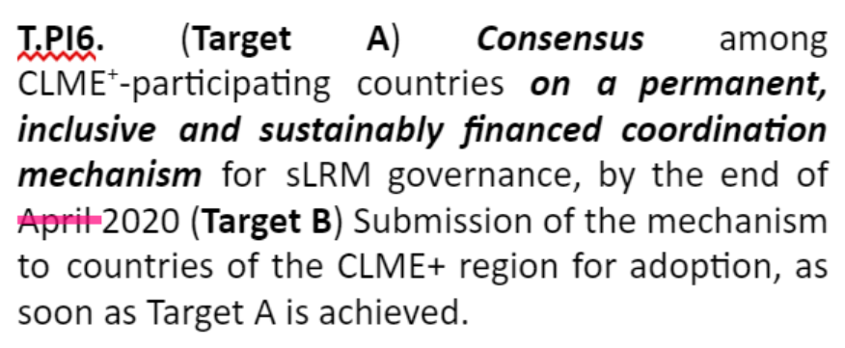
our ASPIRATIONS as a region/project,
Expressed in 2 ~plausible interpretations of the targets
O1.1 PI6 - Coordination Mechanism:
Targets as incorporated in the
(June PSCM approved) Results Framework (RF)
agreement (in principle) on the core aspects of the CM ✔
consensus on the full CM MoU, after legal review
circulation of the fully cleared MoU for signature (interpretation of Target B)
OPTION 1
agreement (in principle) on the core aspects of the CM ✔
there is a fully developed MOU, pre-cleared by the PSC at the technical level and ready to be used for further screening by legal departments of prospective Signatories" (alternative interpretation of Target B)
OPTION 2
BOTH OPTIONS CAN BE SEEN AS “MEETING THE RF TARGETS” - but with different levels of ambition

Slide 5

June PSCM decisions relative to the Coordination Mechanism
(some concern was expressed by PCU at the time…)
meaning of “finalized”: an MOU that is technically AND legally cleared?

Slide 6
RISK of OPTION 2
→ if legal clearance of final MOU is NOT (largely) achieved by CLME+ Project End, there will no longer be a Project/PCU to support further work on MOU and towards the creation of the Coordination Mechanism
→ anticipated possible approx start date of next phase (PROCARIBE+) project: end of 2022 (inception phase), Q2 of 2023, full project implementation...

Slide 7
CLME+ OUTPUT 1.1 - THE COORDINATION MECHANISM
PCU STRATEGIC PROPOSAL, with a view of taking full advantage of opportunity offered by the Project
Note on Project Role:
project can support throughout its lifespan,
but not guarantee achievement of consensus among countries/IGO’s/PSC members
different possible interpretations
of what should be achieved by Project End
PCU’S PROPOSED WAY FORWARD:
Conservative interpretation of Target B, to be achieved by March 2021: as a minimum, technically cleared MOU
2. mitigate the risk of a stall (or substantial slow-down) of the process towards CM creation, once the Project End Date is reached
CLME+ PCU keeps supporting the aspirations of having a technically AND legally cleared MOU that can be circulated for signature, BY or BEFORE Project End.
Most positive scenario: further support signing process if the above is achieved before Project End Date.
1. secure that the minimum requirements under the Results Framework are met:

Slide 8
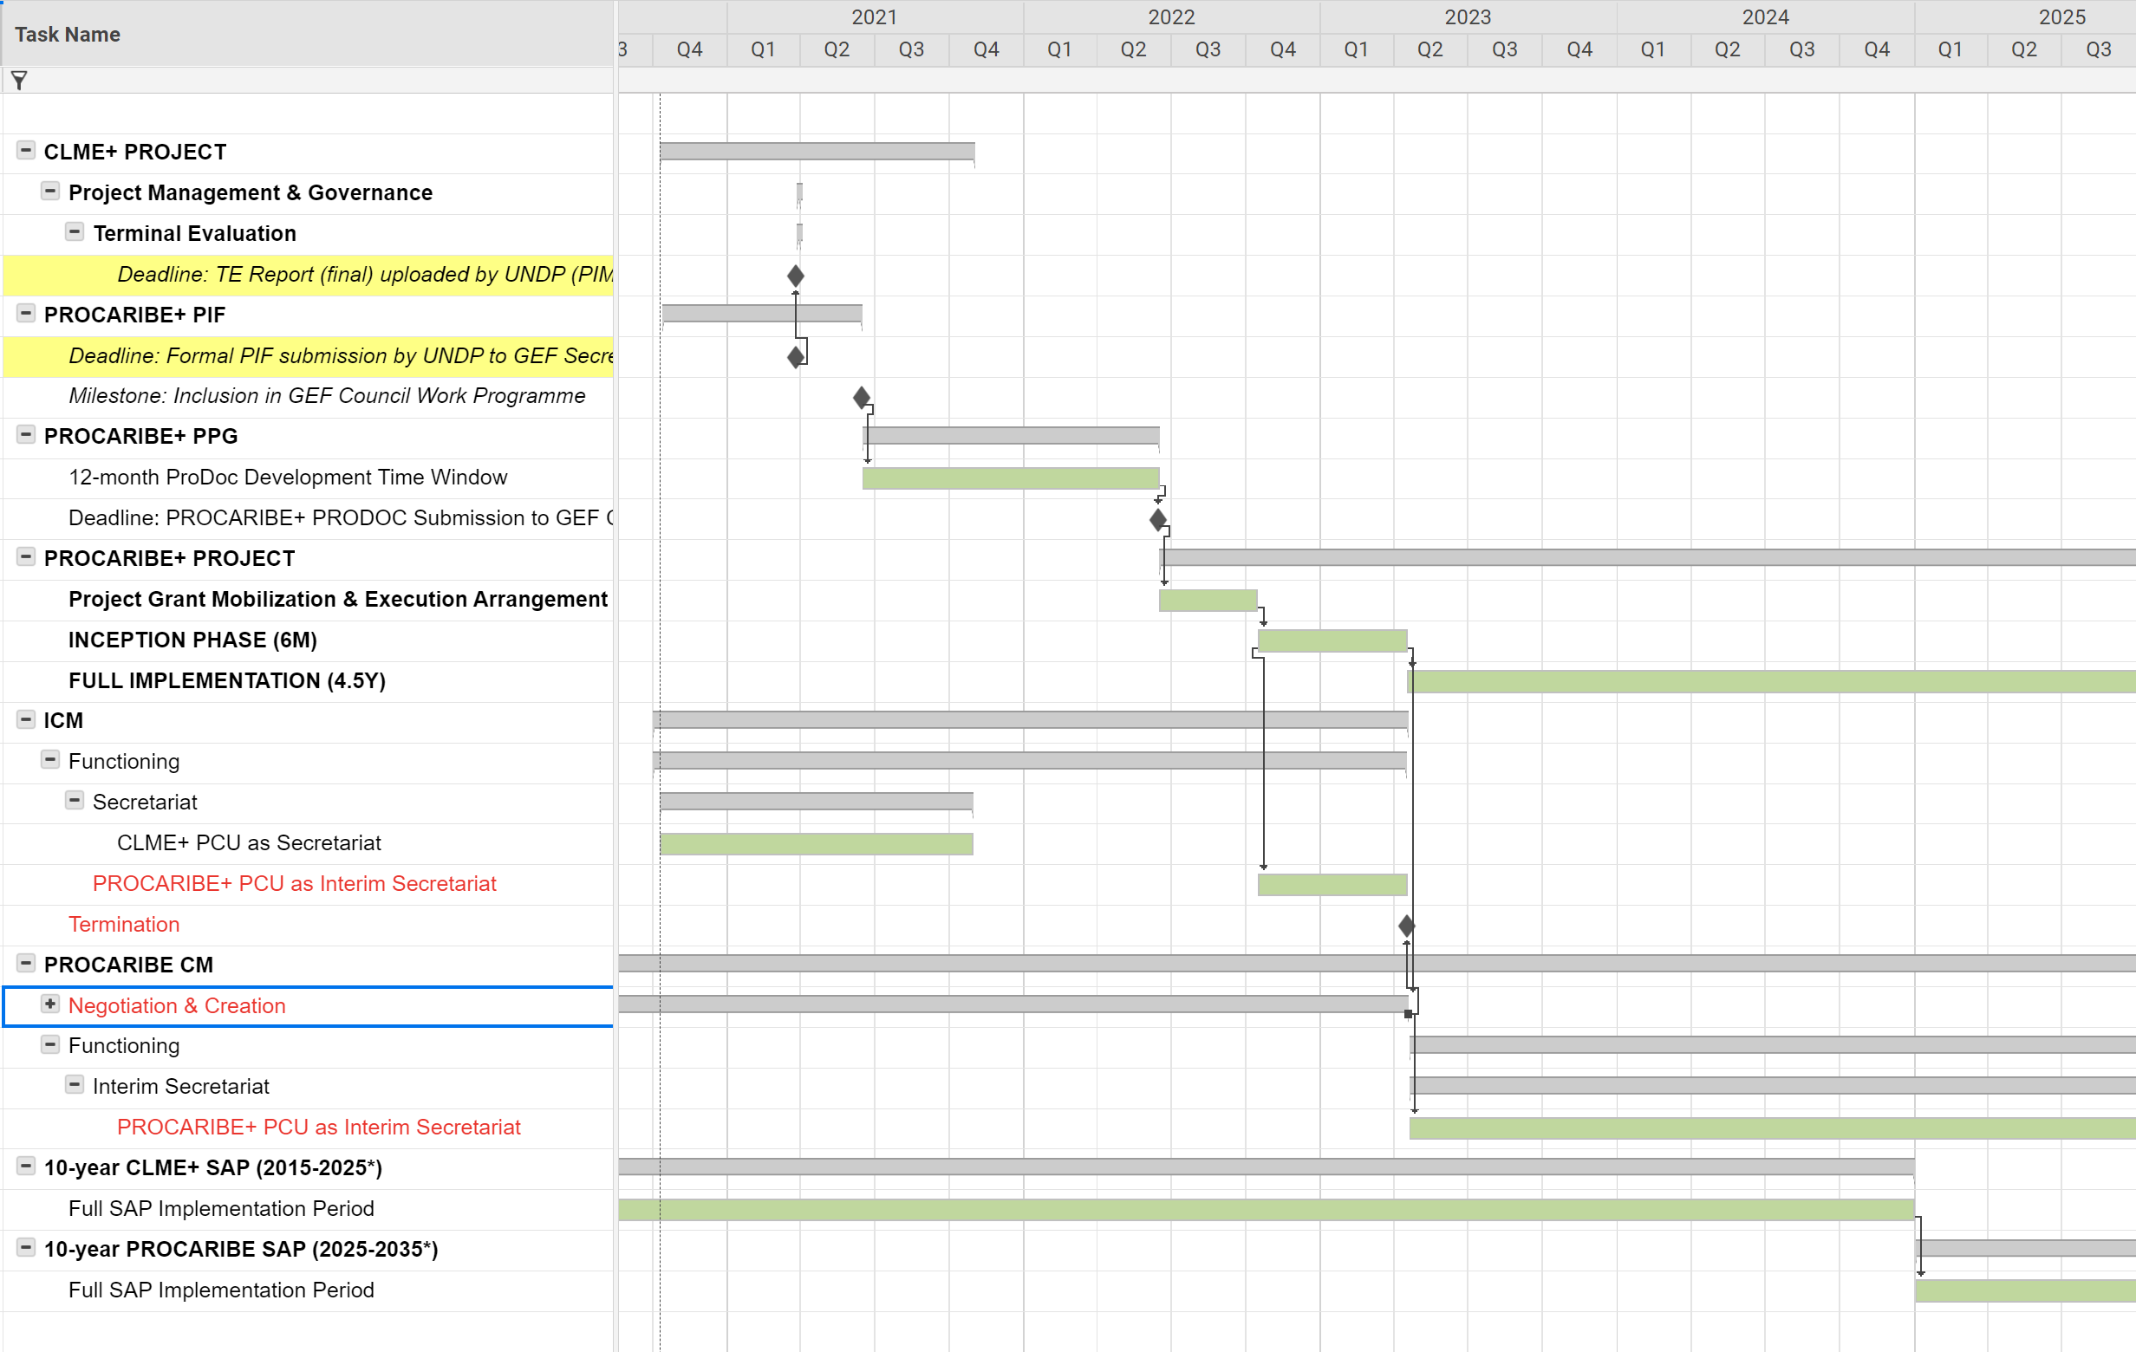
TIMELINE - “beware of the Gap!”
Potentially “dead” period with no progress on MOU if MOU not finalized by Project End
if project end kept in July
Target: have CM created by LATEST end of PROCARIBE+ Inception Phase (that’s 2+ years from now!)
TIMELINE SHOWS:
from CLME+ Project (2015-2021) to PROCARIBE+ Project (2022/23-...)
from ICM to PROCARIBE
from CLME+ SAP (2015-2024) to PROCARIBE SAP (2025-2035)
Development & endorsement of new SAP
- Coordination Mechanism must be up & running!

Slide 9
PROJECT SUCCESS:
TECHNICAL DELIVERY, FINANCIAL IMPLEMENTATION, ADMIN COMPLIANCE, CONTINUITY/SUSTAINABILITY OF OUTPUTS & OUTCOMES
(RISK MANAGEMENT)
CURRENT CONTEXT:
Take into account delays, conflicting priorities... on side of PCU and Co-exec partners, COVID contingency
Take into account need for country review/inputs/feedback of Project Outputs (incl CM MOU), vis-a-vis COVID as a short-term country priority
CLME+ PCU-proposed STRATEGY:
3 months of extra time to conclude all outputs and take process towards creation of Coordination Mechanism as far as possible
(while securing continuity of CLME+ initiative),
within existing project budget and PRoDoc/PSC-approved Project Management Costs

Slide 10
Lessons learnt
from many LME initiatives around the World
CLME - CLME+ have been unique in their seamless transition from SAP development to SAP implementation
The above is a (very) rare feature in the LME World:
TOO many examples out there of prolonged (severe) gaps between one phase to the next, leading to discontinuity, loss of momentum/investments,...
PCU proposal: strategically plan the transition, do what we can to minimize risks of discontinuity
3 extra months can seem like a small amount, but it could have a disproportionate impact
‘Success without successor is failure’

Slide 11
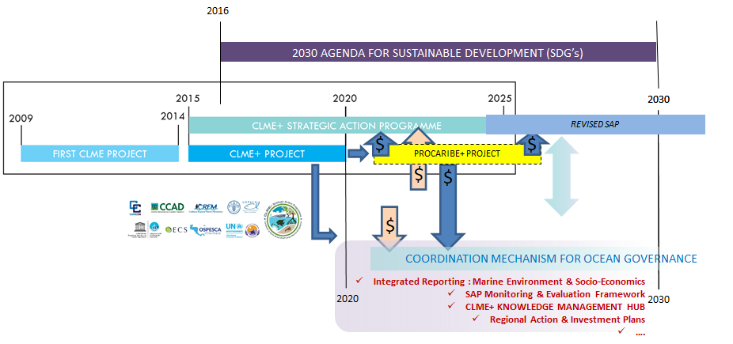
We reiterate the critical importance of continuity/the next phase for cont’ed SAP implementation and for securing the value for the region
of the investments made through the GEF-funded CLME and CLME+ Projects

Slide 12
HOW TO MAKE IT WORK?
DYNAMIC, STRATEGIC PCU STAFFING ARRANGEMENTS
Anticipated staffing (person-months/costs)
July21 - current approved end date
-admin, financial and logistical closure
-support for
legal MOU review,
or for signing*
-(lower intensity)
support for I(F)CM
-preservation
& transfer of
institutional memory
-deliver most outputs
-”final” regular PSCM
-MOU technically cleared (legally cleared if possible)
-TE
-PIF submission
-limited # of outputs
(see Excel)
-legal MOU review
(“ad hoc PSCM),
or support for signing if already legally cleared*
-support functions for I(F)CM
Mar21
June21
Oct21

Slide 13
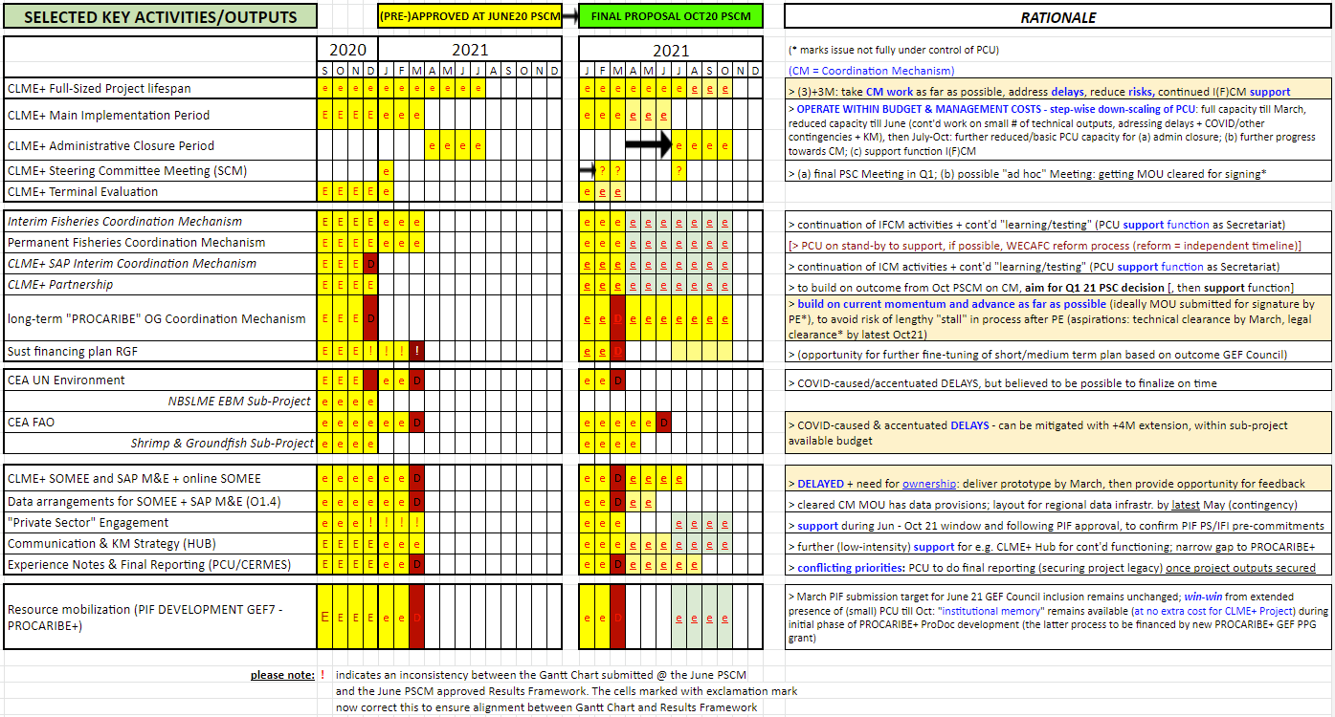
ORIGINAL VERSUS PROPOSED REVISED CLME+ PROJECT TIMELINE FOR KEY ACTIVITIES AND OUTPUTS (FOR PSC APPROVAL)
Note: the below is only a screenshot for illustrative purposes.
For the purpose of analyzing and approving (or commenting on) the proposal,
please visit the original “Gantt Chart” document by clicking here

Slide 14
SUMMARY - WAY FORWARD
(PCU recommendation, for PSC approval)
By end of March 2021:
    Majority of CLME+ Project Outputs delivered, in basic compliance with Project Results Framework
    “Final” regular PSC meeting
    Terminal Evaluation (near-final or final draft)
    Country GEF OFP PIF endorsement letters (→ UNDP submits PIF to GEF Secretariat)
April - June 2021:
    Trim down PCU operational costs as a function of needs & resources
    Optimal use of remaining resources to address/incorporate stakeholder feedback & “upgrade” outputs + few remaining outputs further completed; COVID-19 contingency
    Continue supporting the I(F)CM + the region’s progress towards creating the Coordination Mechanism (possible additional “ad hoc” PSC meeting on the CM, if required)
    By end of April (“before mid-May”): final Terminal Evaluation to GEF Secretariat
July-October 2021: Operational Closure Period (trim down PCU costs further)
        Primary focus: preps for financial, admin and logistical close-down, final report
        Secondary focus: PCU support function - ICM Secretariat, further advances towards CM creation, institutional memory for PROCARIBE+
31 October 2021: CLME+ Project Operationally closed:
→ all outputs DELIVERED, budget optimally USED, full administrative COMPLIANCE + SUSTAINABILITY & CONTINUITY!

Slide 15
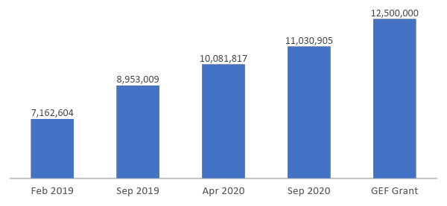
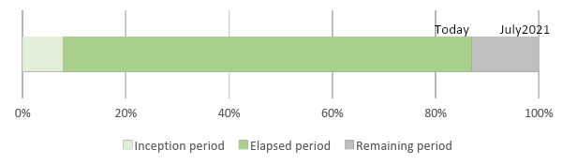
Financial implementation over total GEF CLME+ Project budget
As of September 2020, the PCU has disbursed 88% (US$ 11 MM) of the whole GEF CLME+ grant (US$ 12.5MM). Significant progress has been achieved since the last Budget Implementation Review in April 2020. Notwithstanding, the substantial remaining budget amount is indicative of an important amount of work/tasks still to be executed and finalized to secure successful project completion.
71%
88%
51%
81%
57%
72%
57%
Expenditure* evolution
over total Budget
(*PCU expenditures + disbursements to Co-Executing Partners)
Project elapsed period
Notes:
The first chart shows the current project disbursements/expenditure levels up to September 2020 (11 MM) compared to the total GEF grant and the figures of previous implementation analysis (September 2019 and April 2020). A substantial financial implementation progress in the last twelve months (from 72% to 88% of budget disbursed) is observed.
The second chart shows that the time elapsed under the current duration of the project represents 87% of the total duration. The June PSCM-pre-approved, modified end date for the project is July 2021 (incl. March as end date for technical work).

Slide 16
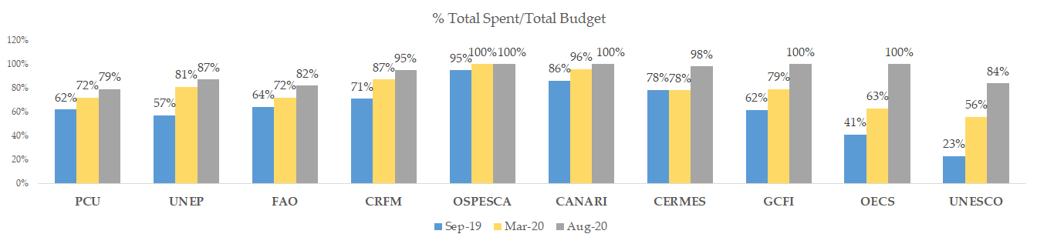
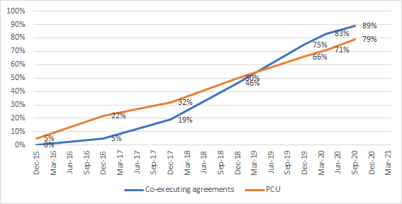
Financial implementation progress per partner
Until August 2020, Partners and PCU show a recovery in the pace of spending of their respective budgets
% of Spent cumulative
over Total Budget
Notes:
The first chart shows the evolution of the Expenditure over Budget ratio for each co-executing partner, including the Project Coordination Unit (PCU). The spent over budget ratio should be understood as an indicator for partner’s grant effective expenditure and may not reflect how its implementation was planned over time. Being aware of that caveat, it can be observed that all the partners achieved improvement in terms of financial execution, including the ones with major budget like FAO and UNEP. However, these last two will have to spent around 15% of theirs respective budgets in the upcoming 3 months. OSPESCA, OECS, CANARI and GCFI has finalized its financial implementation.
The second graph represents how the cumulative percentage of budget disbursement (Spent/Total Budget) has growth along project timeline. The blue line represents the disbursement ratio related to co-executing agreements (all partners consolidated) and the orange one, the PCU’s ratio over the budget which is exclusively its responsibility. From the figure, it can be observed how a very steep implementation curve will be needed for the final project period. By now, the PCU requires to disburse 21% of its budget and, meanwhile, partners need to allocate 11% of their corresponding budget.

Slide 17
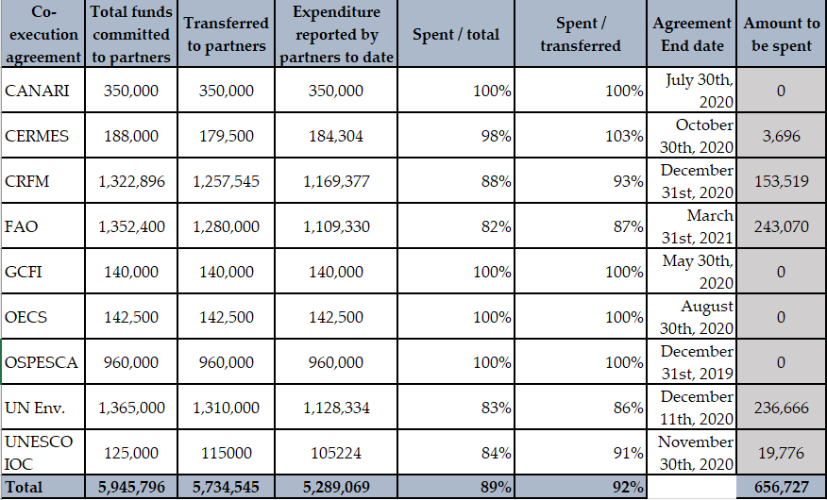
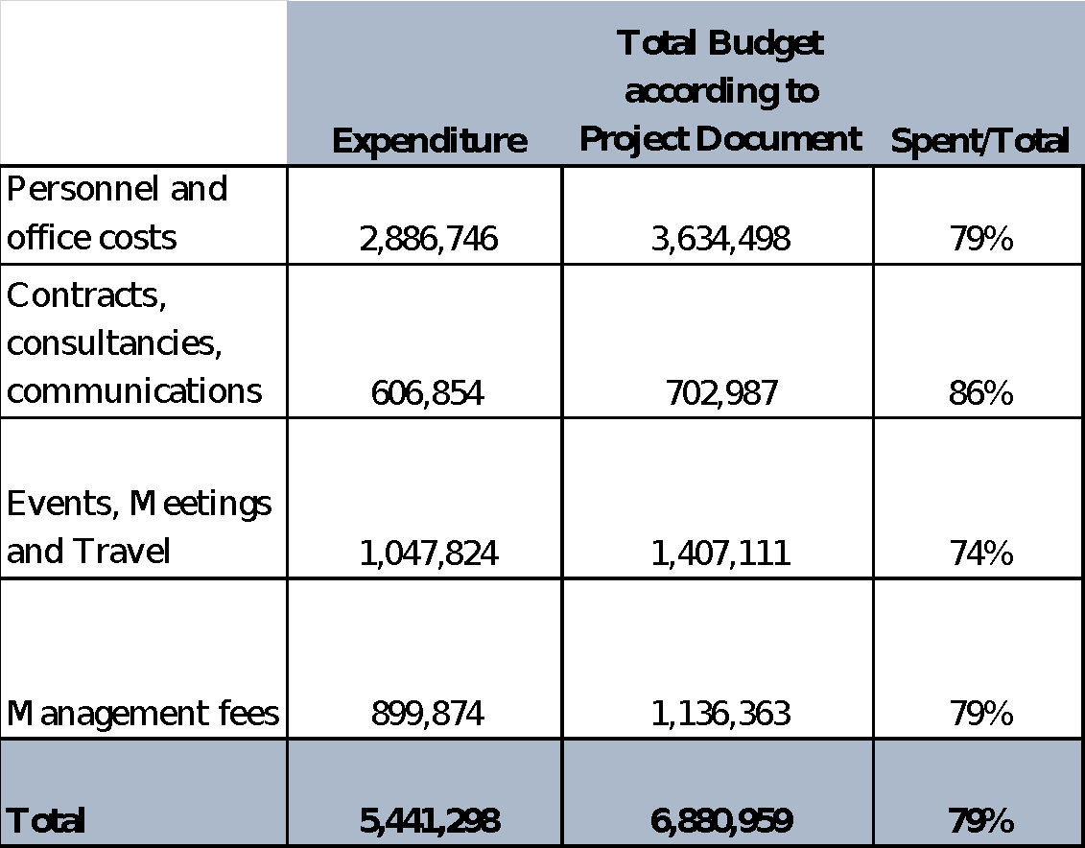
Detailed budget implementation per partner
92% of the amount transferred to partners has been spent which represents 89% of the total co-executing agreements budget. Correspondingly, the PCU has spent 79% of the budget under its responsibility.
Co-executing agreements Budget status (USD)
until August 2020
Project Coordination Unit Budget status (USD)
until August 2020
note: the second column in this table shows how budgets were originally allocated in the CLME+ Project Document, prior to project start
Notes:
This slide shows additional detail on co-executing agreements and PCU budget performance to date, indicating expenditure to date, original budget comparison, and percentage of spent over total budget per item. It is observed that FAO and UNEP need to disburse more than 400K in the upcoming few months.

Slide 18
Conclusions of financial implementation status
Despite several implementation challenges & delays, including those caused or accentuated by COVID19, significant progress has been obtained with the implementation of the project, and of the available financial resources supporting these project activities (budget). In 4 months it has been possible to implement project activities and advancing project outputs leading to a disbursement of US$949 K (7% of the budget), to reach a total disbursed figure of US$11 MM (87% of the total project budget)
Progress in financial execution has occurred both at the PCU level and with co-executing partners. However, for the remainder of the project it will now be especially the PCU who will be facing the greatest responsibility and challenges in terms of implementing project activities and budget. In addition, especially the FAO sub-project has also experienced (COVID-related) implementation challenges during the last semester, indicating that some outputs, with associated budgets of approx USD 140K, cannot be met by current Sub-Project end date (i.e. Dec 2020). Regular monitoring of implementation progress (incl. administrative processes) versus PCU capacity has pointed to implementation risks for an equivalent budget amount of approx US$ 300K if the current “hard” end date for technical implementation (March 2021) is kept.
In light of this, further efforts will still be required from FAO and especially the PCU, in terms of execution of project activities and delivery of several of the project’s flagship outputs (FAO Sub-Project, the Coordination Mechanism, CLME+ SOMEE, CLME+ Hub, SAP M&E,...). This will need to occur in a context of increased technical/operational/HR risks (e.g. COVID impacts incl. on HR, PCU and client/stakeholder capacity and priorities, and risk of staff turn-over).
Contingency Planning and Close monitoring of implementation (PCU and Co-Exec Partners FAO, UNEP, CRFM) must continue.
Considering that still 2MM of the Budget is to be implemented by Project End (incl. 500K to be spent by co-executing partners), a modest project extension is proposed to ensure successful project completion, including full technical and financial implementation, (incl. cont’ed support for key CLME+ ocean governance processes), enhanced risk management and mitigation, and full compliance with administrative, financial and logistical project closure processes and requirements.
Notes:
This slide summaries the conclusions from the CLME+ Project financial implementation status.

Slide 19
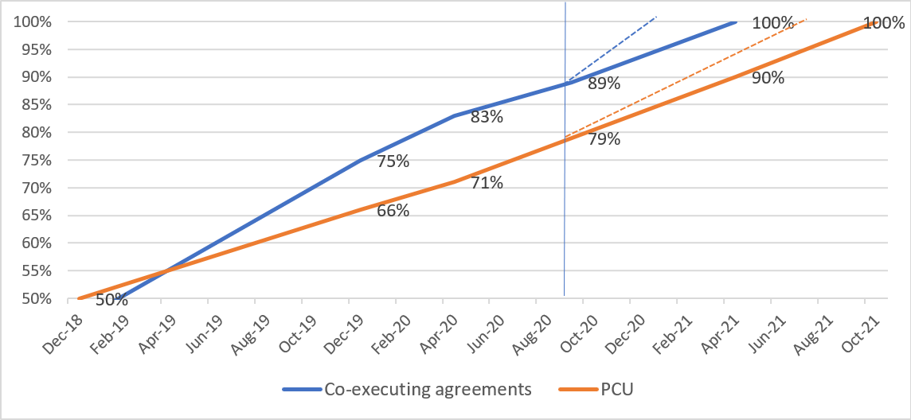
Expenditure implementation pace considering proposed project extension
Notes:
This slide shows the implementation pace without the extension (dotted lines) and with the extension. It is observed that without the extension, the disbursements must be made more speedily, which involves a high implementation risk

Slide 20
“Win-Win”
By granting the FAO sub-project a modest additional extension and by strategically managing PCU HR capacity and composition over time, the extra project extension can be done within available budget
the extra time will help ensure that activities leading to all technical outputs can be duly executed and outputs delivered to the best possible extent, fully taking advantage of available budgets AND and while accommodating for today’s exceptional contingency levels
With only marginal “extra*” management costs arising from the project extension, the extension allows for a (progressively reduced) PCU to remain available to countries and IGO’s and further support critical processes such as: additional time for country review and feedback for key CLME+ Project outputs, for supporting efforts towards the creation of the Coordination Mechanism (in particular consensus building on the MOU), for supporting the work of the Interim Coordination Mechanisms, providing institutional memory in context of preparations for next phase, etc.
*i.e. a very modest, USD 7K increase of UNOPS project management costs, vis-a-vis the June 20 PSCM-approved amount, and keeping total managements costs over full project life span within the budget foreseen for this purpose in the CLME+ Project Document
Notes:
This slide summarizes conclusions of the financial implementation status of the CLME + Project in relation to the proposed extension.

Slide 21
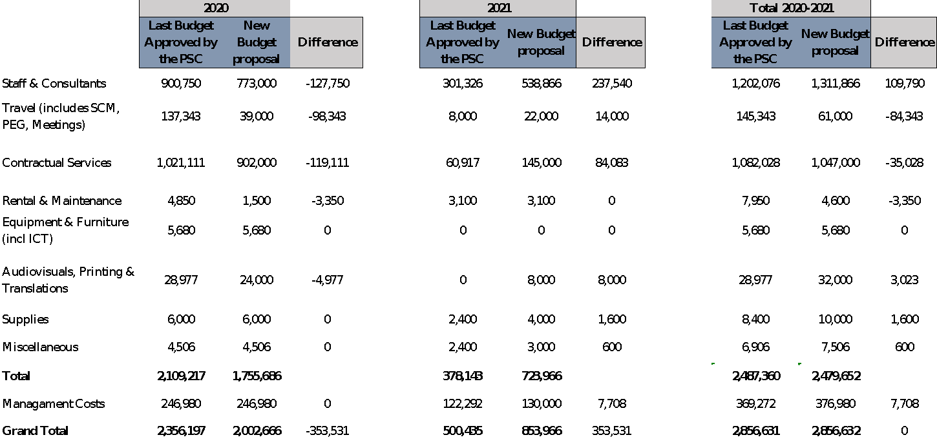
Re-allocation of funds under the 3+3months extension scenario (Closure: October 2021)
Considering the rationale from the technical analysis, a 3-month extension beyond the July pre-approved closure date, until October 2021 can be achieved with the reallocations explained below to pursue project objectives
10
1
4
2
5
11
3
6
7
8
9
Notes:
This slide summarizes the proposed budget re-allocations for the period 2020-2021, which accomodates for implementation delays and risks, optimizes budget allocation in support of delivery of pending outputs, and includes the proposed 3 months project extension until October 2021. The arrows in the slide represent:
1: Unspent funds from the PSC-approved budget for 2020 (mainly due to delay in Human Resources recruitments) which will be reallocated to 2021
2: Proposed reduction of meetings & travel budget due to covid-19 outbreak and related travel risks and restrictions.
3: Proposed reduction of contractual services for 2020 (due to delays in the ToRs development) which will be reallocated to 2021
4: Proposed re-allocation of resources from esp. the unspent 2020 budget and from the 2020 travel budget, to fund project activities during 2021 including the additional 3 months project extension.
5: Proposed remaining funds to support virtual meetings in 2021
6: Proposed re-allocation of resources from the unspent 2020 budget
7: Proposed re-allocation of resources from the unspent 2020 budget and a budget increase (3K) due to identification of further translation requirements
8: Proposed additional office costs for the project extension
9: Additional project management cost
10: Proposed total HR budget increase
11: Proposed total travel budget reduction

Slide 22
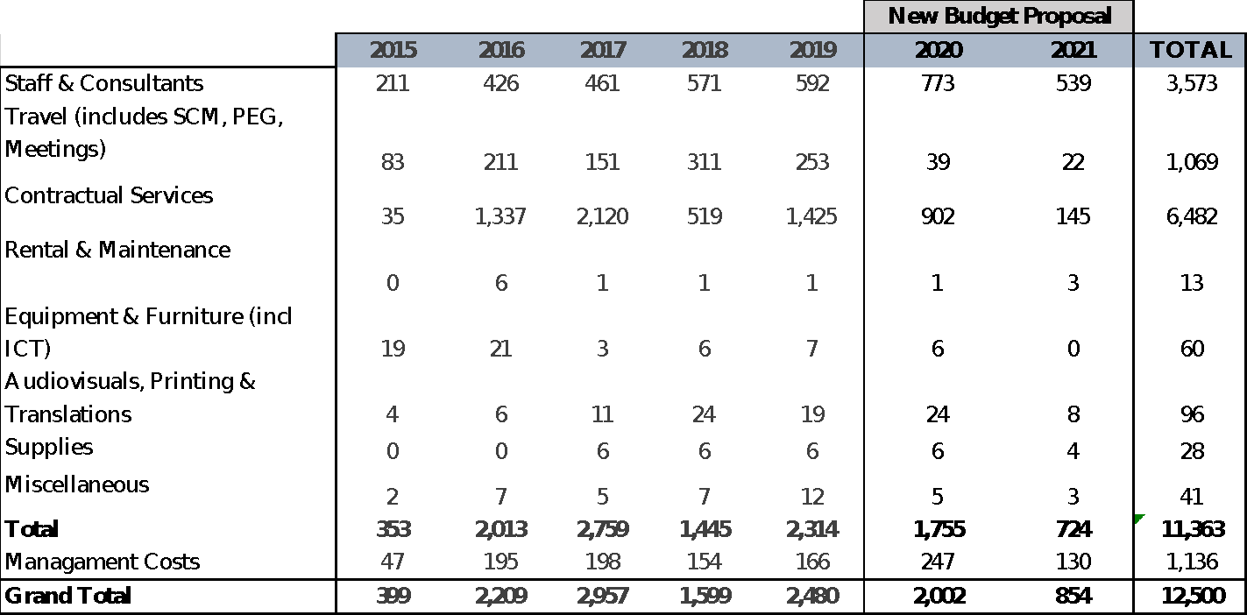
Budget proposal 2020-2021
The PCU is proposing the following Budget Plan (1000s of USD) for the period 2020-2021, for PSC approval
(slight revision of the plan approved at the June 2020 PSCM)
This revised version accommodates for implementation delays and the extra 3 months, putting Project Operational Closure at 31 October 2021 (with majority of technical activities to be finalized by June, and with major focus for the July-Oct period being on admin project close-down)
Notes:
This slide outlines the total Project Budget for the full project implementation period, including the revised Budget Proposal for the period 2020-2021 taking into consideration 2020 implementation delays and transfer of the corresponding share of the June PSCM-approved 2020 budget to 2021. Funds from the PSC-approved 2020 Budget that will not be implemented by year end have now been reallocated to 2021 as explained in slide titled “Re-allocation of funds”.

Slide 23

Project Steering Committee Meeting Oct 2020
THANK YOU
Catalyzing implementation of the Strategic Action Programme for the Caribbean and North Brazil Shelf LME’s

